Slide 1
Constrained Optimization of Elastic Task Adaptation in Real-Time Systems
Marion Sudvarg
PhD Candidate in Computer Science
Washington University in St. Louis
Advised by Dr. Chris Gill
CS 5090: Computer Science Colloquium
Saint Louis University
April 12, 2023

Slide 2
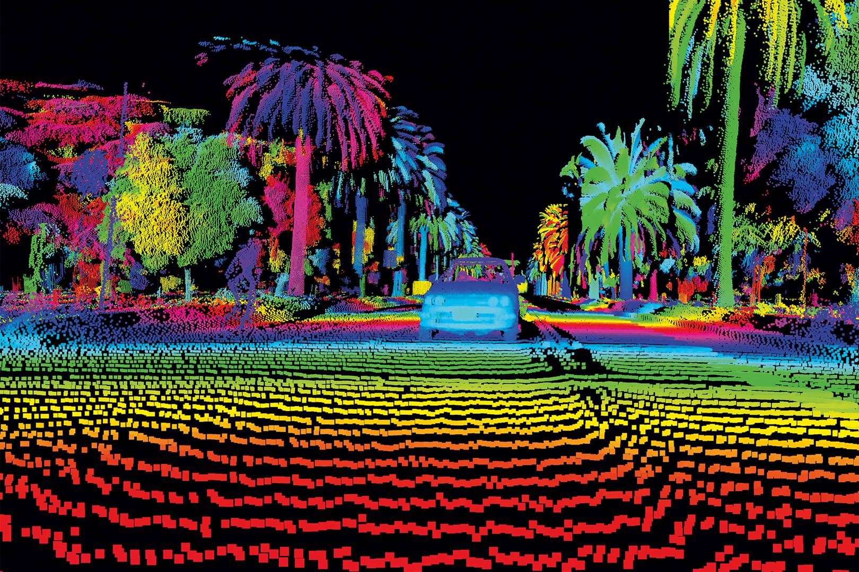

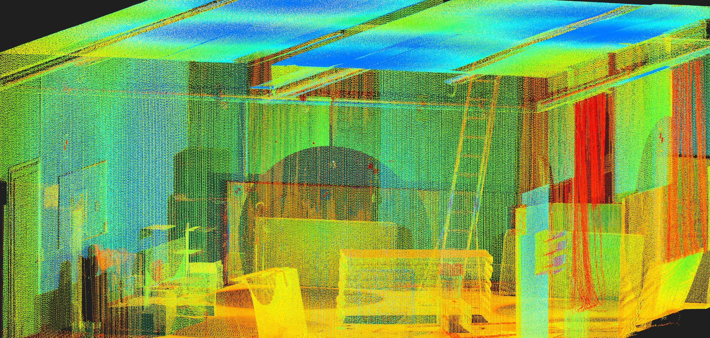
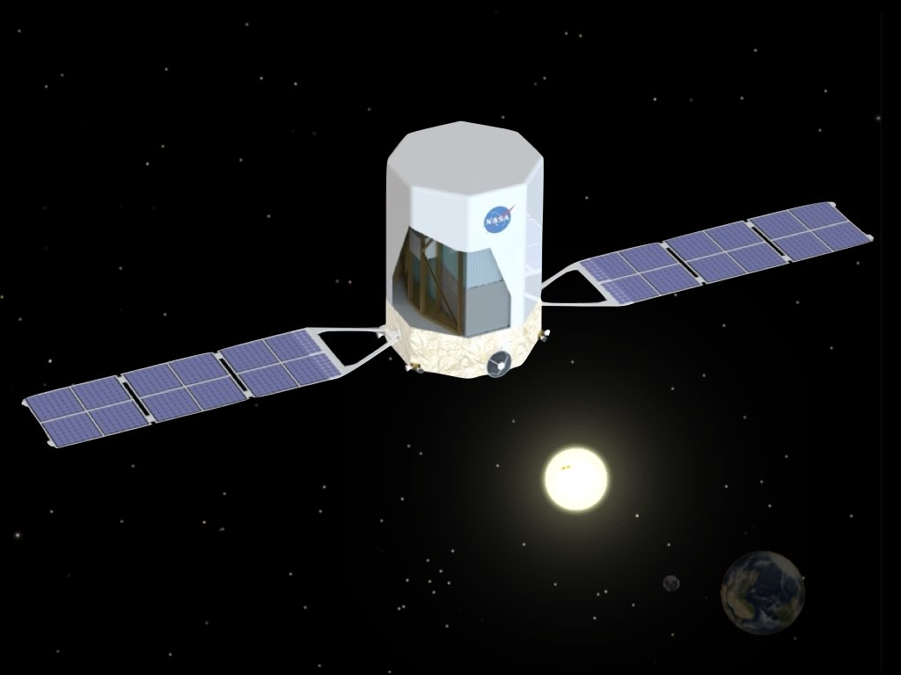

Real-Time Systems
Systems for which timing correctness is just as important as functional correctness
Avionics
Mobile Robotics and SLAM Systems
Autonomous
Vehicles
Video
Streaming
Detection and Localization of Astrophysical Transients

Slide 3
Sporadic Real-Time System Model
Task 𝜏_{i} : A recurrent workload
that may execute repeatedly
Job: An instance of a task
C_{i} = Workload, a.k.a.
Worst-Case Execution Time (WCET) of a single job
T_{i} = Period
(or minimum interarrival time)
D_{i} = Deadline
IMU Readout
Frame
Encoding
GRB Localization
Encode a single frame
Capture current data
Localize a single burst
Implicit Deadline
(D_{i} = T_{i})
Constrained Deadline
(D_{i} ≤ T_{i})
Inverse of frame rate
Device polling interval
Time between detected GRBs
Next frame arrival
Next polling interval
Follow-up time requirements

Slide 4
Overload
U_{i}: Utilization (C_{i}/T_{i})
𝜏₁: (C = 5, T = 10), Utilization = 50%
𝜏₂: (C = 4, T = 7), Utilization = 57%
Total Utilization, U_{SUM} = 107%
Cannot be concurrently scheduled on a single processor!
How can systems adapt in the face of overload while still maintaining service-level guarantees to all tasks?

Slide 5
How can systems adapt in the face of overload while still maintaining service-level guarantees to all tasks?
Characterize
the scenarios where overload may occur
Develop models
for adaptation with provable guarantees of schedulability
Realize adaptability
under schedulability constraints with minimum loss of utility
Elastic Scheduling
Framework for reducing task utilizations in response to overload

Slide 6





Today’s Roadmap
Elastic Scheduling
Elastic Scheduling for Parallel Tasks
Dynamic Workloads and Deadlines
Open Challenges

Slide 7
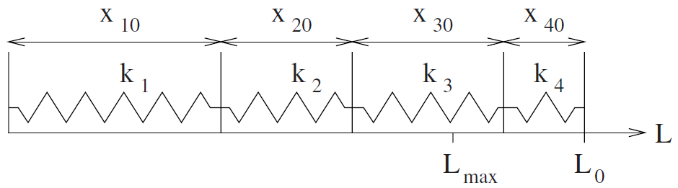
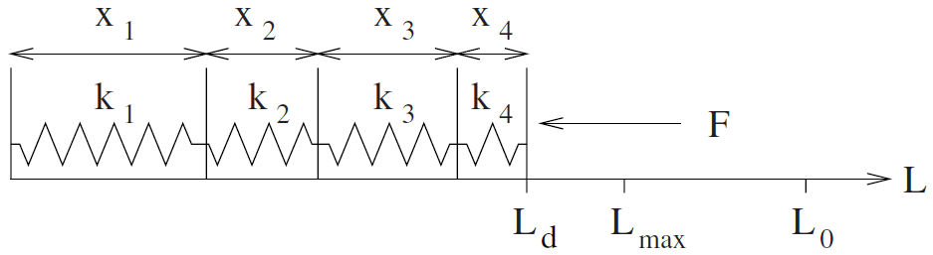
Model for reducing task utilizations in response to system overload
Elastic Scheduling
U_{1,max}
U_{2,max}
U_{3,max}
U_{4,max}
Think of tasks as springs with length representing maximum (uncompressed) utilization
Utilization Bound
U_{SUM}
Each task is assigned an elasticity E_{i} representing its relative adaptability
(Think of elasticity as inverse of spring constant, i.e. stiffer springs are harder to compress)
U₁
U₂
U₃
U₄
Each task’s utilization is “compressed” proportionally to E_{i} until the system is schedulable

Slide 8

Example: Compressing Video Streams
Elastic Scheduling
Each stream is a task
Each frame is a job
C_{i}: Time to capture a frame (1080p, 760p, 480p)
T_{i}^{min}: Desired time between frames (60fps, 30fps, …)
What if the system is overloaded?
Decrease frame rates!
T_{i}^{max}: Based on minimum acceptable frame rate
E_{i}: Based on importance of the stream
(less important == more elastic)
A server handles live capture of multiple video streams

Slide 9
Example: Compressing Video Streams
Elastic Scheduling
𝜏_{i} = (C_{i}, T_{i}^{min}, T_{i}^{max}, T_{i}, E_{i})
U_{i} = C_{i} / T_{i}
U_{i}^{min} = C_{i} / T_{i}^{max}
How to Compress
While total utilization exceeds schedulable bound:
  For each task 𝜏_{i} where U_{i} > U_{i}^{min} :
  Compress utilization proportionally to E_{i}
  If U_{i} < U_{i}^{min}, set utilization to U_{i}^{min}
Once U_{i} values found, assign T_{i} = U_{i}/C_{i}
A server handles live capture of multiple video streams
O(n²)
G. C. Buttazzo, G. Lipari, and L. Abeni. “Elastic task model for adaptive rate control.” RTSS 1998.

Slide 10
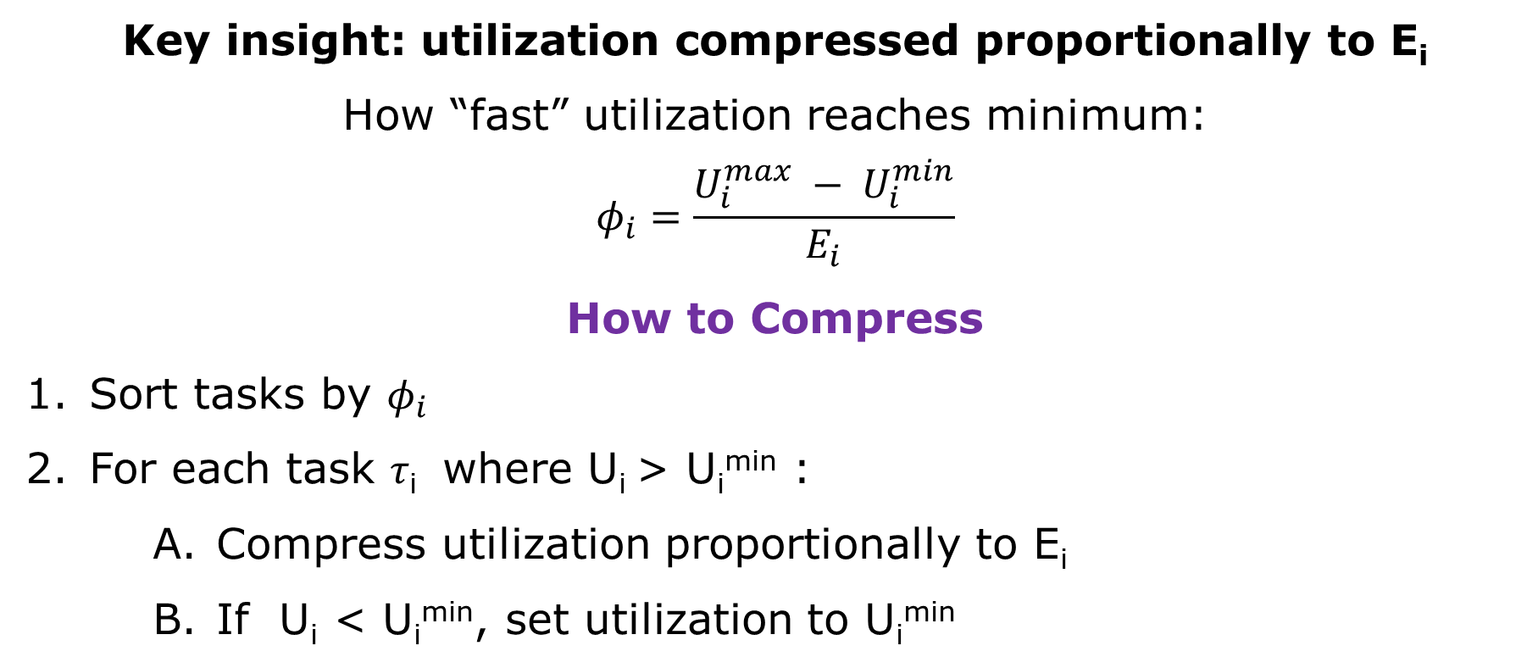
Can we make compression faster?
Elastic Scheduling
Key insight: utilization compressed proportionally to E_{i}
How “fast” utilization reaches minimum:
$$φ_{i}=\frac{U_{i}^{max} − U_{i}^{min}}{E_{i}}$$
How to Compress
Sort tasks by $φ_{i}$
For each task 𝜏_{i} where U_{i} > U_{i}^{min} :
  Compress utilization proportionally to E_{i}
  If U_{i} < U_{i}^{min}, set utilization to U_{i}^{min}
O(n log n)
O(n)
M. Sudvarg, S. Baruah, and C. Gill. “Linear-Time Admission Control for Elastic Scheduling.” Real-Time Systems, Springer, July 2021.

Slide 11
Today’s Roadmap
Elastic Scheduling
Elastic Scheduling for Parallel Tasks
Dynamic Workloads and Deadlines
Open Challenges

Slide 12
Compress utilizations so parallel tasks execute on available cores
Parallel Tasks
Federated Scheduling assigns n_{i} dedicated cores to each parallel task, sufficient to guarantee it meets its deadline
If assigned cores exceeds available cores …
Compress utilizations to decrease required assignments

Slide 13

Parallel Elastic Scheduling Challenges
Parallel Tasks
30
10
𝜏₁ = (C₁ = 30, D₁ = 10)
Without compressing, how many processors do we need?
U_{i} =
= 3
5
C_{1,2} = 5
C_{1,3} = 5
Challenges:
Can’t assign strictly based on utilization
Determining minimum number of processors is NP-Complete in general
C_{1,1} = 3
C_{1,4} = 5
C_{1,7} = 2
C_{1,5} = 5
C_{1,6} = 5

Slide 14
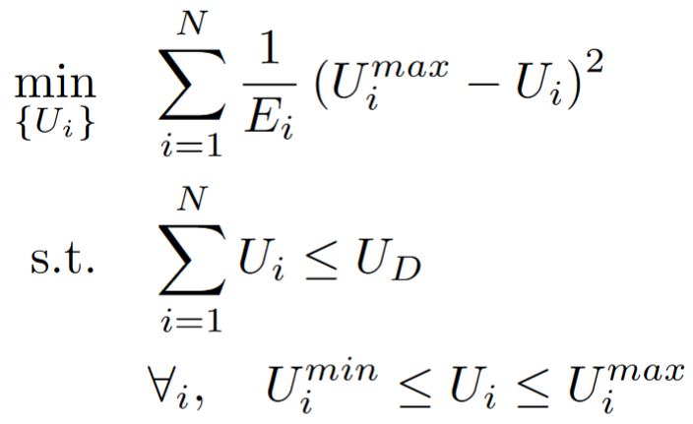
Generalized Elastic Scheduling
Parallel Tasks
A solution to the following constrained-optimization problem satisfies elastic scheduling:
T. Chantem, X. S. Hu and M. D. Lemmon, "Generalized Elastic Scheduling.” RTSS 2006.
Notes:
Intuition: minimize the elastic potential energy in a spring system compressed to a given length

Slide 15
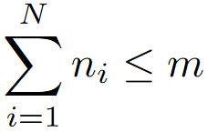
Elastic Model for Federated Scheduling
Parallel Tasks
J. Orr et al. RTNS 2018, 2020

Slide 16
Assigning Processors to Parallel Tasks
Parallel Tasks
𝜏₁ = (C₁ = 30, D₁ = 10)
Without compressing, how many processors do we need?
5
C_{1,2} = 5
C_{1,3} = 5
Challenges:
Can’t assign strictly based on utilization
Determining minimum number of processors is NP-Complete in general
C_{1,1} = 3
C_{1,4} = 5
C_{1,7} = 2
C_{1,5} = 5
C_{1,6} = 5

Slide 17

Assigning Processors to Parallel Tasks
Parallel Tasks
30
10
𝜏₁ = (C₁ = 30, D₁ = 10)
Without compressing, how many processors do we need?
Span L₁ = 10
5
Generally Sufficient:
$$\left\lceil \frac{C−L+1}{D−L+1}\right\rceil$$
C_{1,2} = 5
C_{1,3} = 5
C_{1,1} = 3
C_{1,4} = 5
C_{1,7} = 2
C_{1,5} = 5
M. Sudvarg and C. Gill. “Analysis of Federated Scheduling for Integer-Valued Workloads.” RTNS 2022.
C_{1,6} = 5

Slide 18

Assigning Processors to Parallel Tasks
Parallel Tasks
30
10
𝜏₁ = (C₁ = 30, D₁ = 10)
Without compressing, how many processors do we need?
Span L₁ = 10
5
Generally Sufficient:
$$\left\lceil \frac{30−10+1}{10−10+1}\right\rceil$$
C_{1,2} = 5
= 21
C_{1,3} = 5
C_{1,1} = 3
C_{1,4} = 5
C_{1,7} = 2
C_{1,5} = 5
M. Sudvarg and C. Gill. “Analysis of Federated Scheduling for Integer-Valued Workloads.” RTNS 2022.
C_{1,6} = 5

Slide 19
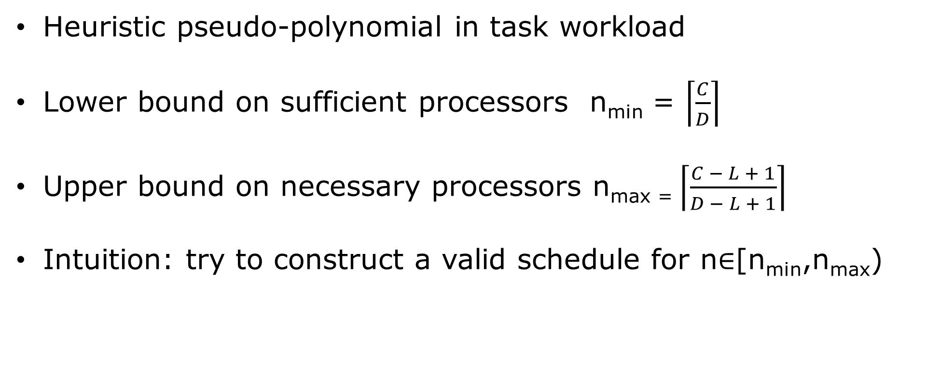
Improved Processor Assignment
Parallel Tasks
Heuristic pseudo-polynomial in task workload
Lower bound on sufficient processors n_{min} = $\left\lceil \frac{C}{D}\right\rceil$
Upper bound on necessary processors n_{max =} $\left\lceil \frac{C − L + 1}{D − L + 1}\right\rceil$
Intuition: try to construct a valid schedule for n∈[n_{min},n_{max})
M. Sudvarg and C. Gill. “Analysis of Federated Scheduling for Integer-Valued Workloads.” RTNS 2022.

Slide 20
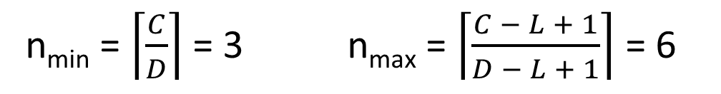
Example
v₁₄
Parallel Tasks
Schedule
D=5
C=14
L=4
v₁₃
t
=0
t
=1
t
=2
t
=3
t
=4
v₄
v₅
v₆
v₇
Core 0
v
v
v
v
v
8
11
12
13
14
Core 1
v
v
v
v
v
9
1
3
4
6
Core 2
v
v
v
v
v₁₂
10
2
5
7
Schedulable with n=3 cores!
v₁
v₂
v₃
v₈
v₉
v₁₀
v₁₁
Heuristic is optimal for 97% of parallel tasks tested (19,000)
n_{min} = $\left\lceil \frac{C}{D}\right\rceil$ = 3 n_{max} = $\left\lceil \frac{C − L + 1}{D − L + 1}\right\rceil$ = 6
M. Sudvarg and C. Gill. “Analysis of Federated Scheduling for Integer-Valued Workloads.” RTNS 2022.

Slide 21
Today’s Roadmap
Elastic Scheduling
Elastic Scheduling for Parallel Tasks
Dynamic Workloads and Deadlines
Open Challenges

Slide 22
How do we realize compression?
Dynamic Tasks
Given an allocation of resources (cores) to a task …
How do we compress its computational workload to minimize degradation of result utility …
While remaining within the dynamic constraints of schedulability?

Slide 23
The Advanced Particle-astrophysics Telescope (APT)

Slide 24

Real-Time Gamma-Ray Burst (GRB) Localization
GRBs are rapid, immense bursts of energy
We are developing a satellite telescope to detect and localize GRBs in real-time
Will enable secondary instruments to immediately point at the burst
Prompt observations in different wavelengths and modalities may answer open questions about
  Neutron star mergers
  Supernova processes
  The nature of dark matter
Algorithms will run on embedded hardware onboard the satellite
Image courtesy NASA, ESA and M. Kornmesser (https://www.nasa.gov/feature/goddard/2019/hubble-studies-gamma-ray-burst-with-highest-energy-ever-seen)

Slide 25
Challenge: Dynamic Workloads and Deadlines
Dynamic Tasks
Every GRB is unique!
Brightness
(10³ – 10⁶ incident gamma rays)
Spectral energy distributions
Initial burst durations
(10 milliseconds – 20 minutes)
Workload depends on
The number of gamma rays entering the detector
Their physical interactions
Deadline may depend on
The duration of the burst
Availability of follow-up instruments
How can we adapt and compress the computational pipeline to maximize localization accuracy even for bright transients while guaranteeing short deadlines?
M. Sudvarg, J. Buhler, R. Chamberlain, C. Gill, and J. Buckley. “Work in Progress: Real-Time GRB Localization for the Advanced Particle-astrophysics Telescope.” OSPERT2022.

Slide 26
How do we realize compression?
Dynamic Tasks
How do we adapt to minimize loss
within schedulability constraints?
Identify parameterized degrees of freedom over which computational workload may be compressed
Event Reconstruction
Source Approximation
Iterative Refinement
Number of gamma-rays selected for reconstruction
Technique
Sample Size
Number of Iterations

Slide 27
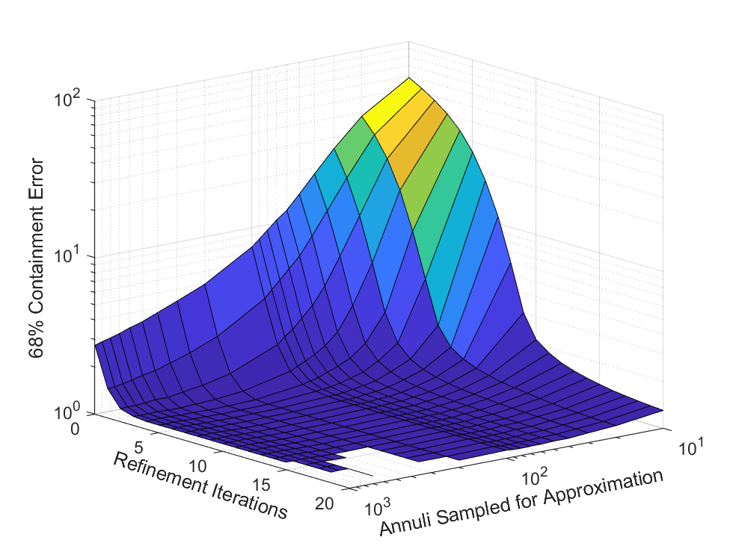
How do we realize compression?
Dynamic Tasks
Characterize loss (due to compression) over parameter space
APT: expected 68% confidence in GRB localization error

Slide 28
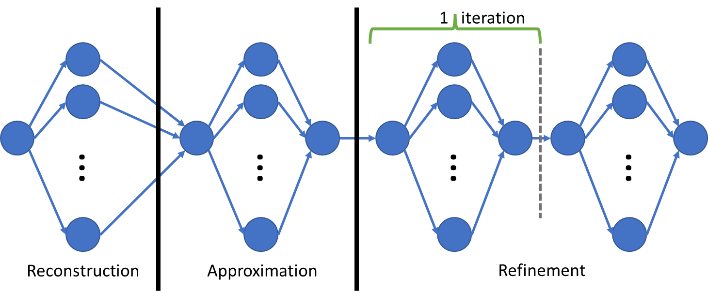
How do we realize compression?
Dynamic Tasks
Characterize worst-case response times
Linear In
Linear In
Quadratic In
Multiplied By
With constants defined by
Highly Parallelizable Fork-Join
Number of gamma-rays selected for reconstruction
Technique
Sample Size
Number of Iterations

Slide 29
How do we realize compression?
Dynamic Tasks
Reduce parameter space to Pareto-optimal subset
Sort parameter space by response time
Reduce to subset of candidate parameter space where loss decreases as response time increases
2657
initial candidate parameter sets
~80
parameter sets in Pareto-optimal subset

Slide 30
How do we realize compression?
Dynamic Tasks
Online: search for best set of parameters satisfying the dynamic constraints
Binary search over Pareto-optimal candidate space to find best parameter set with response time not exceeding deadline
Simulated 4 known short, bright GRBs
Worst-case response time on target platform:
200ms – 1.3s
Imposed 33ms deadline:
Localized to within 1 degree!

Slide 31
Today’s Roadmap
Elastic Scheduling
Elastic Scheduling for Parallel Tasks
Dynamic Workloads and Deadlines
Open Challenges

Slide 32
Overview of Future Work
Open Challenges
Elastic scheduling for SLAM systems
Computationally elastic parallel task compression
Elastic scheduling for resilience and sustainability

Slide 33
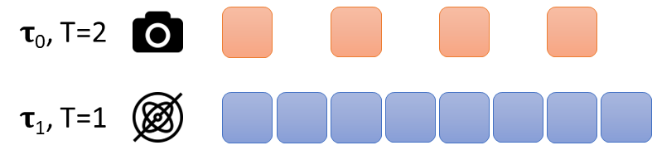

Elastic Scheduling for SLAM
Open Challenges
Simultaneous localization and mapping (SLAM) systems synchronize frames from multiple input sources
  Visual
  Inertial
  LiDAR
Task periods must remain harmonic
Backend tracking and bundle adjustment workload depends on number of input frames
Image courtesy https://projects.asl.ethz.ch/datasets/doku.php?id=kmavvisualinertialdatasets

Slide 34
Computationally Elastic
Parallel Task Compression
Open Challenges
I’ve discussed how to allocate cores to period-elastic parallel tasks
I’ve discussed how to compress computational workload for a single task with preallocated resources
How can we combine these ideas?
Parameterized workload compression over multiple computationally elastic parallel tasks on a limited number of cores

Slide 35



Elastic Scheduling for
Resilience and Sustainability
Open Challenges
Energy-harvesting (e.g., solar powered) devices may have variable processor speeds
Research Proposal Under Review
Device lifetime may be shortened due to transient high current draw and thermal wear
Use elastic scheduling models to adjust computation to reduce power- and heat-based degradation
Minimize e-waste and new material manufacturing
𝛕₀
𝛕₀
𝛕₀
𝛕₀
S=1
𝛕₁
𝛕₁
S=0.8
𝛕₁
𝛕₁

Slide 36
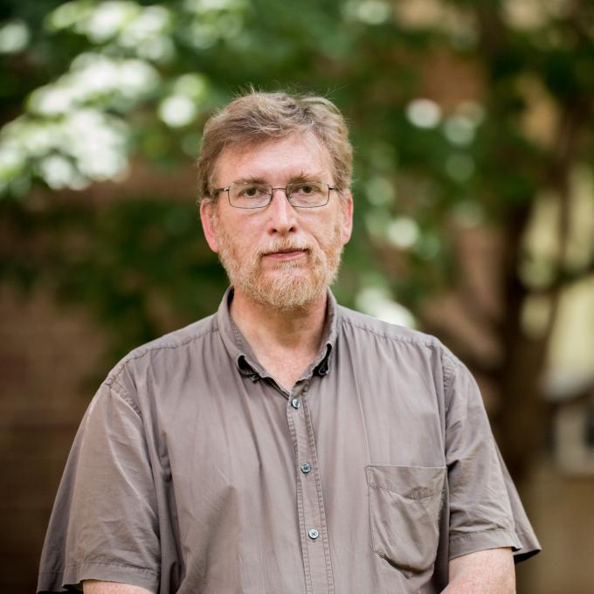
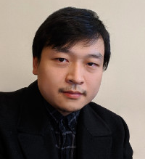
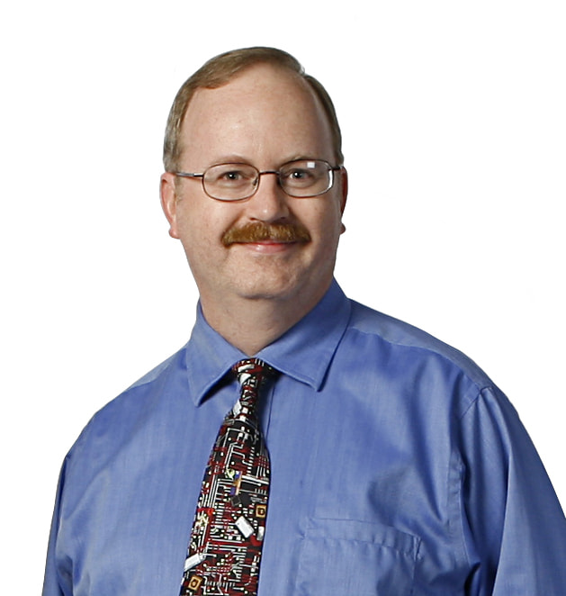
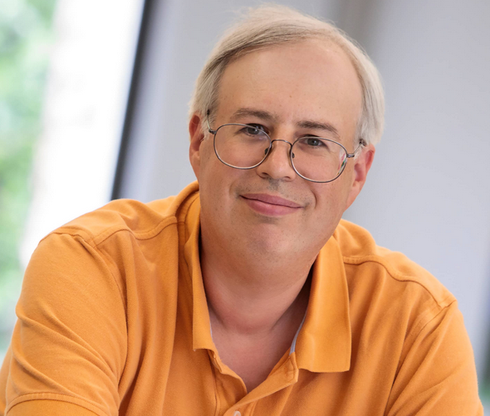

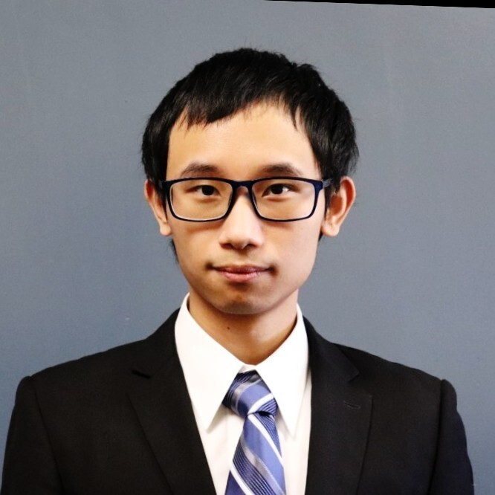


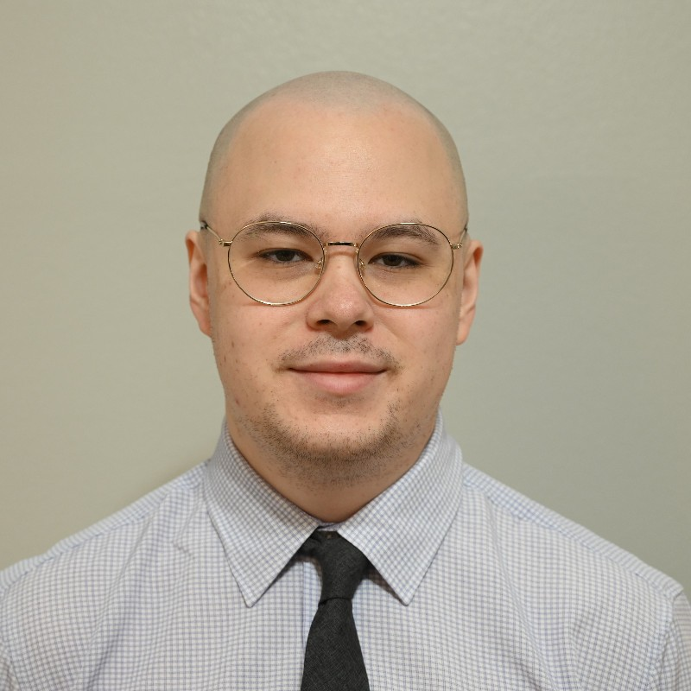


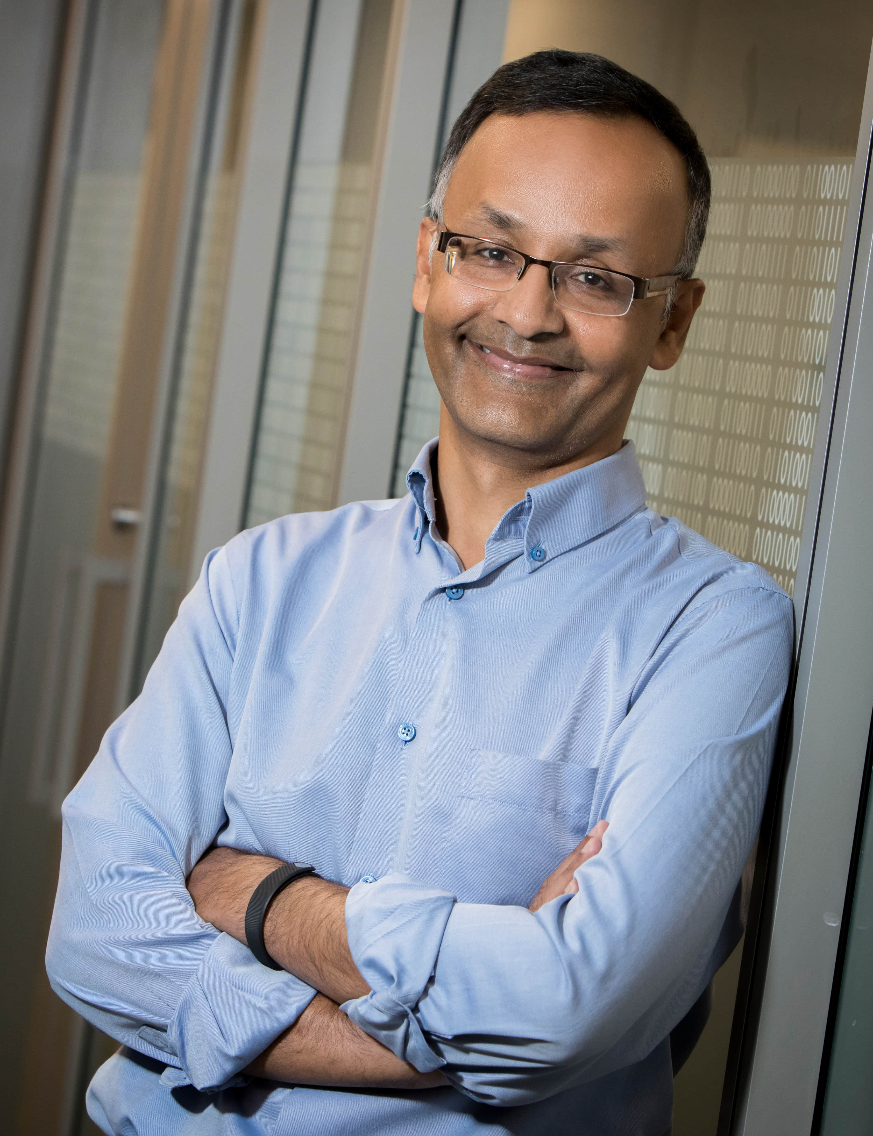
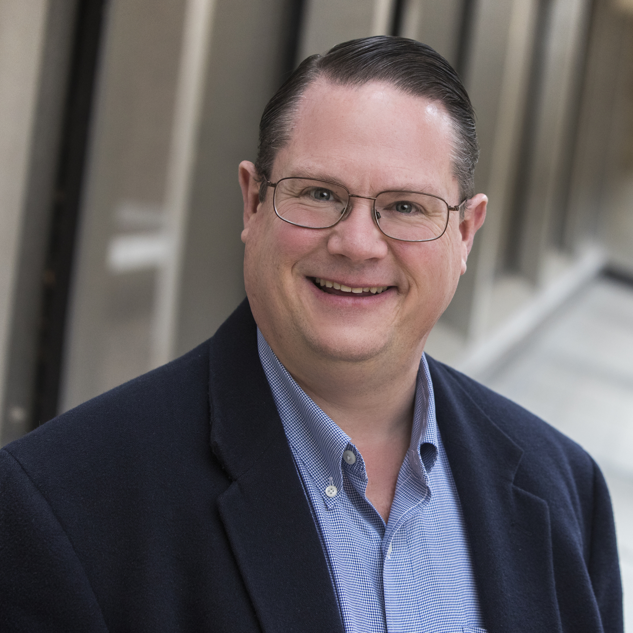

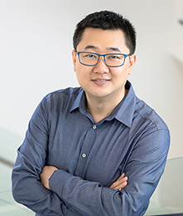


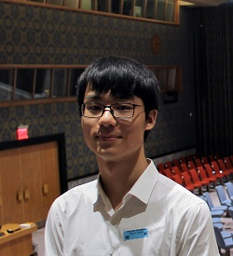
Computer Security & Privacy Laboratory

Slide 37


Thank You!
Linear-Time Elastic Scheduling. RTS2021
Analysis of Federated Scheduling. RTNS2022
Elastic and Parallel Task Scheduling
Front-End Modeling and Design. ICRC2023 (to appear)
APT Project Status. ICRC2021
Prompt GRB Localization. ICRC2023 (to appear)
Real-Time GRB Localization. OSPERT2022
Imaging Calorimeters. ICRC2021
GRB Localization
Supporting Multi-messenger. UrgentHPC2021
APT Simulation. ICRC2021
PolyRhythm. RTSS2022.
Parallel GRB Localization. SC2021
Fast GRB Localization. ICRC2021
www.sudvarg.com
Hardware/OS /Middleware
Any Questions?
Priority-Aware CAmkES. RTCSA2022. Best Paper

