Slide 1




Improved Implicit-Deadline Elastic Scheduling
SIES 2024
Chengdu, China
Marion Sudvarg, Chris Gill, Sanjoy Baruah
msudvarg@wustl.edu www.sudvarg.com
This work was supported by NSF grants CPS-2229290
and CNS-2141256 and a WashU seed grant

Slide 2
Real-Time Systems
Increasingly execute in dynamic environments

Slide 3

Image courtesy wired.co.uk
Notes:
An example of this is in the quickly-developing domain of self-driving cars, where perception pipelines must process data from multiple sensors, such as the pictured LIDAR stream, in a timely fashion. The computational workloads and latency requirements depend on external factors; a crowded city street presents a more challenging environment than a highway in the countryside.

Slide 4
Elastic Scheduling
Real-time systems must adapt to maintain temporal guarantees even on overloaded computational platforms
Giorgio Buttazzo, Giuseppe Lipari, and Luca Abeni. “Elastic Task Model for Adaptive Rate Control.” RTSS 1998

Slide 5
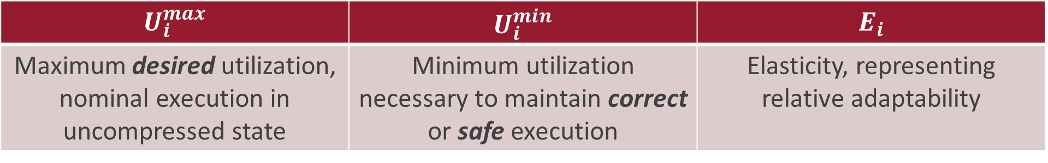
Elastic Scheduling
Elastic scheduling allows tasks to reduce («compress») their utilizations
$$τ_{i}$$
$$U_{i}^{max}$$ | $$U_{i}^{min}$$ | $$E_{i}$$
Maximum desired utilization, nominal execution in uncompressed state | Minimum utilization necessary to maintain correct or safe execution | Elasticity, representing relative adaptability
Each task’s utilization is decreased from its maximum proportionally to its elasticity until the system becomes schedulable
Task utilizations constrained to remain above the minimum

Slide 6


How is utilization compressed?
Extend Task Periods
Control Systems
Buttazzo et al. “Quality-of-Control Management in Overloaded Real-Time Systems.” IEEE Transactions on Computers 2007
Reduce Task Workloads
Gamma-Ray Burst Localization
Sudvarg, Buhler, Chamberlain, Gill, Buckley, Chen. “Parameterized Workload Adaptation for Fork-Join Tasks with Dynamic Workloads and Deadlines.” RTCSA 2023.
Image Masking
Sudvarg, Wang, Buhler, Gill. “Subtask-Level Elastic Scheduling.” RTSS 2024.
Atmospheric Aerosol Monitoring
Simultaneous Localization and Mapping (SLAM)
Sudvarg, Li, Wang, Baruah, Buhler, Gill, Zhang, Ekberg. “Elastic Scheduling for Harmonic Task Systems.” RTAS 2024.

Slide 7
When is utilization compressed?
Offline schedulability analysis
Dynamic workloads due to external environment
Online changes in available resources
Admission of new tasks
Task overruns in mixed-criticality systems
Zhuoran Sun, Marion Sudvarg, Chris Gill. “Elastic Scheduling for Graceful Degradation of Mixed-Criticality Systems.” RTNS 2024.

Slide 8
Algorithms that assign task utilizations under the elastic scheduling model must be efficient during online adaptation

Slide 9
Our Contributions
Efficient algorithms for implicit-deadline elastic scheduling
Linear-time online adaptation for utilization bound schedulability analysis
(Uniprocessor Scheduling, Fluid Scheduling, Partitioned EDF)
Binary search for more complex analysis
(Heuristic Partitioned EDF)
Quadratic-time online adaptation for Global EDF

Slide 10
Uniprocessor Scheduling

Slide 11
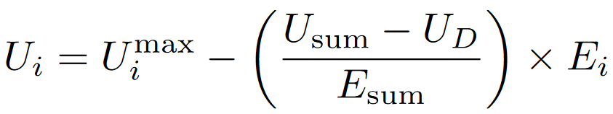

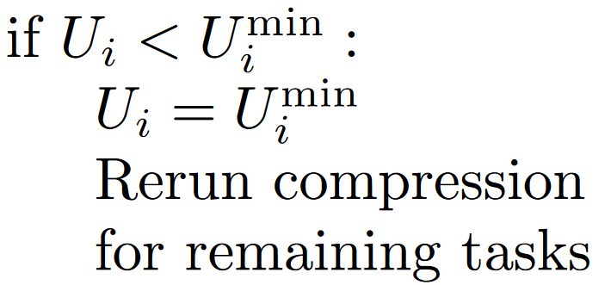
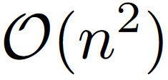
Original Algorithm
Giorgio Buttazzo, Giuseppe Lipari, and Luca Abeni. “Elastic Task Model for Adaptive Rate Control.” RTSS 1998
Recall: task utilizations decreased proportionally to elasticity until schedulable

Slide 12
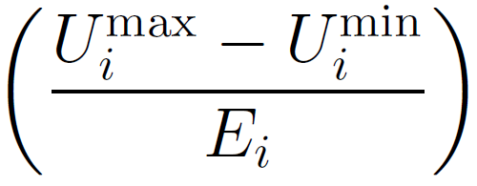
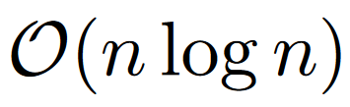
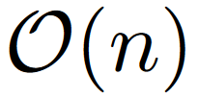
Faster Algorithm
“Amount” of compression to reach minimum utilization
Sort!
Compress in a single traversal

Slide 13
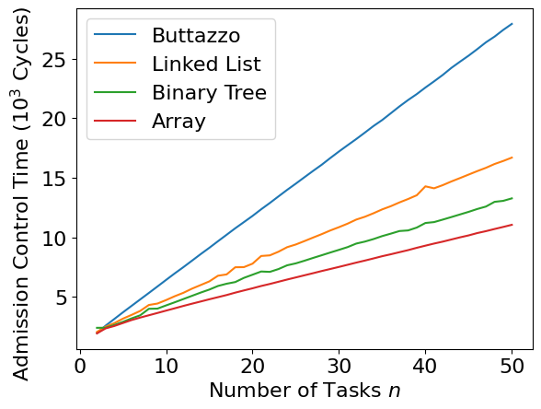
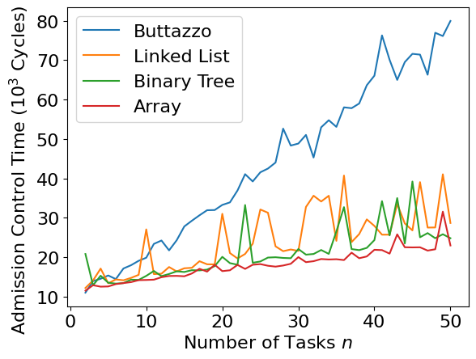
Task Admission Times on Raspberry Pi 3B+
Median
Max

Slide 14
Fluid Scheduling

Slide 15
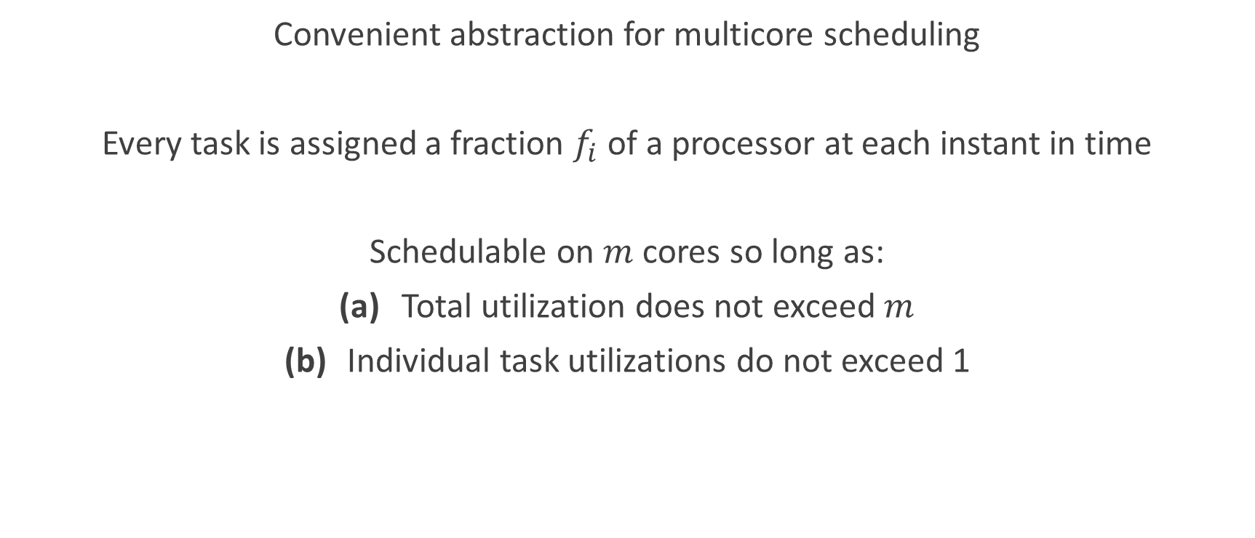
Fluid Scheduling
Convenient abstraction for multicore scheduling
Every task is assigned a fraction $f_{i}$ of a processor at each instant in time
Schedulable on $m$ cores so long as:
Total utilization does not exceed $m$
Individual task utilizations do not exceed 1

Slide 16
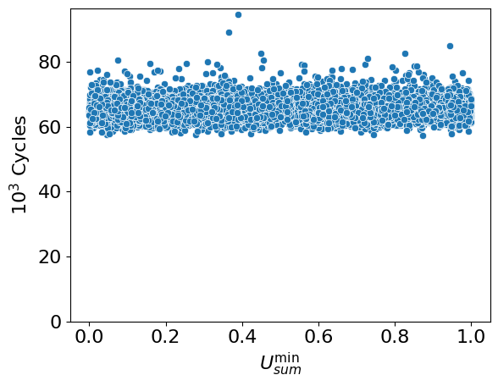
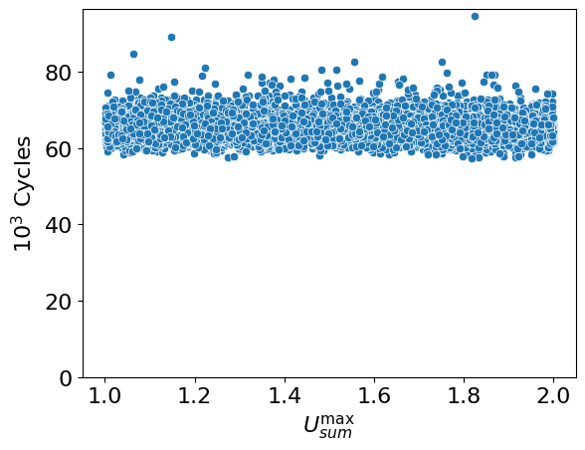
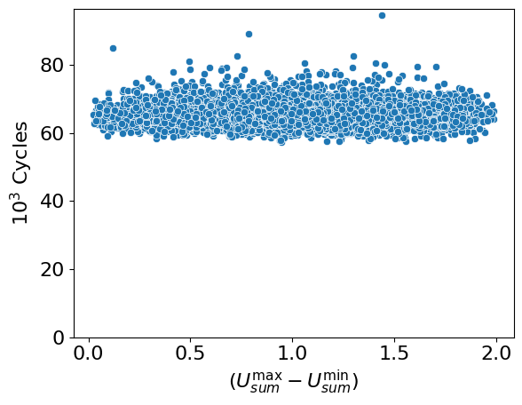
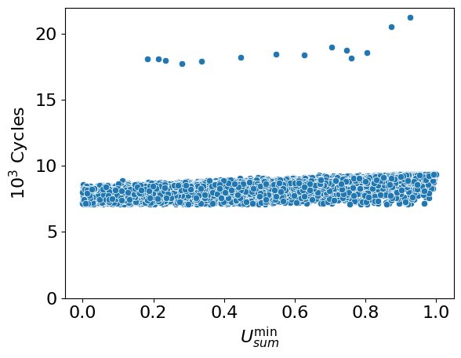
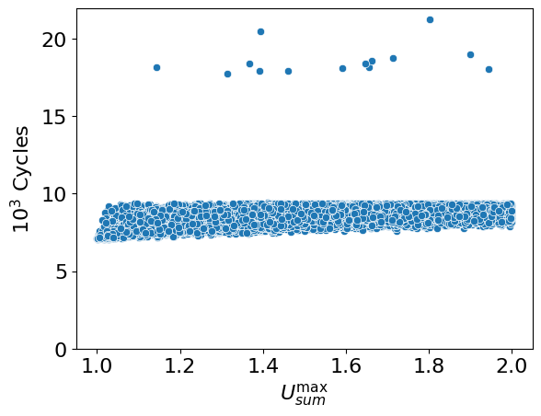
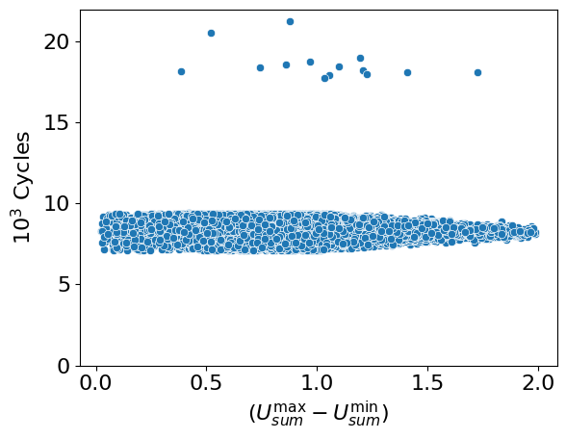
Initialize and Sort
Compress

Slide 17
Partitioned EDF

Slide 18
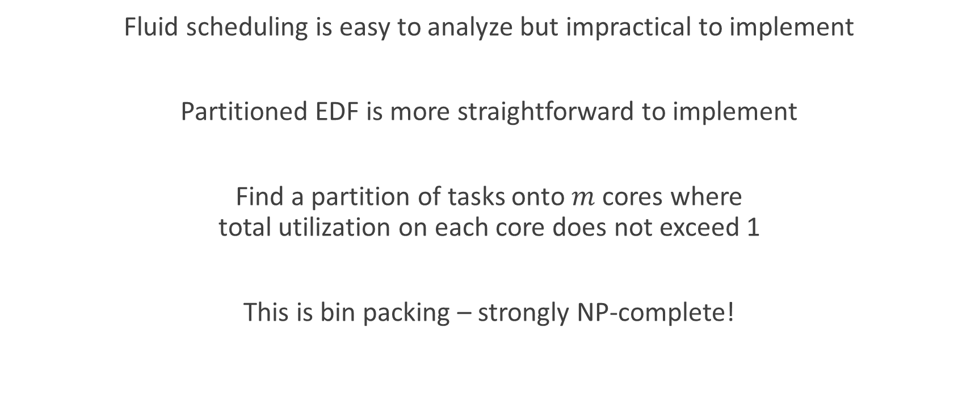
Partitioned EDF
Fluid scheduling is easy to analyze but impractical to implement
Partitioned EDF is more straightforward to implement
Find a partition of tasks onto $m$ cores where
total utilization on each core does not exceed 1
This is bin packing – strongly NP-complete!

Slide 19

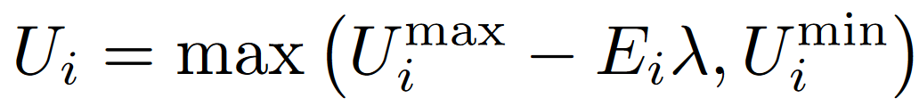
Let’s revisit the original elastic model
Recall: task utilizations decreased proportionally to elasticity until schedulable
Amount of compression
Goal: find the smallest that guarantees schedulability

Slide 20
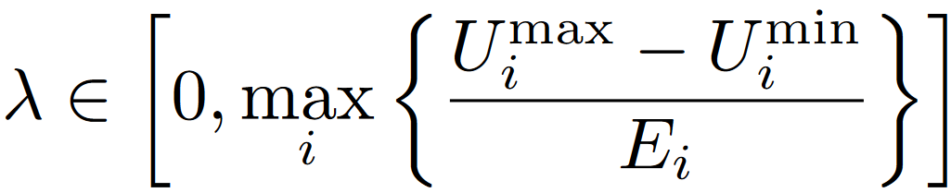
Original Algorithm
James Orr, Sanjoy Baruah. “Multiprocessor Scheduling of Elastic Tasks.” RTNS 2019.
Linear search for the smallest λ with precision ε in
For each λ, use pseudo-polynomial bin packing heuristics to check schedulability

Slide 21
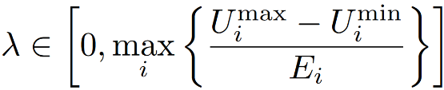
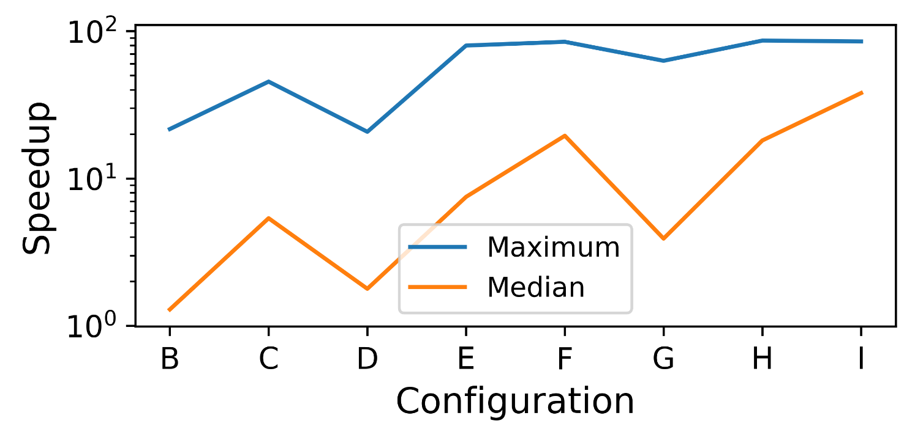
Improvement 1: Use Binary Search

Slide 22

Improvement 2: Use Utilization Bound
First-fit and best-fit decreasing bin packing guarantee a utilization bound of
$$\frac{m+1}{2}$$
Sanjoy Baruah. “Partitioned EDF Scheduling: A Closer Look.” Real-Time Systems, 2013.

Slide 23
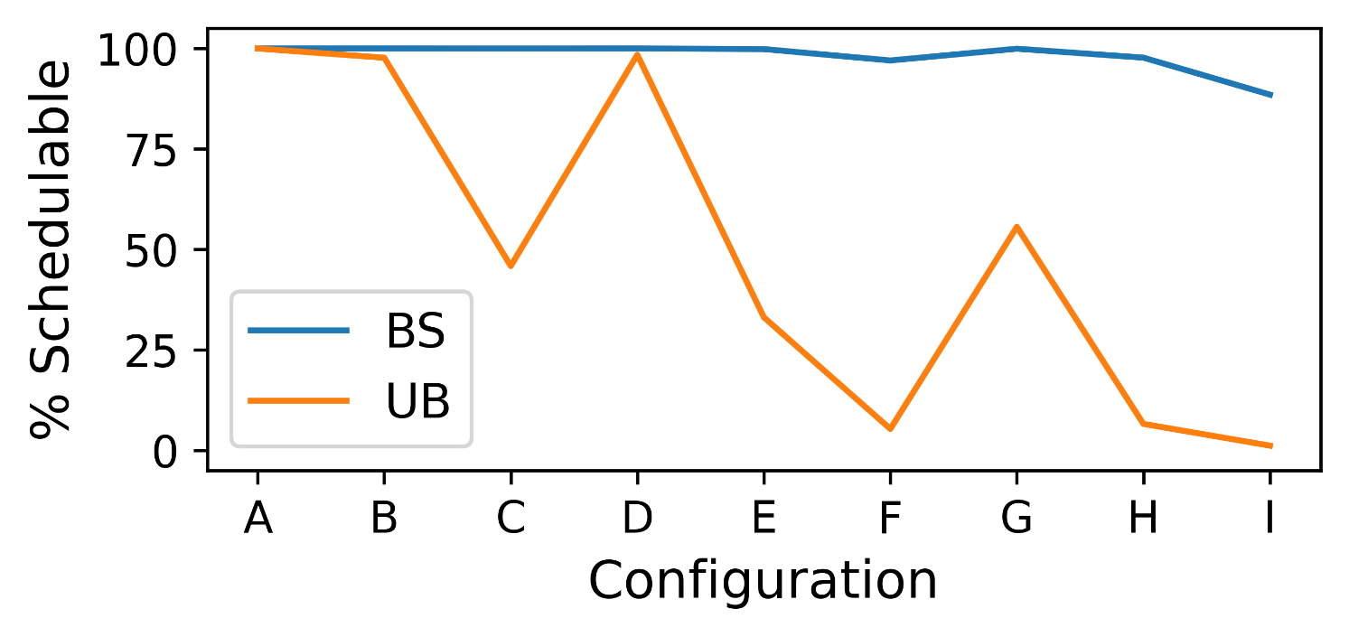
Improvement 2: Use Utilization Bound

Slide 24
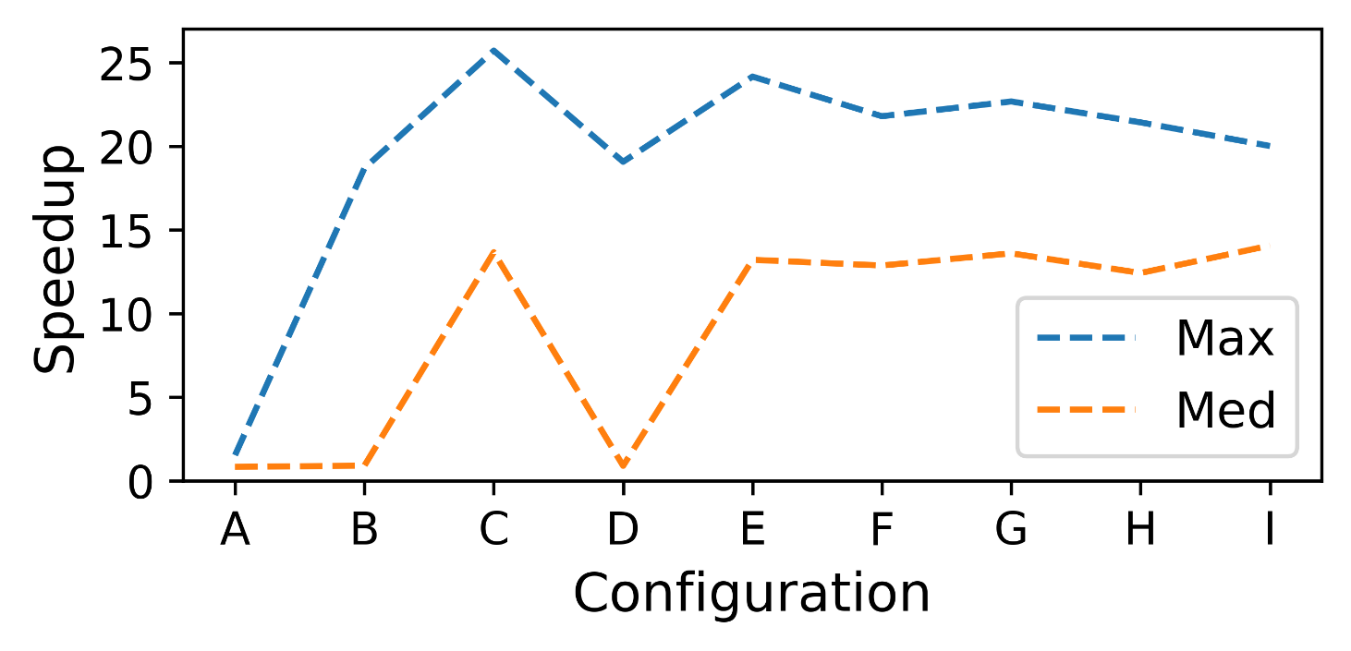
Improvement 2: Use Utilization Bound

Slide 25
Global EDF

Slide 26
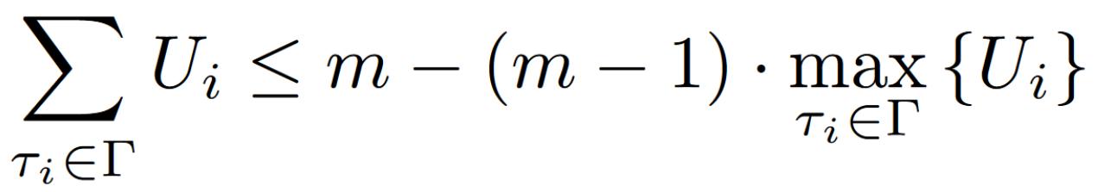

Global EDF
On $m$ cores, the $m$ active jobs with earliest deadlines execute
Schedulable on $m$ cores so long as:

Slide 27
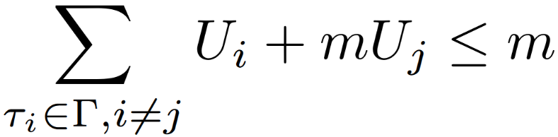


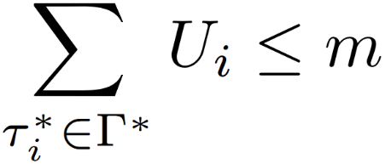
Global EDF

Slide 28

Global EDF: Algorithm
Utilization-bound compression!
Problem: We do not know which task $τ_{i}$ will have $\max_{i}{U_{i}}$ after compression
Solution: Try all tasks!
Initial sort only needs to be done only once.

Slide 29
Conclusions
Elastic scheduling adapts task utilizations in the face of overload.
Online adaptation must be fast.
We have presented fast elastic scheduling algorithms for implicit-deadline tasks:
  Uniprocessor scheduling
  Fluid scheduling
  Partitioned EDF
  Global EDF

Slide 30
Future Work
Can we extend these techniques to other scheduling algorithms?
Hyperbolic bound for RM
Partitioned RM
Global RM
Algorithm PriD

Slide 31
Thank You!
www.sudvarg.com
msudvarg@wustl.edu

