Slide 1
PolyRhythm: Adaptive Tuning of a
Multi-Channel Attack Template for Timing Interference
Ao Li*, Marion Sudvarg*,
Han Liu, Zhiyuan Yu, Chris Gill, Ning Zhang
RTSS 2022
* Presenters and Equal Contributions

Slide 2

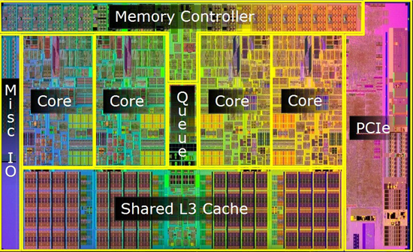
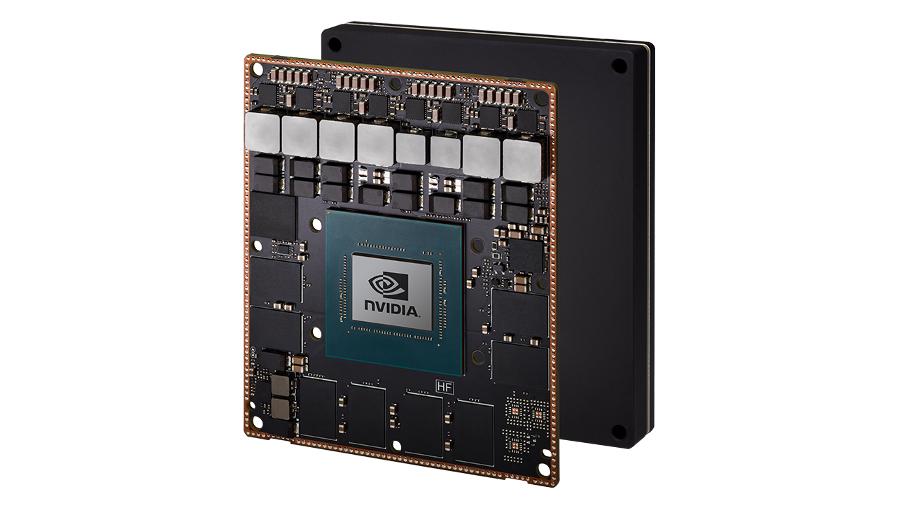


Motivation
Multi-core computing platforms
  Improved performance
  Better for size, weight and power (SWaP) constraints
  Increasingly deployed on embedded real-time systems

Slide 3
Motivation
Interference is a long-standing problem
  Shared resource contention by co-running tasks
  Worst-case performance is unpredictable
  Malicious interference can cause hundreds of times of delay
  Characterizing interference in complex systems is challenging
How can we, as system designers, empirically profile worst-case/malicious interference?

Slide 4
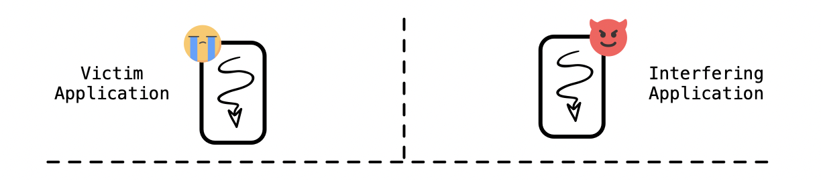


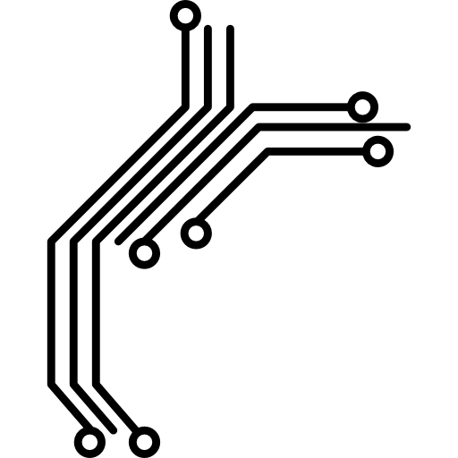


Survey on Existing Literature
System Call Interface
OS-based Channels
VFS
Socket
Context Switching
CCS' 12
RTSS' 11
File Systems
SK_buffer
OSDI' 20
Task Spawning
EMSOFT' 12
OSDI' 10
ASPLOS' 10
RTAS' 22
OS Review' 08
Volume Manager
TCP/UDP
Task Scheduling
Device Driver
SIGMETRICS' 13
DAC' 01
CPU Port
TLB
Cache
Row Buffer
Bus
Architectural Channels
PACT' 15
ISCA' 16
RTAS' 19
Usenix Security' 07
RTAS' 20
S&P' 19
ISCA' 19
RTAS' 20
Usenix ATC' 11
RTAS' 15
ISCA' 14
Asia CCS' 17

Slide 5





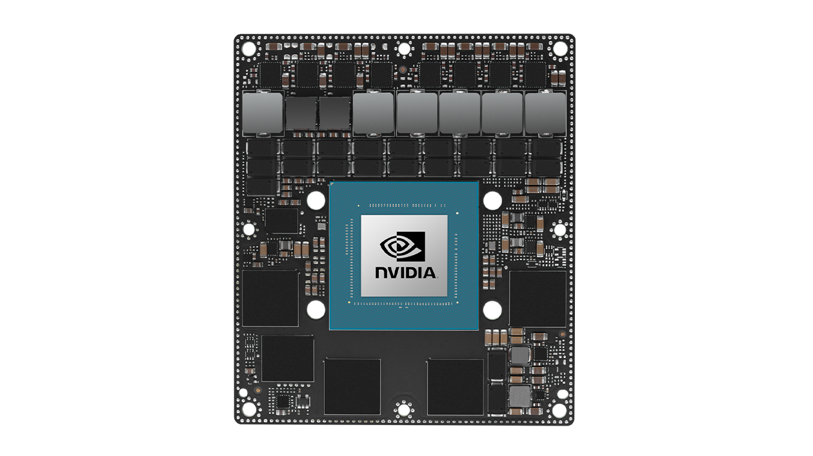
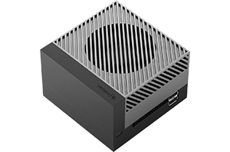
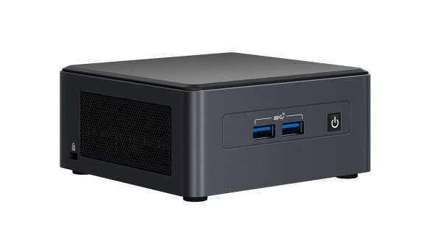
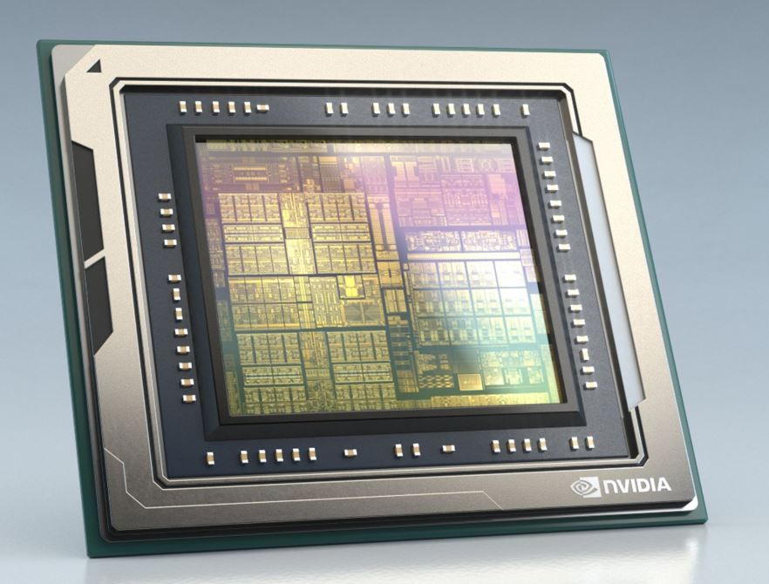
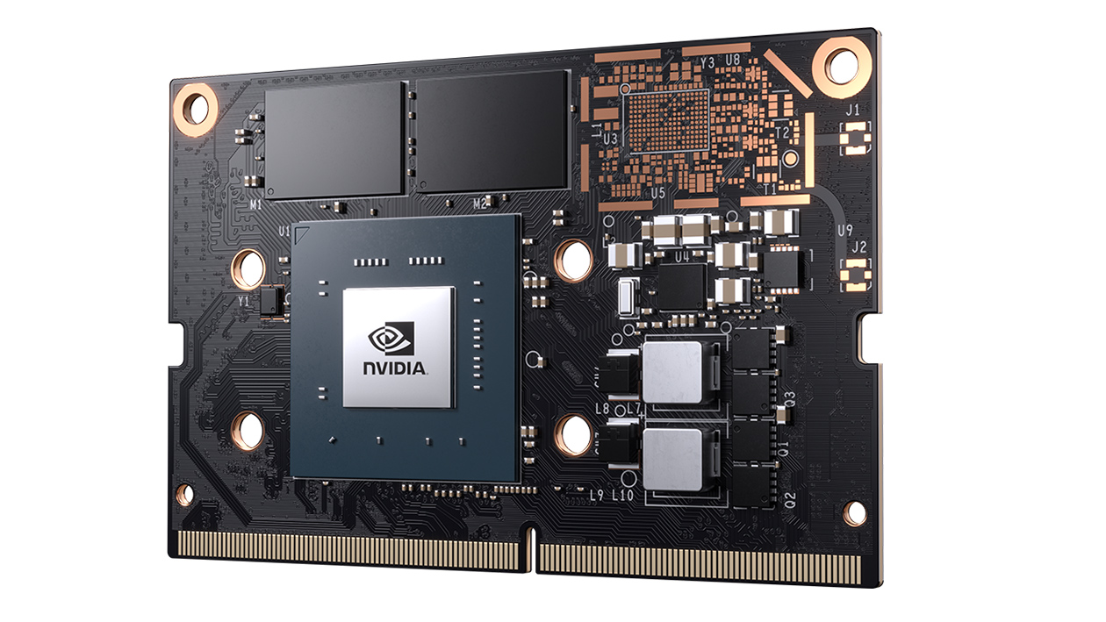
Survey on Existing Literature
System Call Interface
OS-based Channels
VFS
Socket
Context Switching
File Systems
SK_buffer
Task Spawning
Volume Manager
TCP/UDP
Task Scheduling
Device Driver
TLB
Cache
Bus
Architectural Channels
CPU Port
Row Buffer

Slide 6
Research Challenges
What are the resource-contention channels?
How do we automatically tune the parameters for diverse and heterogenous OSes and architectures?
How can we adaptively select combinations of different channels to maximize the attack impact?

Slide 7



Overview of Our Proposed Solution
Systemization of performance interference on:
  Shared OS resources
  Shared architectural resources
Automatic tuning of maximum performance interference on each channel (Platform-targeted)
Adaptive combination of different channels to maximize the attack effects (Workload-targeted)
We want to enable design of more resilient systems
                Characterizing worst-case/malicious multi-channel timing interference

Slide 8
PolyRhythm
A templated tool for running worst-case/maximum interference
  Synthesizes primitives across multiple architectural and kernel-based channels
  Uses a genetic algorithm to tune platform-specific parameters offline
  Searches online to find contention regions
  Reinforcement learning dynamically selects which channel to target online at each time step

Slide 9
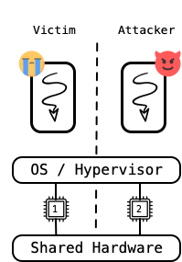
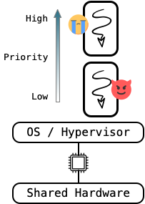
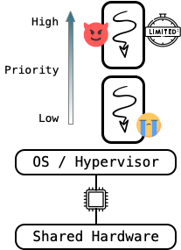
Threat Models and Isolation
(a) Core Partitioning
(b) Low-Priority Attacker
(c) Bandwidth Limitations

Slide 10
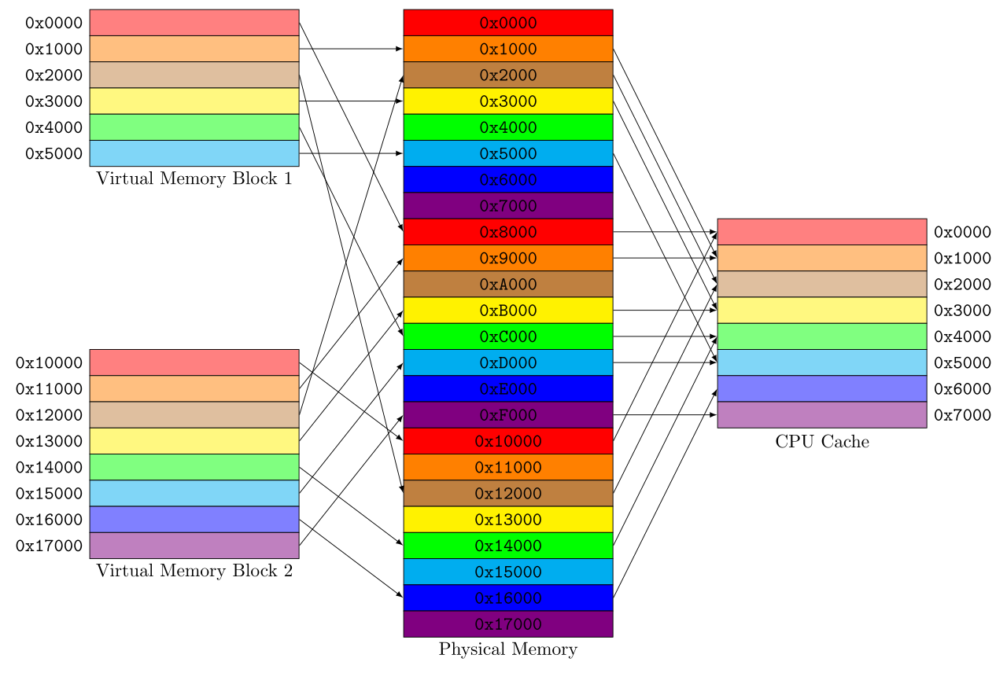
Cache Channels
Potential sources of interference:
  Cache evictions on common core
  Shared last level cache
  Shootdowns on shared TLB
Cache coloring or partitioning can help
But there may be hidden shared resources
  Miss status holding registers
  Writeback buffer
./polyrhythm cache <threads> <stride> <size>
Attack Cache
Number concurrent attack threads
Allocate array of size
Iteration step in cache lines
(TLB primitive parameters available in online manual)

Slide 11



Memory Channels
Contention for common memory controller and bus
Data in DRAM row buffers returned significantly faster
Attempt to evict victim data from buffers
DRAM Row
Buffer
./polyrhythm row_buffer <threads> <stride> <size> <pattern>
Attack DRAM row buffer
Number concurrent attack threads
Allocate array of size
Sequential iteration step
Random or sequential access
(Memory bandwidth primitive parameters available in online manual)

Slide 12
OS Channels
I/O Attack Primitives
  Network and block devices are increasingly fast
  I/O request queues are getting larger, increasing contention
  I/O scheduler can be targeted for overhead
  Contention points along deep driver stacks may be exploited
File System Attack
  Locked data structures can cause priority inversion
Fork Bomb Attack
  Increase size of queues and endpoints
  Overwhelm thread structure allocators
(All 9 channel primitive parameters available in online manual)

Slide 13
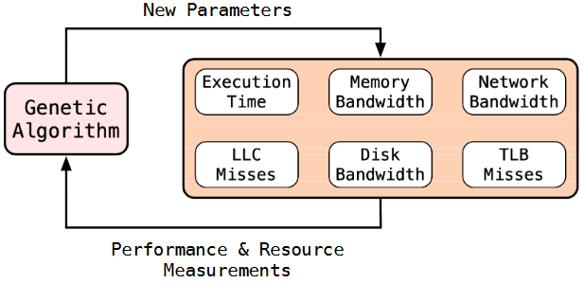
Genetic Algorithm for Offline Tuning
For each primitive, find best parameters for target platform (Arch+OS)
Run against a workload that heavily uses the channel
Use hardware performance counters to determine effectiveness
Each generation, try several sets of parameters
Next generation crosses parameters from most successful previous runs
Performed offline
  No prior knowledge of victim workloads
  Allows access to hardware performance event counters
GA/main.py
--channel cache
Independently tune all channels
Tune only cache channel

Slide 14
Online Contention Region Search
Resource locality and runtime allocation may be variable
  Hardware page mapping locality based on availability
  Binding open network ports at launch
PolyRhythm’s online attack can search for regions overlapping with victim
  Cache eviction sets
  Common DRAM rows
  Network ports and address families
Profiles its own execution times to infer interference
  No elevated privileges required for online attack
Regions not highly dynamic across victim lifetime
  Real-time tasks often avoid dynamic paging
  Port numbers remain consistent
Fast
Slow
./polyrhythm cache <threads> <stride> <size> <online:0/1>

Slide 15
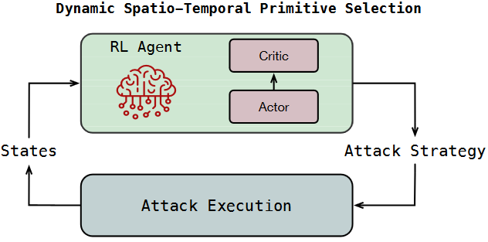
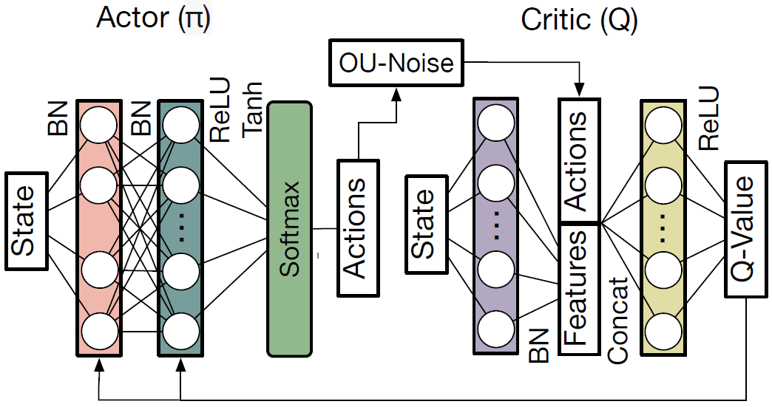
Dynamic Spatio-Temporal Primitive Selection
At each time step select the primitive that maximizes victim delays
Different victim workloads have different control flows and resource usage patterns
PolyRhythm uses reinforcement learning to select action
Train a deep deterministic policy gradient using hardware-in-the-loop against target platform running representative victim application
Trained action network loaded with online attacker

Slide 16
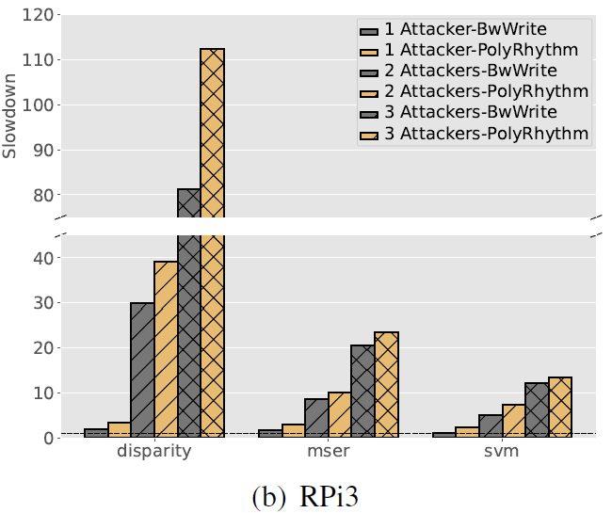
Effect of Offline Tuning
Compared PolyRhythm’s tuned cache primitive to untuned BWWrite attack from:
M. Bechtel and H. Yun, “Denial-of-service attacks on shared cache in multicore: Analysis and prevention.” RTAS 2019
CortexSuite benchmark victim running on dedicated core
Captured mean slowdowns over 100 runs
X Slowdown
Platform: Raspberry Pi 3B

Slide 17
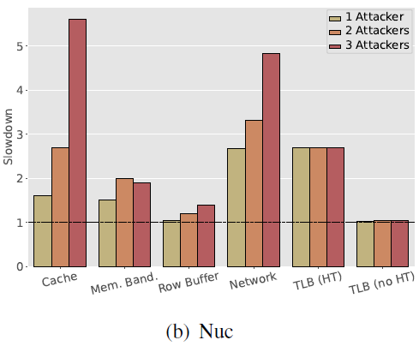
Attack Primitive Platform Dependence
Compared tuned primitives on multiple platforms
Victims selected from stress-ng workloads
Victim runs on dedicated core
Measured max slowdown over 100 runs
X Slowdown
Platform: Intel Nuc 8

Slide 18
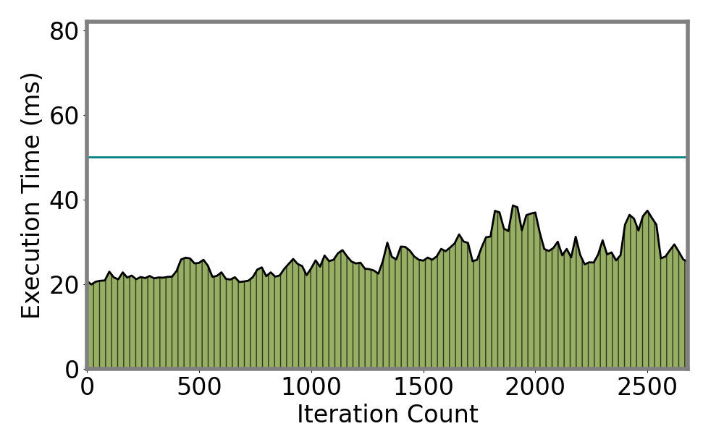
Attacking ORB-SLAM3
Attack ORB-SLAM3 on Intel Nuc
Running with 50ms main loop over EuRoC MAV dataset
We compare slowdowns induced by PolyRhythm’s multiple stages
No Attacker
HyperThreading Enabled
ORB-SLAM3 high priority
PolyRhythm low priority
8 attack threads

Slide 19
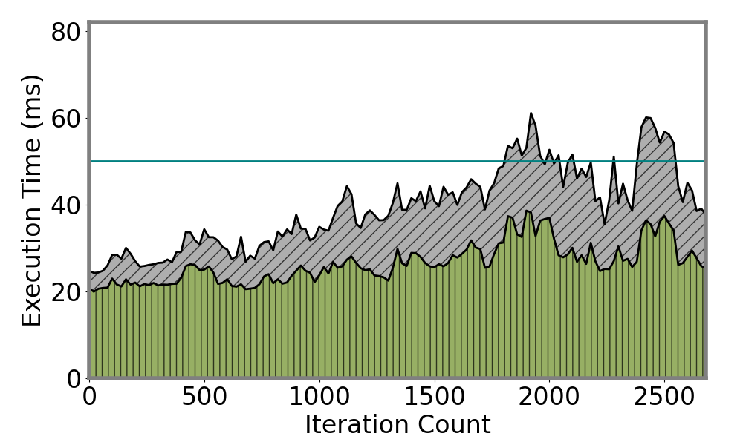
Attacking ORB-SLAM3
Attack ORB-SLAM3 on Intel Nuc
Running with 50ms main loop over EuRoC MAV dataset
We compare slowdowns induced by PolyRhythm’s multiple stages
Overrun
Cache Attack
HyperThreading Enabled
ORB-SLAM3 high priority
PolyRhythm low priority
8 attack threads

Slide 20
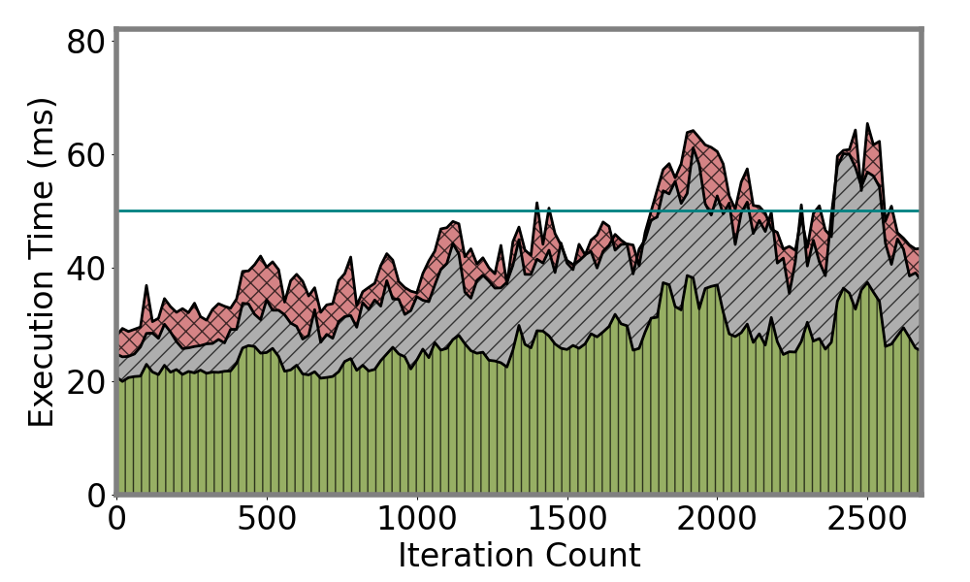
Attacking ORB-SLAM3
Attack ORB-SLAM3 on Intel Nuc
Running with 50ms main loop over EuRoC MAV dataset
We compare slowdowns induced by PolyRhythm’s multiple stages
Overrun
Online Contention
Region Search
HyperThreading Enabled
ORB-SLAM3 high priority
PolyRhythm low priority
8 attack threads

Slide 21
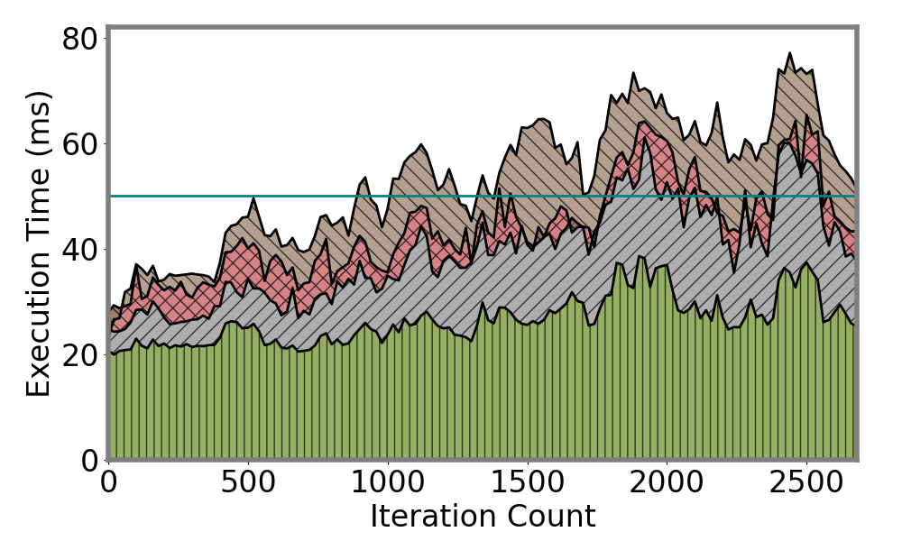
Attacking ORB-SLAM3
Attack ORB-SLAM3 on Intel Nuc
Running with 50ms main loop over EuRoC MAV dataset
We compare slowdowns induced by PolyRhythm’s multiple stages
Overrun
Dynamic Spatio-Temporal Primitive Selection
HyperThreading Enabled
ORB-SLAM3 high priority
PolyRhythm low priority
8 attack threads

Slide 22
Conclusions
PolyRhythm demonstrates the ability of targeted attacks to substantially inflate execution times
May inform more accurate WCET estimates
Helps to analyze the effectiveness of isolation techniques
Open source and available to all:
https://github.com/WUSTL-CSPL/PolyRhythm
We welcome engagement from the community: questions, collaboration, and contributions

Slide 23

Thank You!
Project Link:
https://github.com/WUSTL-CSPL/PolyRhythm
QR Code:
Any Questions?

