Slide 1

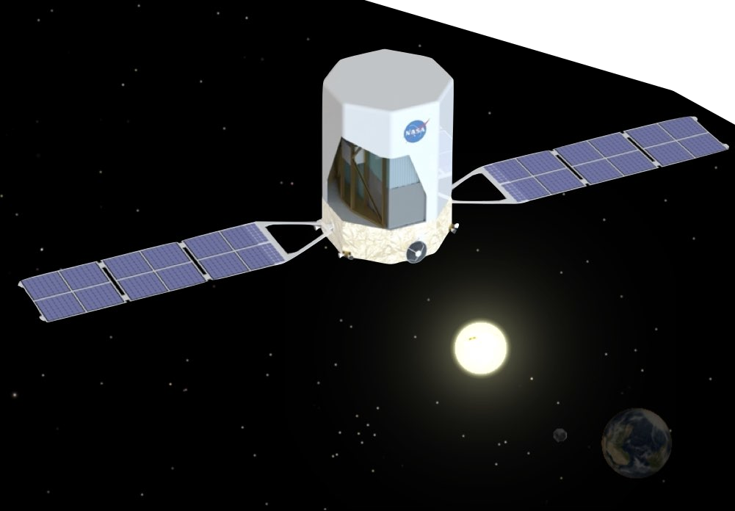
Adaptive Execution for
Real-Time Observations of Astrophysical Transients
Marion Sudvarg, Ye Htet, Sanjoy Baruah,
Jeremy Buhler, Roger Chamberlain, Chris Gill, Jim Buckley
RTSOPS 2024, Lille, France
Supported by NASA, NSF, and Washington University in St. Louis

Slide 2





Pathways to Discovery in Astronomy and Astrophysics for the 2020s
ASTRO2020 Decadal Survey
A “space-based time-domain and multi-messenger program”
is a top priority

Slide 3
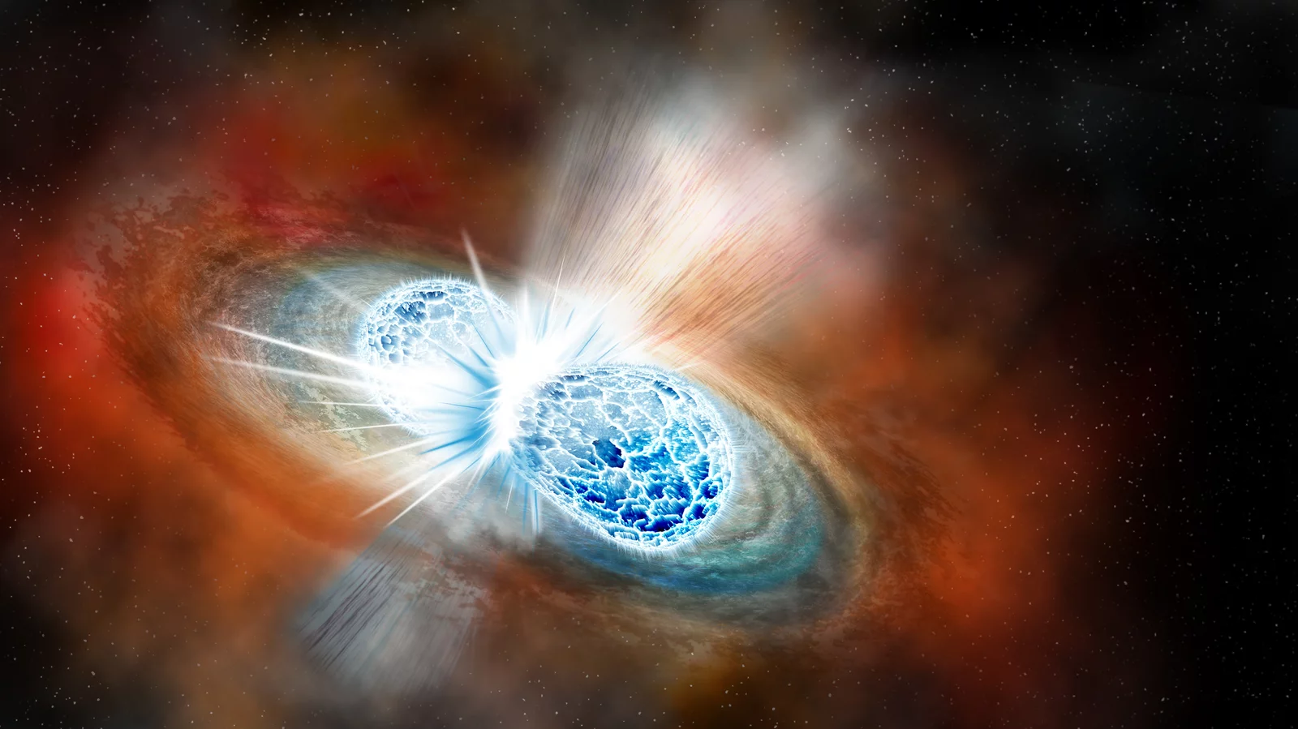
Image courtesy Robin Dienel/Carnegie Institution for Science (https://www.npr.org/sections/thetwo-way/2017/10/16/557557544/astronomers-strike-gravitational-gold-in-colliding-neutron-stars)
Notes:
The idea is to coordinate concurrent observations of astrophysical phenomena by instruments with different observational modalities.
For example, binary neutron star mergers are an event that can potentially reveal a lot of new physics. Neutron stars are stars that have collapsed under their gravitational field, and are extremely dense – a few cubic centimeters can weigh a billion tons. The gravity is strong enough that electrons and protons are squeezed together into neutrons. Not surprisingly, when two of these pull each other into their mutual orbits and merge, a lot of energy is released very quickly.

Slide 4
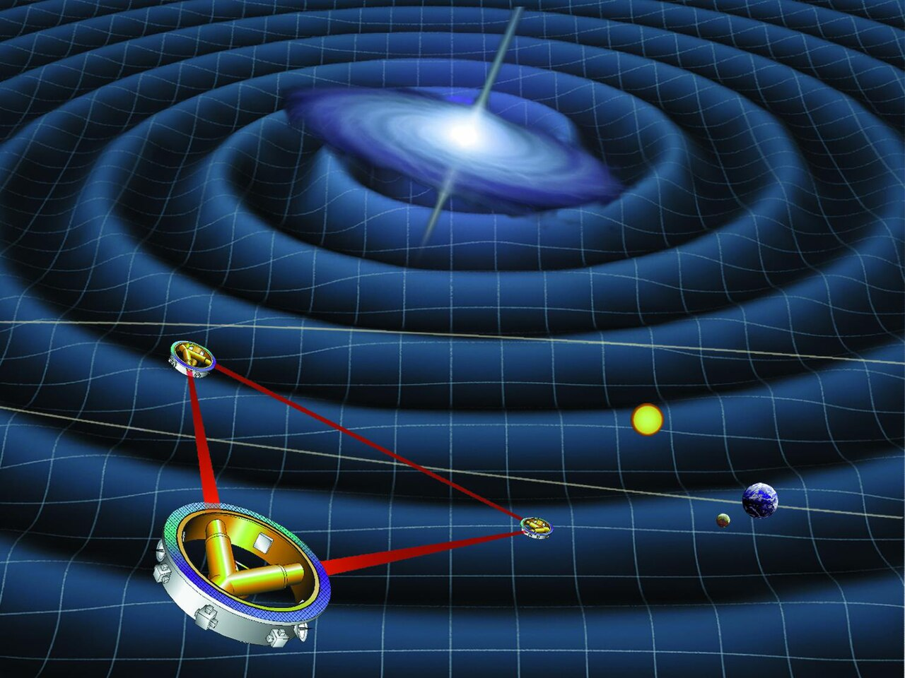
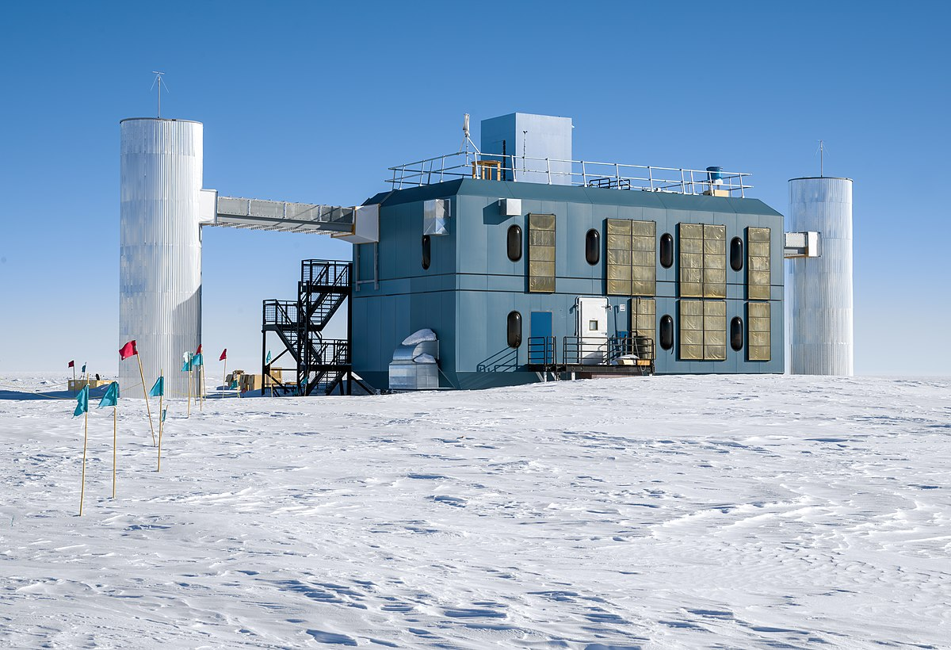



Notes:
This energy can be in the form of gravitational waves, which might be picked up by a detector like the LISA observatory, a joint project underway by NASA and the European Space Agency. But these may release a large number of neutrinos, which are difficult to detect, and so the IceCube neutrino observatory in Antarctica wants to correlate neutrino observations with gravitational waves and localize to a common source (e.g., binary neutron star merger).

Slide 5
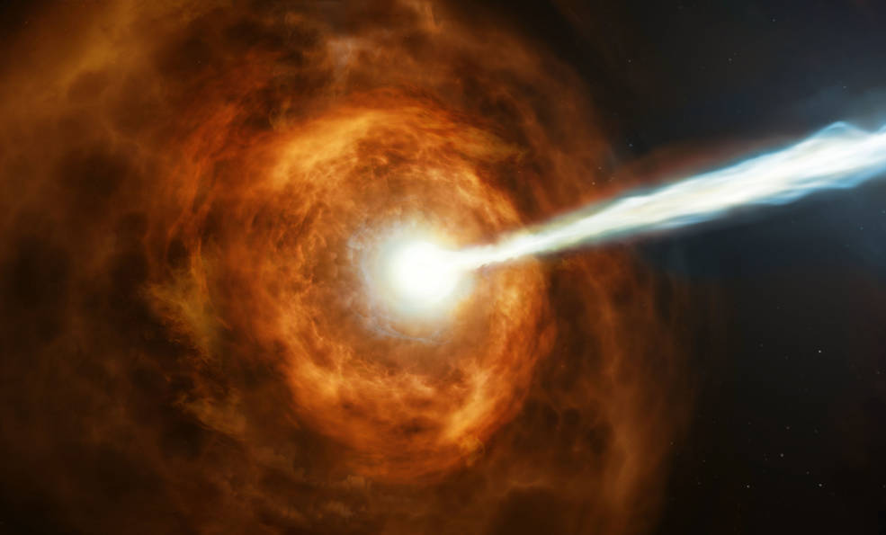
Image courtesy NASA, ESA and M. Kornmesser (https://www.nasa.gov/feature/goddard/2019/hubble-studies-gamma-ray-burst-with-highest-energy-ever-seen)
Notes:
This energy can also be in the form of gamma-rays, which are high energy photons. Not surprisingly, gamma ray bursts, which are a fast release of a huge number of gamma rays with an extreme energy density, are a component of BNS mergers. So we’d like to be able to coordinate observations of gamma ray bursts with other modalities, e.g., optical observations at lower energies of the EM spectrum (visible light, UV, infrared, etc.).

Slide 6
Notes:
This is a rendering of the Advanced Particle-Astrophysics Telescope, our proposed gamma-ray telescope. The interesting thing about gamma ray photons is that they are high energy enough that they act more as particles than waves. So they are difficult to optically lens. This has an advantage though. It means that a gamma ray detector doesn’t have to focus on one spot, so it can get a full sky field of view.

Slide 7
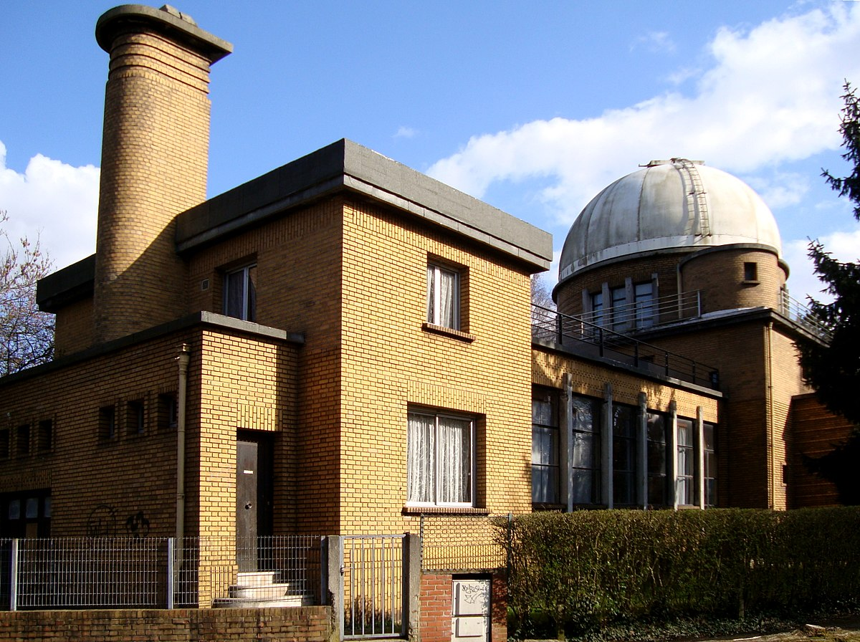
Major Challenges
Gamma-ray burst (GRB) localization is computationally expensive
Optical telescopes are slow to slew into position
Notes:
Our goal is to coordinate detection of the gamma ray burst with secondary optical observations, but this means we need to figure out the direction of the GRB after it’s been detected. Despite the advantages of a full sky view, the disadvantage is that localizing the GRB based on the measured interactions in the detector is computationally expensive, and so usually instruments stream data down to the ground for post-processing. This streaming is usually bandwidth-constrained, and the processing itself can be slow. Furthermore, optical telescopes can be very slow to actually turn to the directed orientation. Many optical telescopes are large and unwieldy, sitting in big observatory domes like the one pictured here in Lille, France. This can add several minutes to the observational delay. For example, a very important gamma ray burst observed in 2017, which was the first BNS merger seen by the current gravitational wave detectors LIGO (in the US) and Virgo (in Italy) took 11 hours from gamma ray detection to actually finding its optical counterpart.

Slide 8
Solution: Real-time GRB localization in space
Analog Sensing
ADC Conversion
FPGA-Based Preprocessing
Single Event Reconstruction
GRB Localization
4-core Pi 3B+ at 700 MHz
Subdegree localization in <100ms

Slide 9
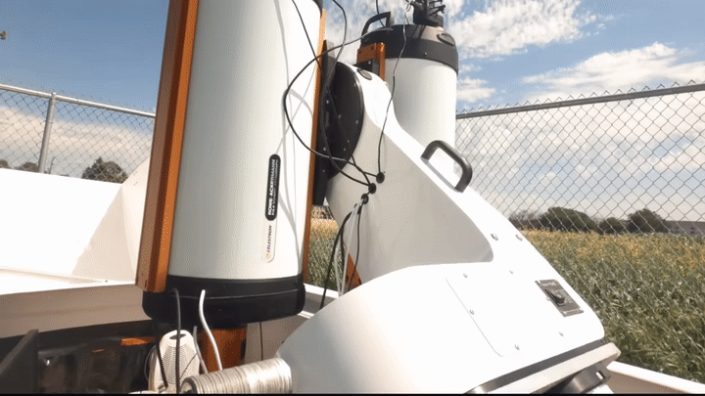
Solution: Ultra-fast robotic telescopes
Video courtesy University of Minnesota, https://www.youtube.com/watch?v=CCco9IQ6DrU

Slide 10
Problem Overview
Coordinate software-based localization in high-energy detector with physical observations by secondary optical telescopes
The system should aim to minimize the expected latency from space-based detection to secondary observations of astrophysical transients

Slide 11
Minimize delay from detection to optical observation

Slide 12
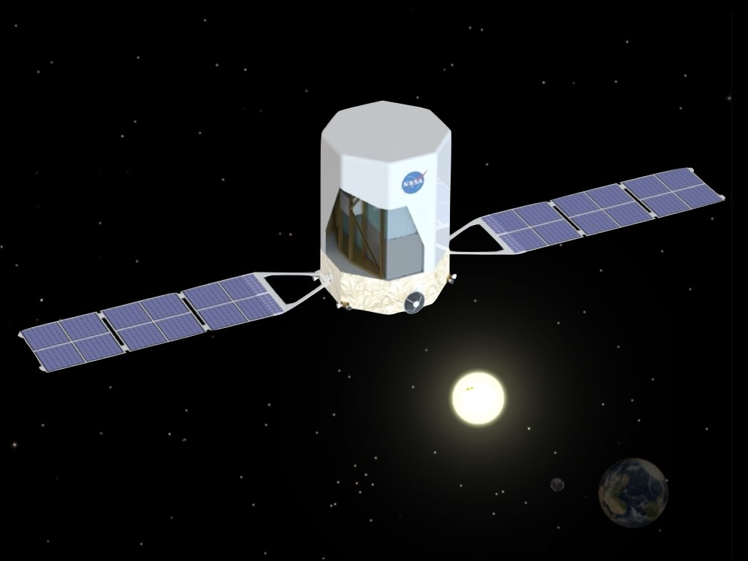

Minimize delay from detection to optical observation
Localized
Region
Burst
Optical Telescope FoV

Slide 13
Speed and Accuracy Tradeoffs
Less Computation Onboard
Longer Optical Search Time
More Computation Onboard
Shorter Optical Search Time

Slide 14
Optimization Problem
Minimize Expected Delay
Localize
Communicate
Search
Pick a localization strategy $ℒ$
that minimizes $t\left(ℒ\right)+\frac{A(ℒ)}{2s}$

Slide 15
Localization Strategy
Parameters to Adjust
Number of gamma-ray events selected for reconstruction
Number of reconstructed events sampled for initial approximation
Approximation algorithm used
Number of refinement iterations

Slide 16
Localization Strategy
We know how to select a Pareto-optimal strategy to
minimize expected localization error
given a dynamic deadline
Parameterized Workload Adaptation for Fork-Join Tasks with Dynamic Workloads and Deadlines. RTCSA 2023.

Slide 17
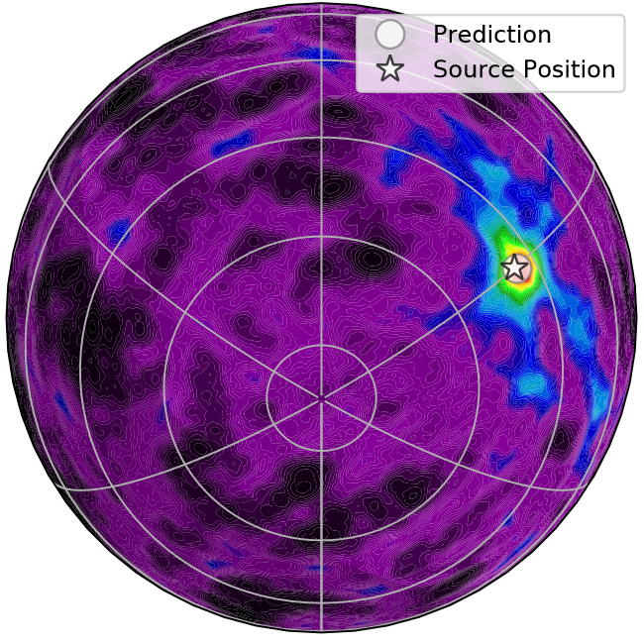
Limitations / Open Questions
How to constrain source to a region
What is the optimal search strategy if:
  The region is probabilistic?
  The telescope cannot move with uniform speed?
Does the search strategy change if updates are sent as the region is refined?

Slide 18
What if …
We detect another GRB during localization?
We detect a high-energy cosmic ray?
A command is received?
A temperature sensor sends and alert?
Adaptive scheduling of multiple jobs

Slide 19
Elastic Scheduling
Introduced by Buttazzo et al. at RTSS 1998
Adaptation for overutilized recurrent task systems
Task utilizations reduced in weighted fair fashion
Each task constrained with a minimum utilization

Slide 20
EDF Job Scheduling

Slide 21
EDF Job Scheduling
A job is EDF-schedulable if the sum of its remaining execution time,
plus the remaining execution time of jobs with earlier deadlines,
does not exceed the time until its deadline

Slide 22
Elastic Job Scheduling

Slide 23
Elastic Job Scheduling
Compress!
Compress!

Slide 24
Algorithm Sketch
Sort active jobs by distance to minimum execution time constraint
For each job:
Scan through list of jobs to find those with earlier deadlines
Use this to set up workload compression problem
Solve in linear time
M. Sudvarg, S. Baruah, and C. Gill. “Linear-Time Admission Control for Elastic Scheduling.” Real-Time Systems, Springer, July 2021.
Can we do this faster than quadratic time?

Slide 25
Open Problem: Competitive Factor
When a job arrives, the algorithm will find the minimum amount of (weighted) workload compression to guarantee schedulability
What if the algorithm is clairvoyant?
Could it apply more compression to some jobs to achieve an overall lower maximum compression?

Slide 26
Thanks! Questions or Ideas?
How to constrain source to a region?
Optimal search strategy by optical telescope?
What if updates are sent as region is refined?
How to select strategy online (based on GRB parameters, availability of optical telescopes, etc.)?
Faster algorithm for elastic job scheduling?
What is the competitive ratio of elastic job scheduling?
Can we incorporate adaptive (slimmable/early-exit) FPGA-based DL?
What are the scheduling implications of offloading ML to accelerators?

