Slide 1
A Concurrency Framework for Priority-Aware
Intercomponent Requests in CAmkES on seL4
Marion Sudvarg, Chris Gill
Washington University in St. Louis
St. Louis, Missouri, United States
Presented by Marion Sudvarg
RTCSA 2022
Supported in part by NSF grants CSR-1814739 and CNS-17653503 and NASA grant 80NSSC21K1741.

Slide 2
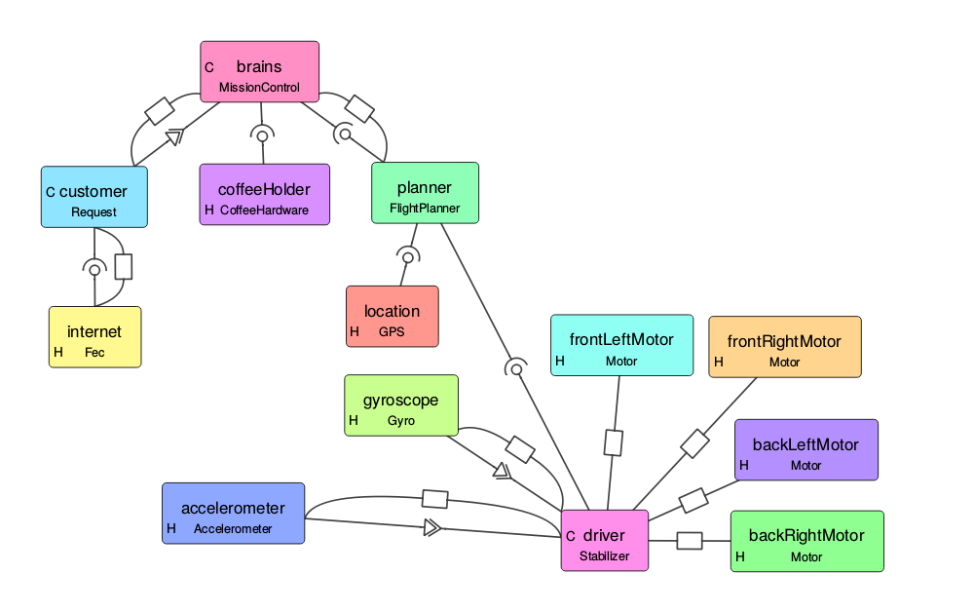
Component-Based Design
Components encapsulate and isolate both state and functionality
Provide structure, modularity, and reusability
A component defines explicit interfaces for communication and control flow
Example Component-Based System for Drone
Set Speed
Calibrate
New Accelerometer
Poll
Diagram courtesy https://docs.sel4.systems/projects/camkes/visual-camkes/VisualCAmkES_Layout_Example.png

Slide 3
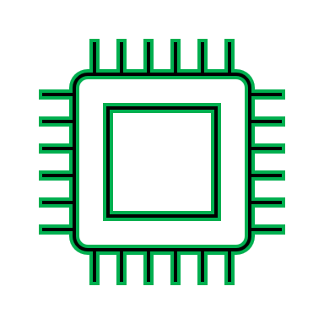
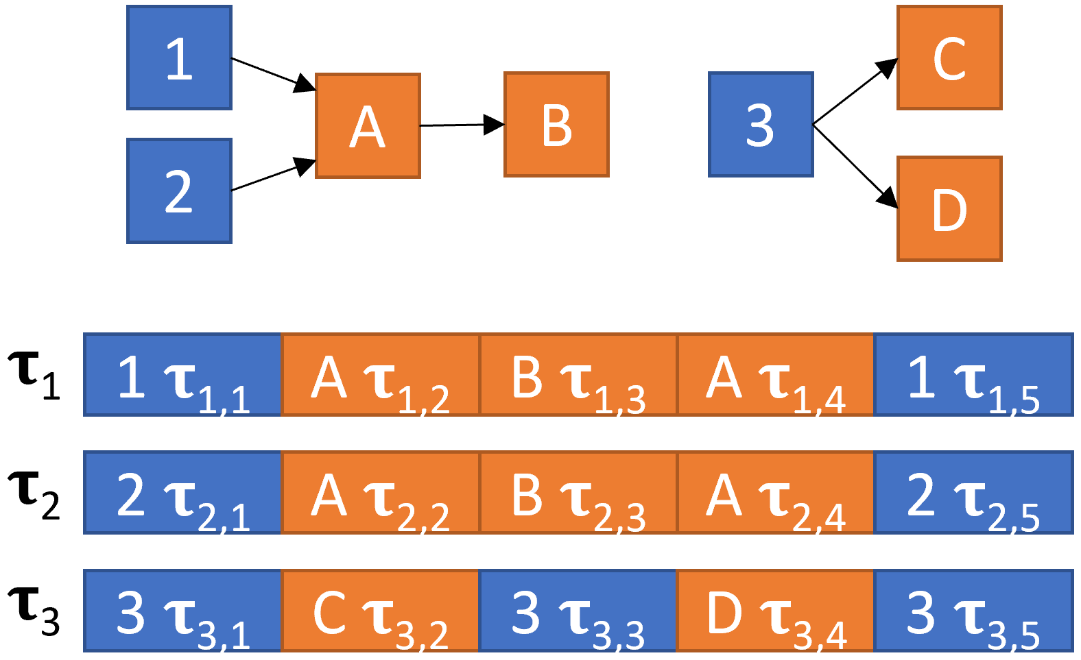
Real-Time Component-Based Systems
Timer or Event-Based Tasks
A component might originate a real-time task
Tasks may share common functionality or state, encapsulated by service components
Task execution begins in the originating component
Proceeds via synchronous RPC invocations across shared components
Shared Components
Camera L
Camera R
Object Detection
Record Event

Slide 4

seL4
Formally verified, capability-based, lightweight microkernel
Supports real-time and mixed-criticality systems
Provides resilience for real-world systems (e.g. the Boeing Unmanned Little Bird H-6U)
Image courtesy of Boeing: https://www.boeing.com/defense/unmanned-little-bird-h-6u/

Slide 5
CAmkES
Component description language and framework for seL4
Provides Component Procedure Interfaces (CPIs) for Remote Procedure Call (RPC) requests
CPIs assigned a single thread that waits on an seL4 endpoint at a static priority specified at compile-time
  This is not well-suited to task execution that cross-cuts components
  Tasks of different priorities may concurrently send requests to the same CPI!

Slide 6
Our Contribution
Because CAmkES and seL4 lack full support for hard real-time tasks executing end-to-end across multiple components …
We extend CAmkES with a concurrency framework for priority-aware intercomponent requests
RPC invocation overhead is not significantly increased
Code available from:
https://www.sudvarg.com/priority-aware-camkes

Slide 7
Our Extensions
Do not change seL4’s verified codebase or existing CAmkES software
Require minimal changes to existing CAmkES component specifications
Provide macros and compile-time checks for easy adoption
Remain fully in userspace
Support both reentrant execution and locked critical sections over shared state
Bound overhead by using priority semantics to guarantee consistency over lock acquisition without additional atomic operations

Slide 8
Target System
Implicit deadline, sporadic, hard real-time task systems
Fixed-priority, preemptive scheduling on unicore
  Tasks and dependent components must execute on the same core
  This supports unicore and fully-partitioned multicore systems
Closed, trusted systems
For components encapsulating thread-safe, reentrant shared functionality we provide priority propagation
For components encapsulating shared state we provide priority-based shared resource access/locking protocols:
  Non-Preemptive Critical Sections
  Immediate Priority Ceiling Protocol
  Priority Inheritance Protocol

Slide 9
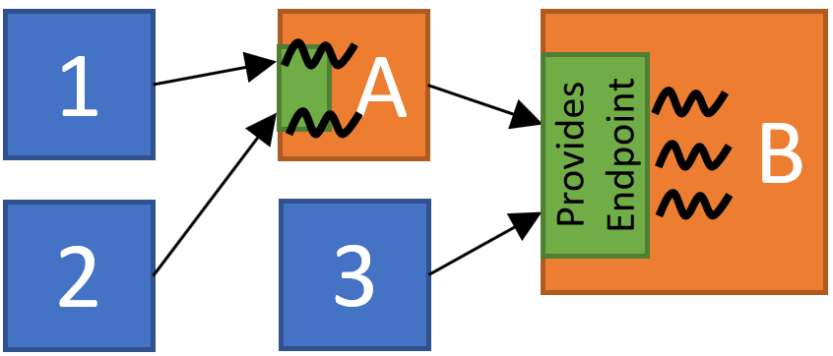
Priority Propagation
For CPIs encapsulating shared functionality
Execution should be at the priority of the requesting task
  Request message coupled with priority
  Responding thread sets its own priority to request priority before running procedure
Execution should be preemptible if requested by a higher priority task
  Threadpool sized according to the number of possible concurrent requests guarantees thread availability
  Threads wait at the priority ceiling of all requestors, guaranteeing preemption can occur

Slide 10
Shared Resource Access Protocols
A CPI can encapsulate mutually exclusive execution over shared state (a critical section)
Locking and priority-based access protocols are managed within the component through our framework
The CPI encapsulates both the locking semantics and functionality over the shared state

Slide 11
Static Priority Locking Protocols
A CPI is assigned a single thread – implicitly prevents concurrent execution over the critical section
Non-Preemptive Critical Sections (NPCS):
  The thread is assigned the maximum system priority
  NPCS suffers from inflated worst-case blocking times
Immediate Priority Ceiling Protocol (IPCP):
  The thread is assigned the maximum priority among possible requesting tasks
  Also called the Highest Lockers Priority (HLP)
  IPCP has comparatively better worst-case blocking times
While implicitly supported in CAmkES, our framework declares these explicitly

Slide 12
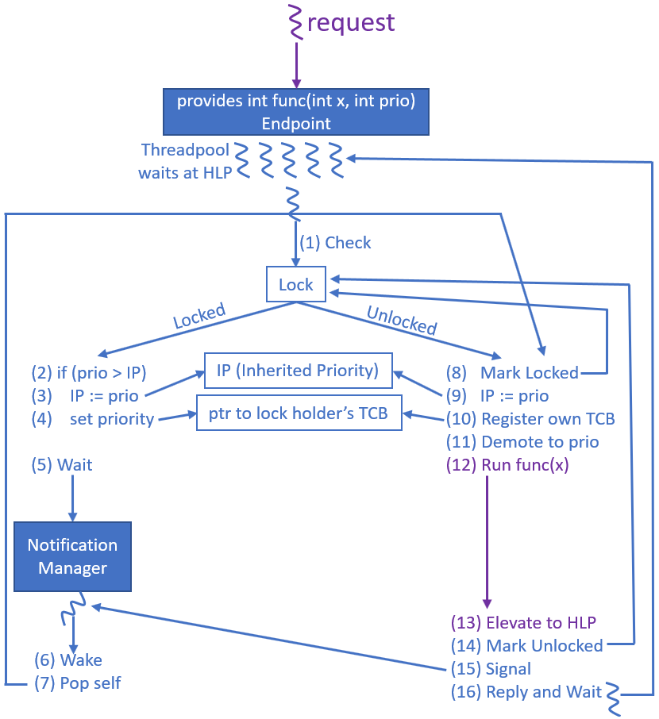
Priority Inheritance Protocol
Nonatomic Boolean Lock
Priority Inheritance
Bookkeeping
Wait
Demote Priority and Execute
Wake and Proceed
Unlock and Signal

Slide 13
Notification Manager
seL4 provides the Notification Object, a binary semaphore
Threads woken in FIFO order by default
seL4 MCS kernel Notification Object is priority ordered using a linked list
We provide a userspace Notification Manager which implements a priority-ordered heap
Notification Object
P=10
Notification Object
Notification Object
P=6
P=8
Notification Object
Notification Object
P=2
P=4

Slide 14
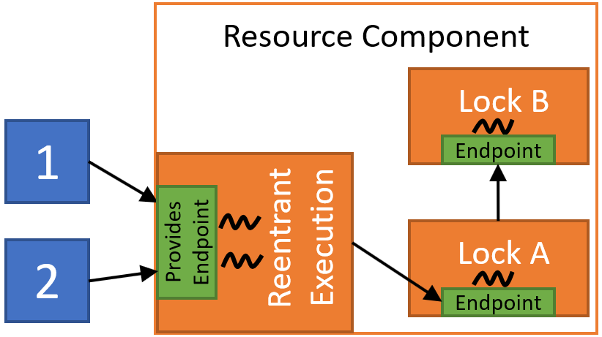
Nested Locking
Achieved via nested requests among CPIs encapsulating locking protocols
Absence of request cycle implies deadlock avoidance
CAmkES can generate a system digraph representation in the DOT language, useful for cycle detection
Limitation: our PIP implementation can only send requests to static priority CPIs (IPCP or NPCS)

Slide 15
Round-Robin Scheduling
Threads of equal priority may preempt each other
  seL4 implements round-robin scheduling by default
  Breaks semantics of priority-based shared resource access
  E.g., an NPCS critical section (maximum priority) may be preempted
Under round-robin scheduling, we use priority laddering
  Tasks assigned even priorities
  Shared resource CPIs are assigned odd priorities (HLP+1)
  128 task priority levels still available (compared to 100 in Linux)

Slide 16
Framework Overheads
Intel x86-64: Intel Xeon Gold 6130 Skylake at 2.1 GHz
ARMv8: Raspberry Pi Model 3 B+ (AARCH32) at 700MHz
Worst-case RPC request overhead: <6μs Intel, <16μs RPi3
Compared to base CAmkES RPC: ~3μs Intel, ~7μs RPi3
Notification Manager Overheads
Intel (<540 ns)
RPi3 (<680 ns)

Slide 17
Evaluation of Synthetic Task Sets
Root Dispatcher
For each configuration, randomly generated 10 task sets for each utilization in 0.1-1.0
x300
Task dispatcher components
Task System
System Dispatcher
System Dispatcher
Task System
…
System Dispatcher
Task System
TimeServer
D1
D2
D3
Task Components
Evaluated 3 shared component configurations
A and B propagate priorities
A and B use IPCP
A propagates, B uses PIP
1
2
3
We provide a custom implementation of the CAmkES TimeServer component for the Raspberry Pi 3B+
Shared Components
A
B
No task missed a deadline!
Evaluated randomly-generated synthetic task sets

Slide 18
Conclusions and Future Work
We provide new extensions to CAmkES on seL4
  Supports priority propagation for reentrant CPIs
  Allow CPIs to encapsulate priority-based locking protocols without the need for additional atomic operations
Support hard real-time behavior for cross-component task execution
We intend to extend our concurrency framework to
  Allow for nested PIP
  Support asynchronous event notifications
  Continue to improve its ease of adoption
  Reduce false positives in deadlock detection
  Enforce behavior over untrusted components in open systems

Slide 19
Thank You!
Any questions?
https://www.sudvarg.com/priority-aware-camkes

Slide 20
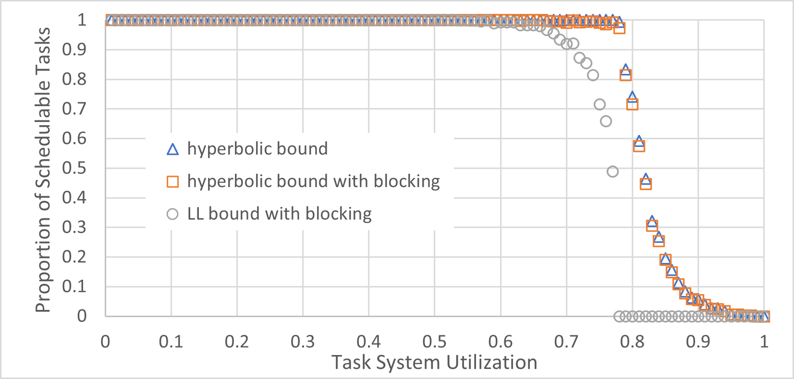
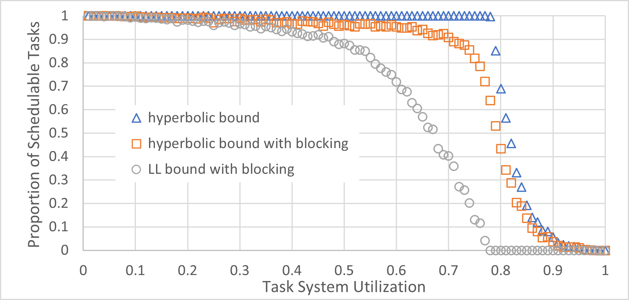
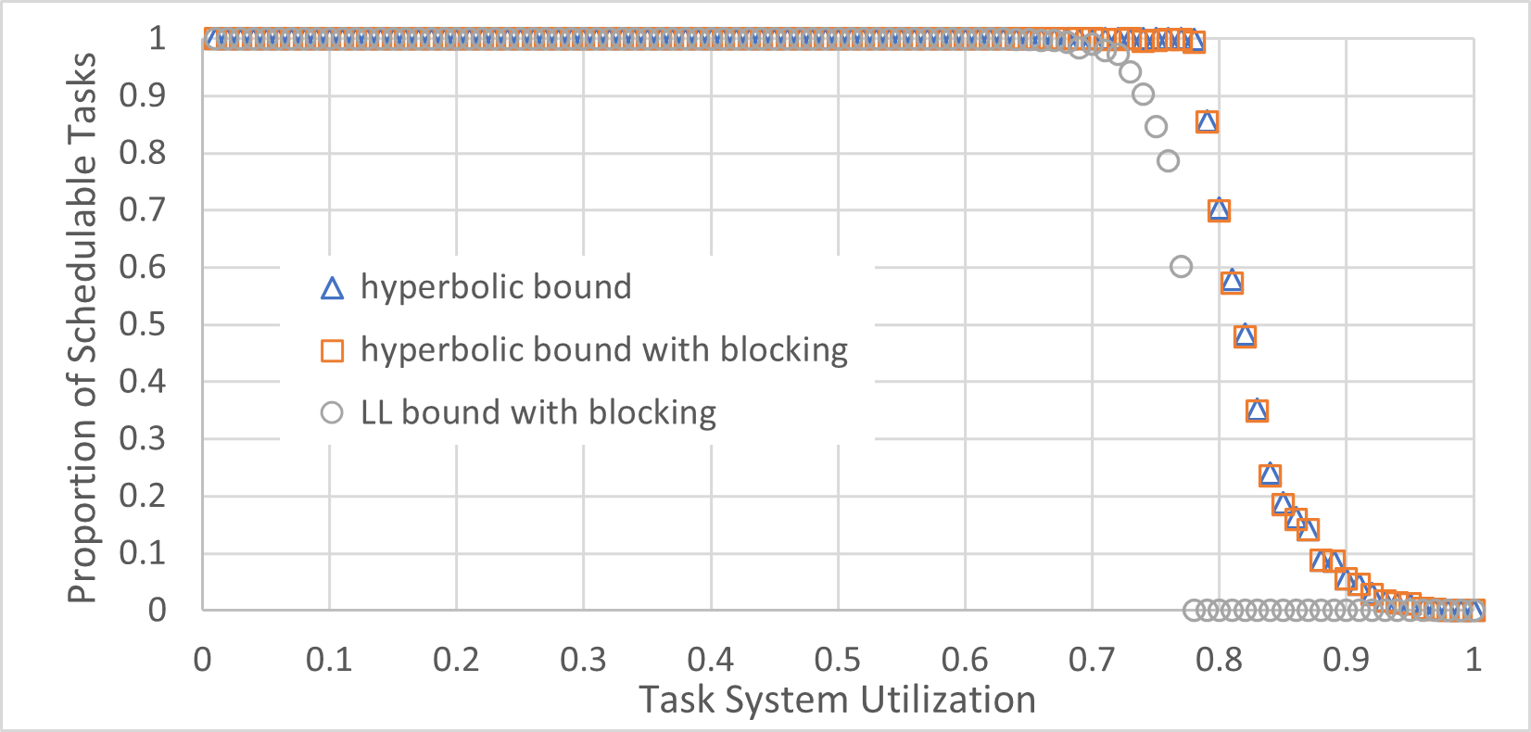
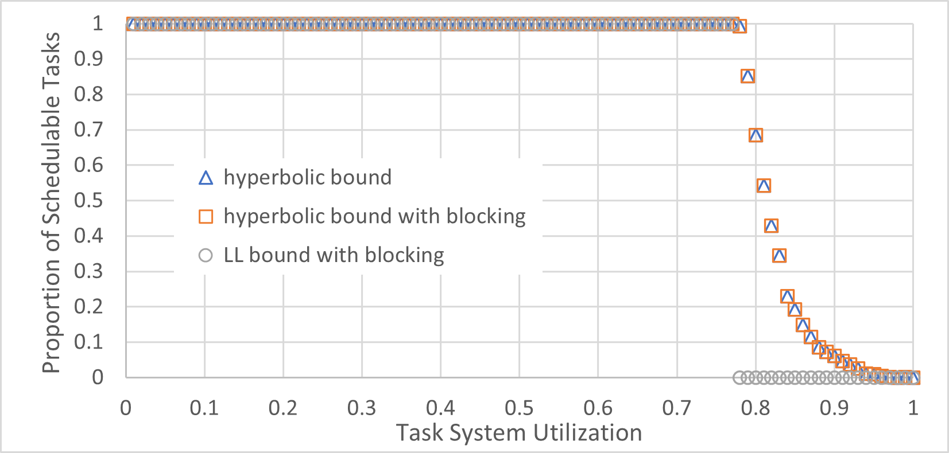
Theoretical Schedulability: Intel
IPCP
NPCS
Generated 1000 task sets for each utilization
Task periods 5ms-1s using log-uniform distribution
PIP
Propagation

Slide 21

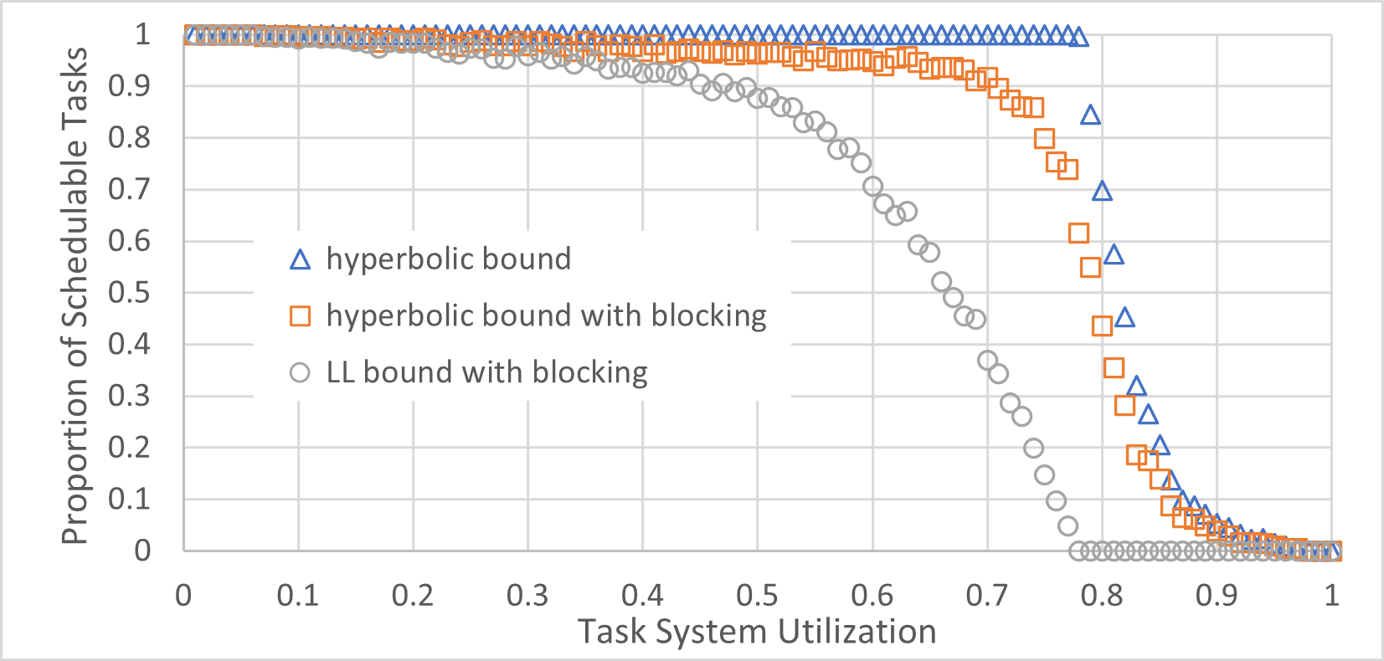
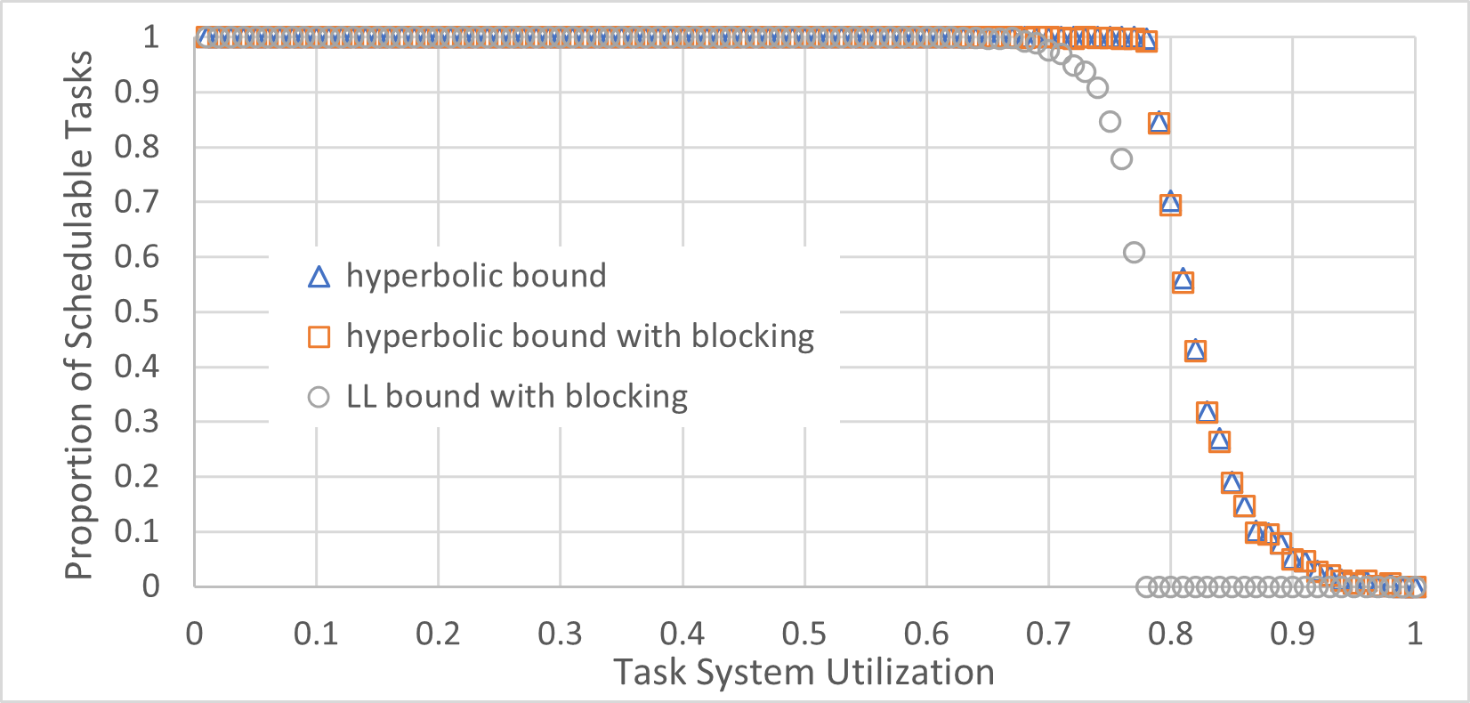
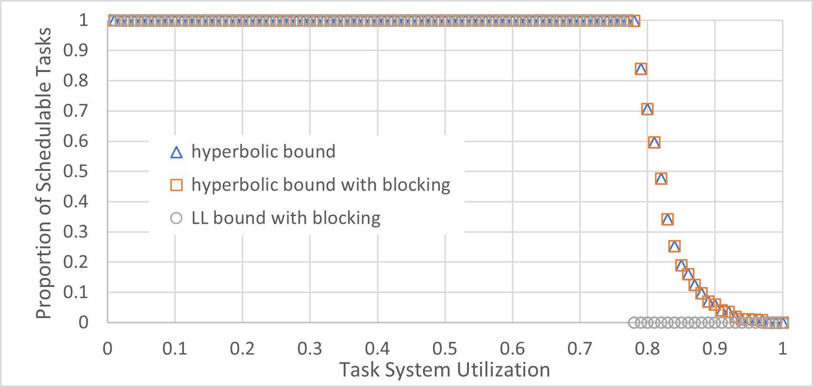
Theoretical Schedulability: RPi3
IPCP
NPCS
Generated 1000 task sets for each utilization
Task periods 5ms-1s using log-uniform distribution
PIP
Propagation

Slide 22
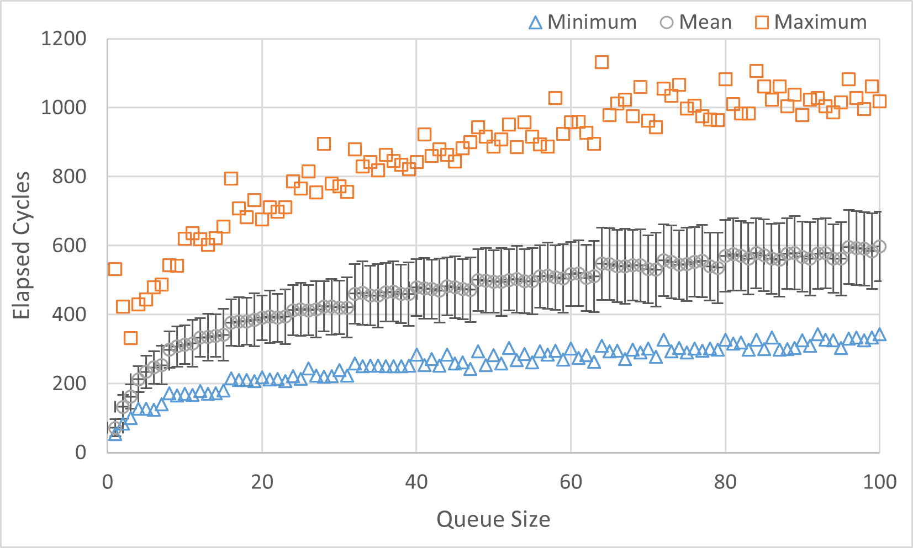
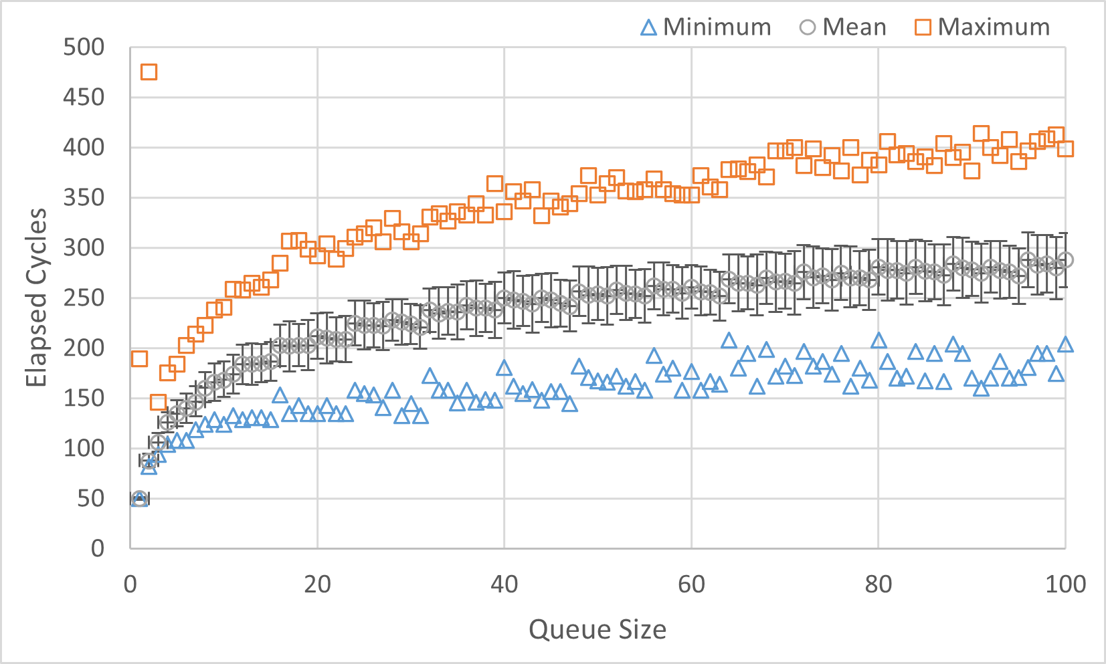
Framework Overheads (in Cycles)
Intel x86-64: Intel Xeon Gold 6130 Skylake at 2.1 GHz
ARMv8: Raspberry Pi Model 3 B+ (AARCH32) at 700MHz
Worst-case RPC request overhead: <11400 Intel, <8200 RPi3
(Compared to base CAmkES RPC: ~5600 Intel, ~4800 RPi3)
Notification Manager Overheads
Intel (<1140 cycles)
RPi3 (<480 cycles)

