Slide 1



Elastic Scheduling for Harmonic Task Systems
Marion Sudvarg, Ao Li, Daisy Wang,
Sanjoy Baruah, Jeremy Buhler, Chris Gill, Ning Zhang,
Pontus Ekberg (Uppsala University)
Thursday, May 16
RTAS 2024

Slide 2


Slide 3
Real-Time Systems
Increasingly execute in dynamic environments

Slide 4
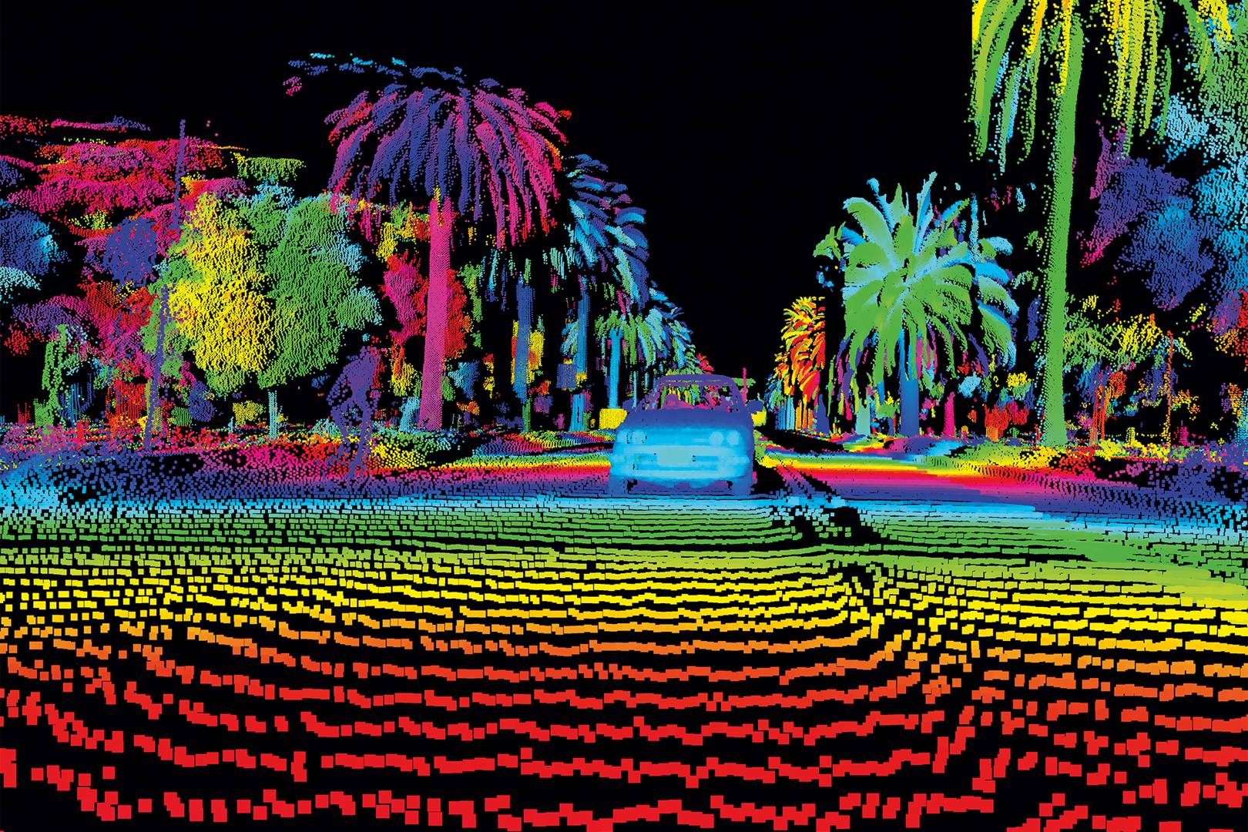
Image courtesy wired.co.uk
Notes:
Lidar pipeline: must recognize car, but must also do so on time to avoid collision

Slide 5
Real-time systems must adapt to maintain temporal guarantees even on overloaded computational platforms
Elastic Scheduling
Giorgio Buttazzo, Giuseppe Lipari, and Luca Abeni. “Elastic task model for adaptive rate control.” RTSS 1998

Slide 6
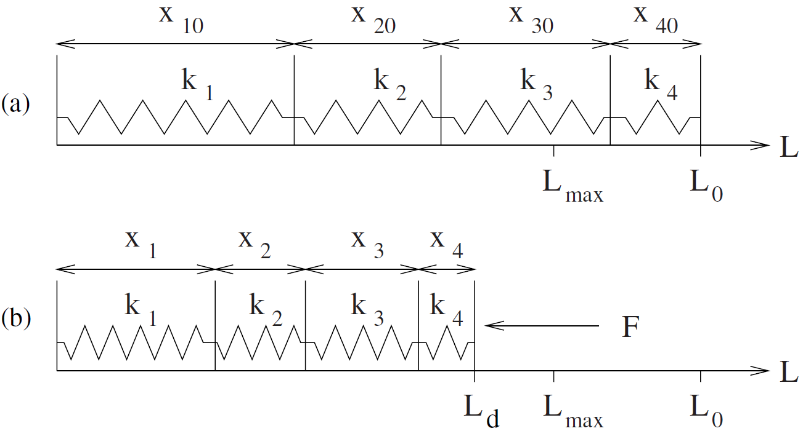






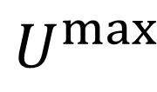


















$$U_{1}^{max}$$
$$U_{2}^{max}$$
$$U_{3}^{max}$$
$$U_{4}^{max}$$
$$E_{1}$$
$$E_{2}$$
$$E_{3}$$
$$E_{4}$$
$$U$$
$$U^{max}$$
$$U_{1}$$
$$U_{2}$$
$$U_{3}$$
$$U_{4}$$
$$E_{1}$$
$$E_{2}$$
$$E_{3}$$
$$E_{4}$$
$$U$$
$$U_{D}$$
$$U^{max}$$
$$U_{1}^{min}$$
$$U_{2}^{min}$$
$$U_{3}^{min}$$
$$U_{4}^{min}$$
Notes:
Task utilizations are traditionally decreased by increasing their periods

Slide 7
Elastic Scheduling of Implicit-Deadline Tasks with Harmonic Periods

Slide 8
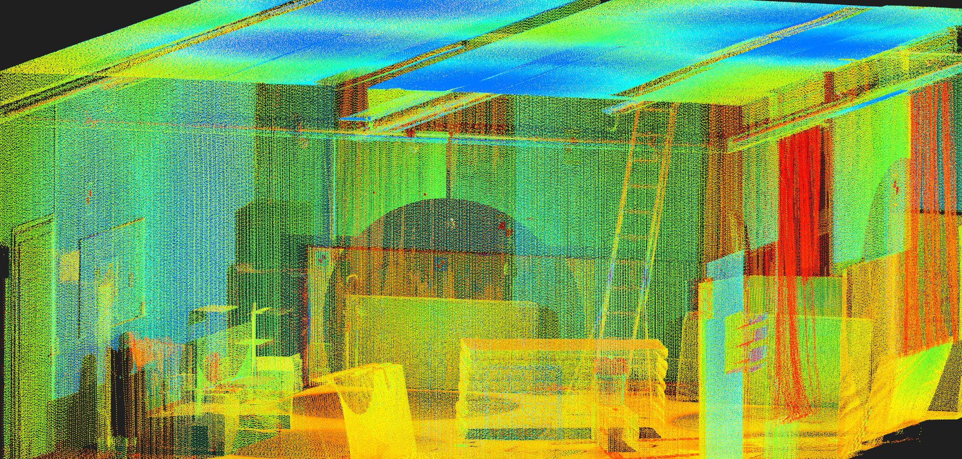
Image courtesy https://projects.asl.ethz.ch/datasets/doku.php?id=kmavvisualinertialdatasets
Simultaneous localization and mapping (SLAM) systems

Slide 9



SLAM systems synchronize frames from multiple input sources
Visual
Inertial
Lidar
ORB-SLAM3
𝛕₀, T=1
𝛕₁, T=2
𝛕₂, T=4
Harmonic Periods

Slide 10
This Talk
Selecting harmonic periods
Elastic scheduling with harmonic periods
Case study: atmospheric aerosol sampling
Case study: ORB-SLAM3
Open questions in computational complexity

Slide 11
The Harmonic
Period Problem
Mitra Nasri, Gerhard Fohler, Mehdi Kargahli. “A Framework to Construct Customized Harmonic Periods for Real-Time Systems.” ECRTS 2014.

Slide 12
The Harmonic Period Problem
x3
x2
x2
x3
x2
T₁
T₂
T₃

Slide 13
Non-Overlapping Intervals
e₃
s₃
e₂
s₂
e₁
s₁
T₁
T₂
T₃

Slide 14
Non-Overlapping Intervals
e₃
s₃
s₂
e₂
s₁
e₁
T₁
T₂
T₃

Slide 15
e₂
e₃
e₄
e₅
e₆
e₇
e₈
e₉
s₁
s₂
s₃
s₄
s₅
s₆
s₇
s₈

Slide 16
e₂
e₃
e₄
e₅
e₆
e₇
e₈
e₉
s₁
s₂
s₃
s₄
s₅
s₆
s₇
s₈
≤
e₂
e₃
e₄
e₅
e₆
e₇
e₉
e₉
s₁
s₁
e₂
e₃
e₄
e₅
e₆
e₇

Slide 17
e₉
s₁

Slide 18
e_{n}
= k
s₁
Upper bound on Projected Harmonic Zones
k²

Slide 19
Overlapping Intervals
x2
x1
x2
T₁
T₂
T₃

Slide 20
The Harmonic
Elastic Problem

Slide 21
Problem
Proportional compression may not maintain the harmonic period relationships

Slide 22
Solution
Use equivalent constrained optimization

Slide 23
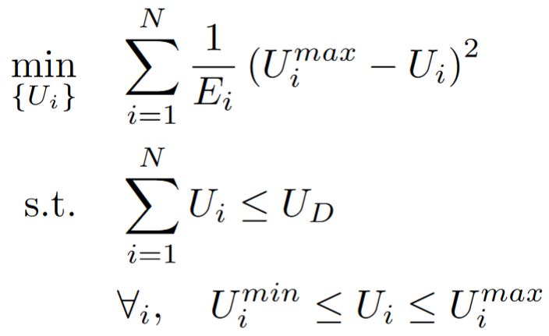
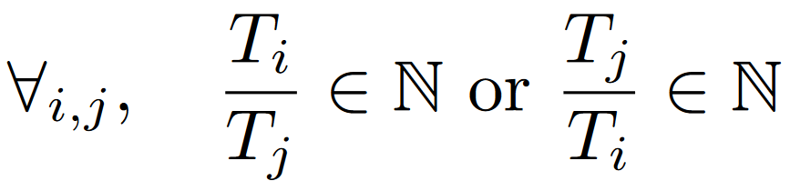
Thidapat (Tam) Chantem, Xiaobo (Sharon) Hu, and Michael D. Lemmon. “Generalized Elastic Scheduling.” RTSS 2006

Slide 24
Problem
Solving this constrained-optimization problem is NP-hard

Slide 25
Ordered Harmonic Elastic Problem
ORB-SLAM3
𝛕₀, T=1
𝛕₁, T=2
𝛕₂, T=4

Slide 26
Build a lookup table offline
to enable fast online compression in response to changes in available utilization

Slide 27
1. Enumerate “Projected Harmonic Intervals”
x1
x1
T₁
T₂
T₃

Slide 28
1. Enumerate “Projected Harmonic Intervals”
x1
x2
T₁
T₂
T₃

Slide 29
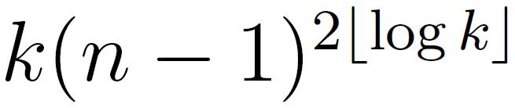


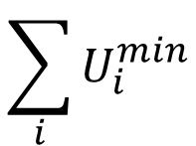
2. Build lookup table matching ranges of utilization to optimal PHI
$$U_{D}$$
x1, x1, x7
x3, x2, x1
x2, x4, x3
x3, x1, x2
x1, x3, x2
x1, x2, x1
$$\sum_{i}{U_{i}^{min}}$$
$$1$$
For n tasks, table size at most

Slide 30
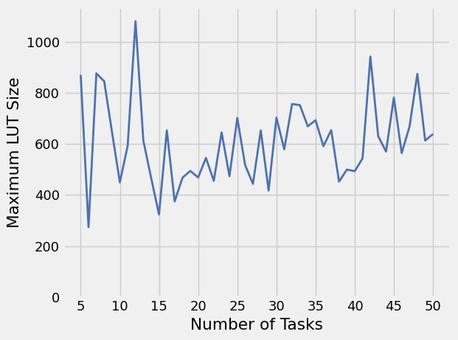
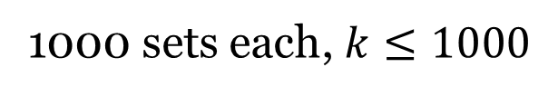
For n tasks, table size at most
1000 sets each, $k≤1000$

Slide 31


3. Adjust online to changes in available utilization
For n tasks, table size at most
Binary search over table
Polynomial!

Slide 32
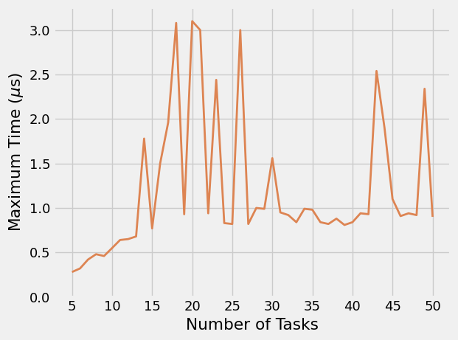
For n tasks, table size at most
1000 sets each, $k≤1000$

Slide 33
Case Studies

Slide 34
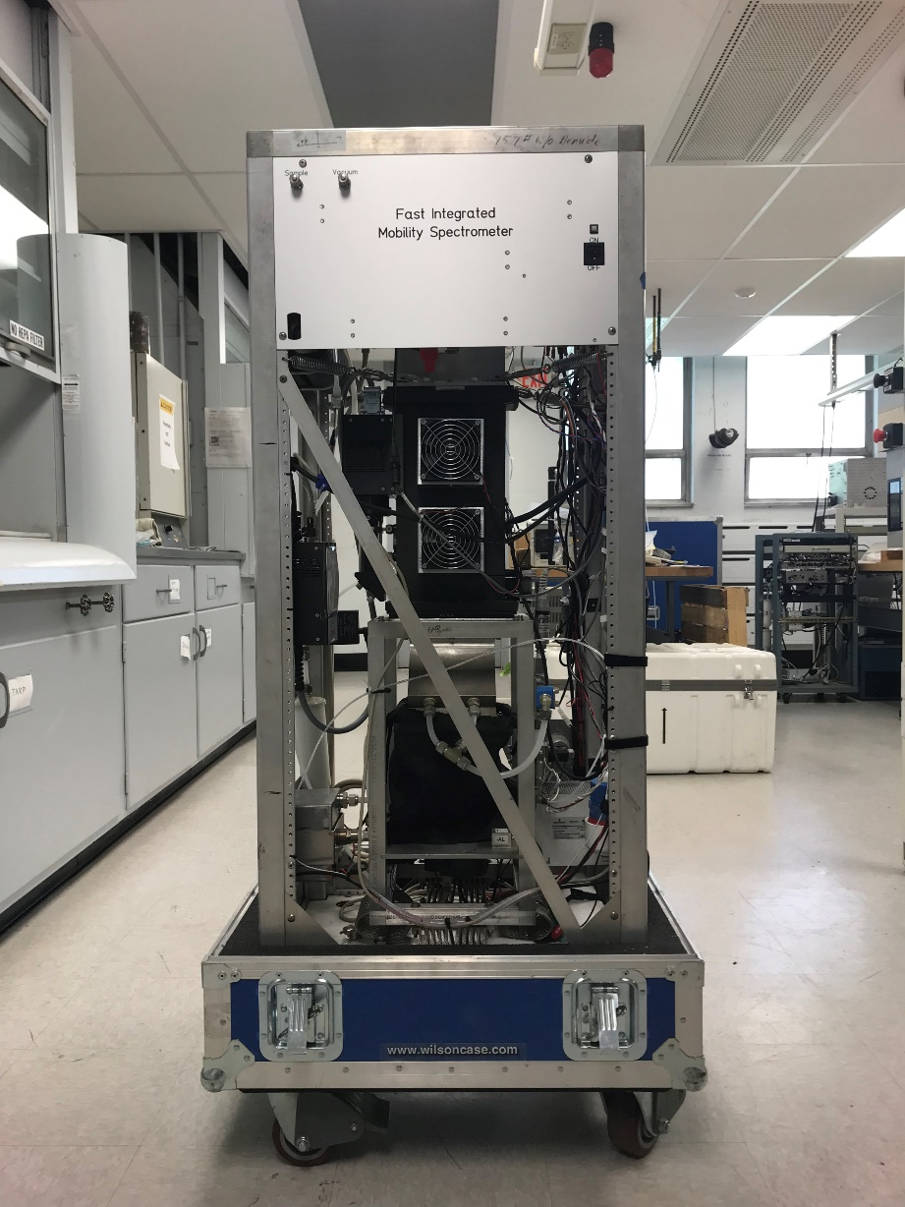
The Fast Integrated Mobility Spectrometer (FIMS)
Notes:
The Fast Integrated Mobility Spectrometer (FIMS) is a flown instrument that characterizes atmospheric aerosols. Recent efforts to enable real-time measurements of aerosol particle sizes (e.g., to instruct the aircraft to follow an aerosol plume) achieved the desired performance on a Raspberry Pi 4.The improved computational pipeline illustrated captures and processes images to detect particles, grouping them into fixed-duration windows of particle inlet time. Using matrix inversion, it converts instrument responses from particle spatial coordinates to determine the particle size distribution within each window. “Housekeeping” (HK) data readouts from other sensors (e.g., temperature and pressure) are synchronized with the inversion process, and are used to determine if a new data inversion matrix must be computed. Harmonic execution guarantees a fixed, integral number of time windows associated with each job. This stabilizes the fraction of particles lost during the inversion process, ensuring a consistent representation of particle distribution and maintaining measurement accuracy, while also bounding the latency between a particle’s inlet time and its subsequent inclusion in the reported size distribution.

Slide 35
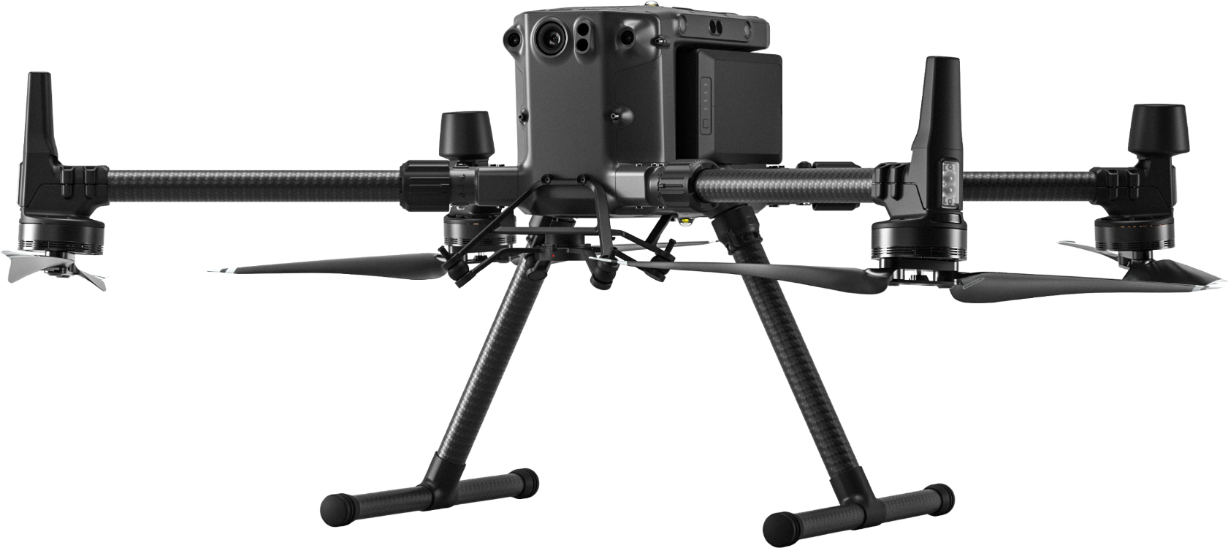
The Fast Integrated Mobility Spectrometer (FIMS)
Image courtesy https://www.seilergeodrones.com/shop/dji-matrice-300-rtk/

Slide 36
The Fast Integrated Mobility Spectrometer (FIMS)
HK Data Queue
HK Data
Data
Inversion
Process
Image
Particle Time Window Queue

Slide 37
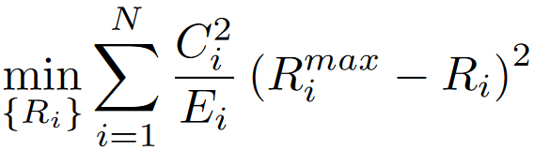
Selecting elastic constants to minimize result error within the constraints of schedulability

Slide 38
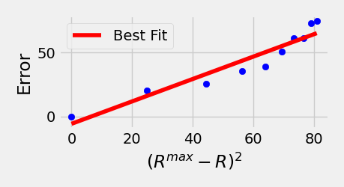
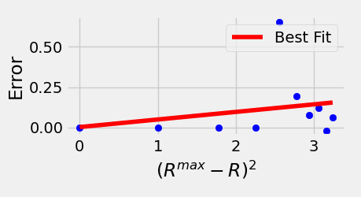
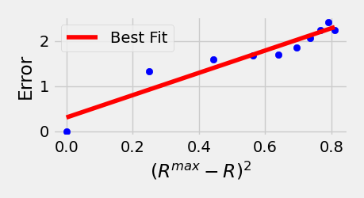
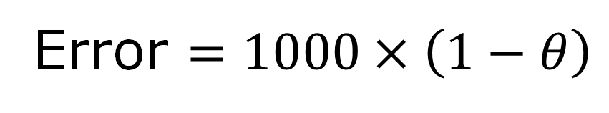
Error $=1000×\left(1−θ\right)$
Process Image
HK Data
Data Inversion

Slide 39
With utilization limited to 0.1-0.5 by a high-priority interfering task,
no FIMS tasks missed their deadlines

Slide 40
ORB-SLAM3
Camera
Images
Tracking
Mapping
IMU

Slide 41
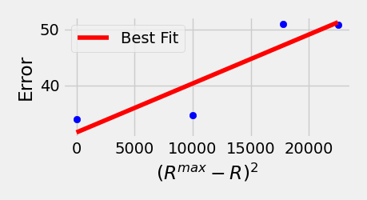
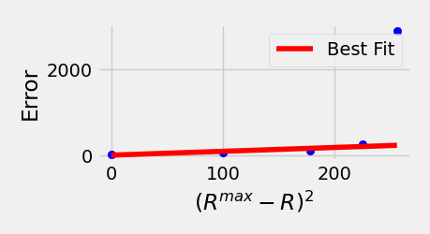
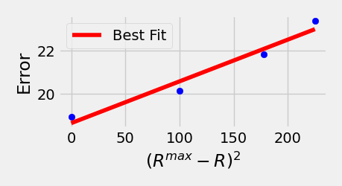
Error $={10}^{4}×$Relative Translational Error
IMU
Camera
Mapping

Slide 42
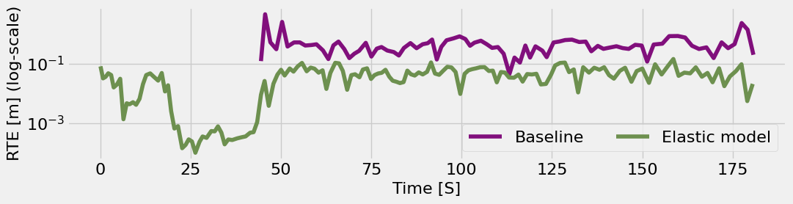
ORB-SLAM3

Slide 43
Key Takeaways
Pseudo-polynomial algorithm for harmonic period selection problem
Building LUT offline enables polynomial-time elastic adaption in response to changes in utilization bound
Effective when applied to applications with dataflow pipelines: FIMS and ORB-SLAM3

Slide 44
NP
Harmonic Period Problem
Harmonic Elastic Problem
Ordered Harmonic Elastic Problem
P

Slide 45
Strongly NP
Harmonic Period Problem
Weakly NP
Harmonic Elastic Problem
Integer Factor
Ordered Harmonic Elastic Problem
P

Slide 46
Strongly NP
Weakly NP
Harmonic Elastic Problem
Harmonic Period Problem
Integer Factor
Ordered Harmonic Elastic Problem
P

Slide 47
Strongly NP
Weakly NP
Harmonic Elastic Problem
Harmonic Period Problem
Integer Factor
Ordered Harmonic Elastic Problem
P

Slide 48
Strongly NP
Harmonic Elastic Problem
?
Weakly NP
Harmonic Period Problem
Integer Factor
Ordered Harmonic Elastic Problem
P

Slide 49
Strongly NP
Harmonic Elastic Problem
?
Weakly NP
Harmonic Period Problem
Integer Factor
Ordered Harmonic Elastic Problem
P

Slide 50
Strongly NP
Harmonic Elastic Problem
?
Weakly NP
Ordered Harmonic Elastic Problem
Harmonic Period Problem
?
Integer Factor
P

Slide 51
Strongly NP
?
Harmonic Elastic Problem
Ordered Harmonic Elastic Problem
?
Weakly NP
Harmonic Period Problem
Integer Factor
P

Slide 52








