Slide 1

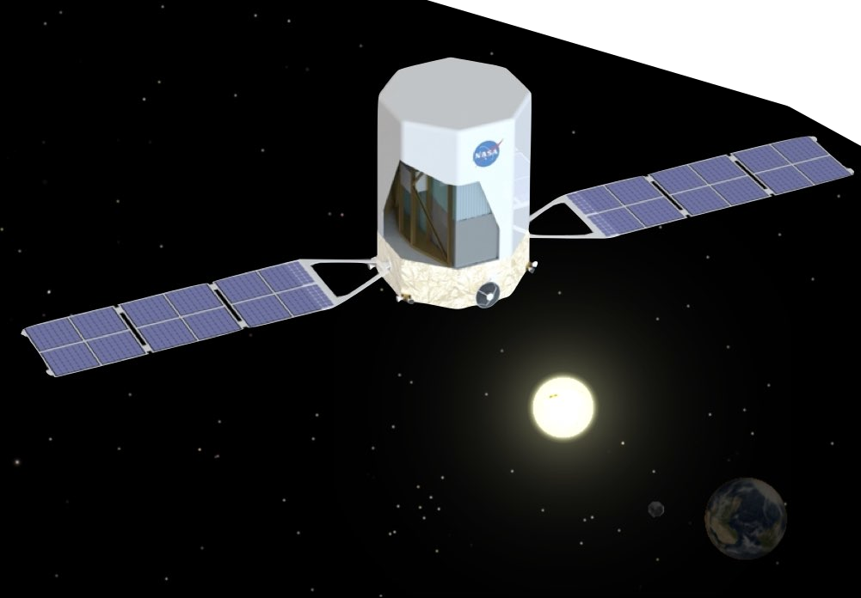
Work in Progress:
Real-Time GRB Localization for the
Advanced Particle-astrophysics Telescope
Marion Sudvarg*, Jeremy Buhler, Roger Chamberlain, Chris Gill, James Buckley
Washington University in St. Louis
OSPERT 2022
The research presented in this paper was supported in part by NSF grants CSR-1814739 and CNS-17653503 and NASA grant 80NSSC21K1741.

Slide 2
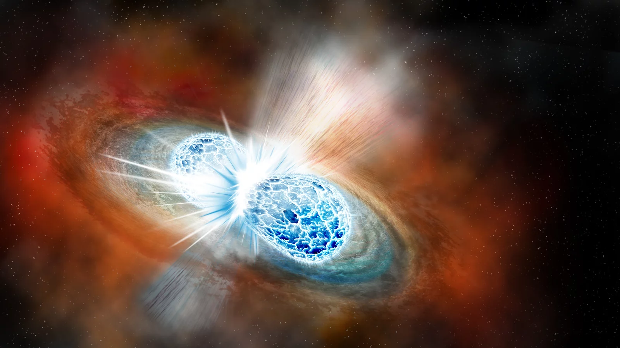
What can gamma-ray bursts tell us about …
Neutron star collisions?
Image courtesy of Robin Dienel/Carnegie Institution for Science (https://www.npr.org/sections/thetwo-way/2017/10/16/557557544/astronomers-strike-gravitational-gold-in-colliding-neutron-stars)

Slide 3
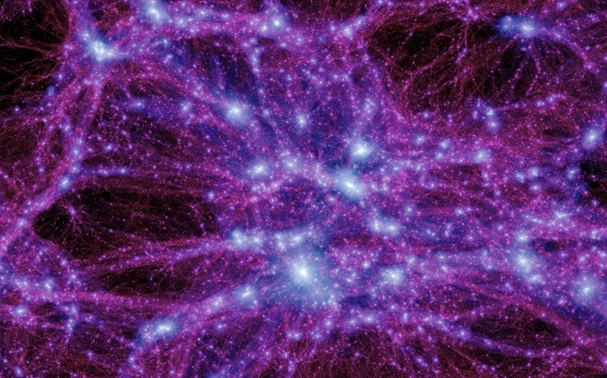
What can gamma-ray bursts tell us about …
The nature of dark matter?
Image courtesy US Department of Energy (https://commons.wikimedia.org/wiki/File:Dark_matter.jpg)

Slide 4
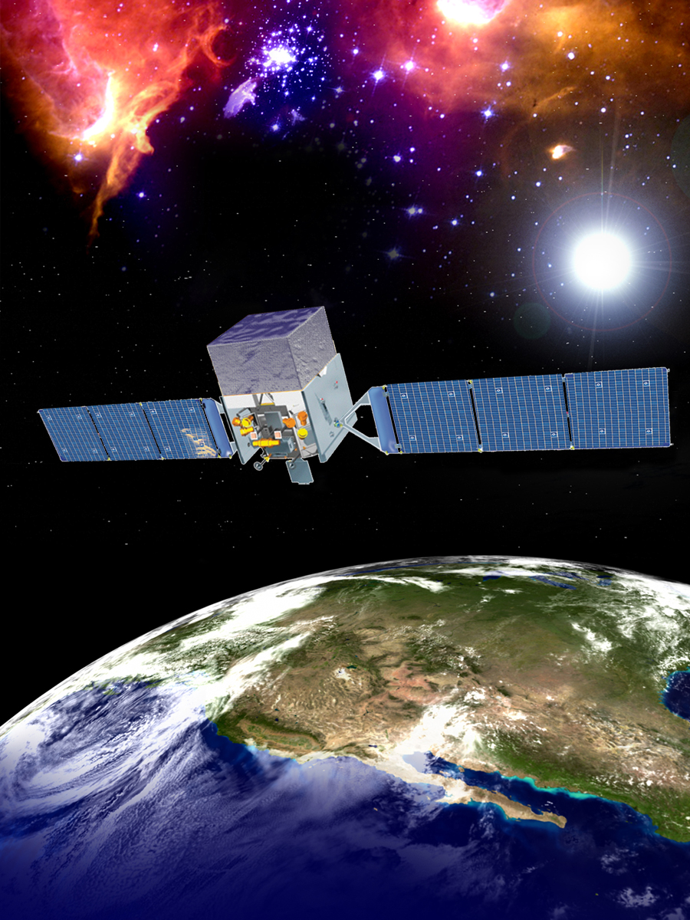
These are still open questions in astrophysics
The Fermi gamma-ray space telescope is seeking answers
Fermi sends data to Earth for later processing
This delays follow-up observations
Image courtesy NASA (https://fermi.gsfc.nasa.gov/)

Slide 5



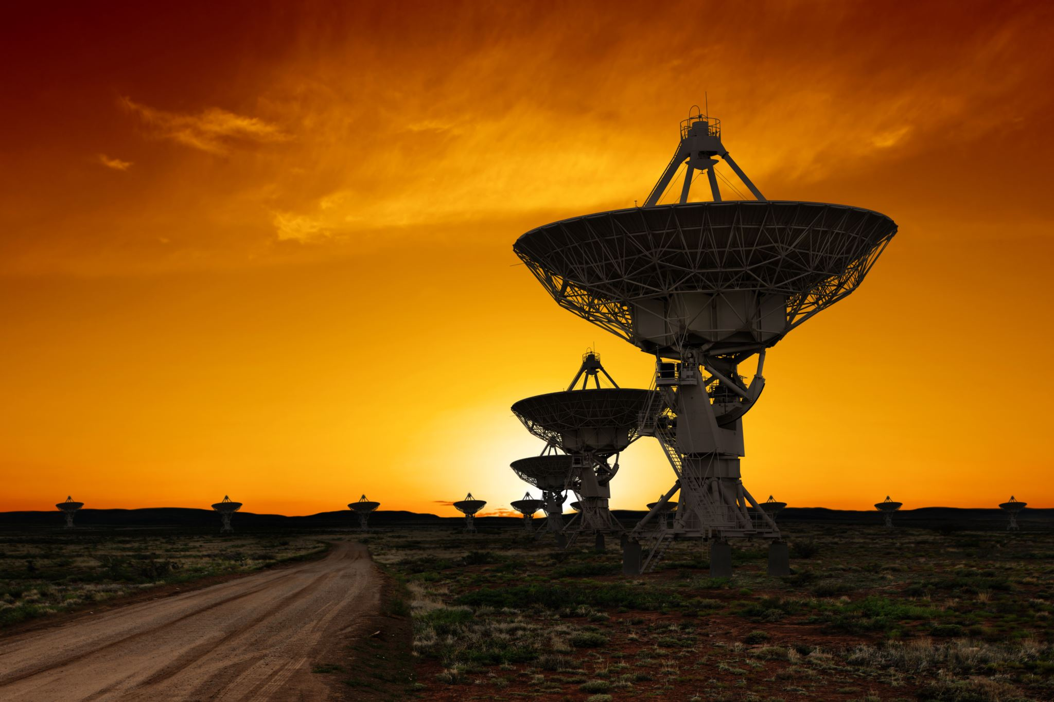
Our Goal: Real-Time GRB Localization for Follow-Up Observations
Gamma-ray bursts are often followed by other emissions
These may be transient – lasting only minutes or seconds
The Advanced Particle-astrophysics Telescope (APT) will localize GRBs in real-time using onboard embedded hardware
This will allow other instruments to point at the GRB source for follow-up observations
γ
X-Ray
visible light
gravity waves
The Blue Marble: Full disk view of the Earth taken on December 7, 1972, by the crew of the Apollo 17 spacecraft en route to the Moon at a distance of about 29,000 kilometres (18,000 mi).

Slide 6
GRB Localization Pipeline
Layers of optical fiber arrays light up in response to gamma-ray interactions
Each fiber is read by a photodetector coupled with an ASIC
Each layer array is multiplexed to one or more FPGAs that time-integrate signals and infer centroids (the energies and spatial coordinates of the corresponding interactions)
FPGAs for each layer send data to a CPU
The CPU infers the physical interaction process (e.g., Compton scattering, pair production)
Gamma-ray trajectories are reconstructed from the centroids
Multilateration over multiple gamma-rays determines an estimated source direction

Slide 7
Problem: Dynamic Workload
Every GRB is unique!
Workload depends on the number of gamma-rays entering the detector (on the order of 10³-10⁶)
A different algorithm is used for each interaction process
The expected proportions of each process are dependent on the GRB’s emission spectrum
This spectrum is highly variable among different GRBs
For a single GRB, the spectrum may evolve over time

Slide 8


Problem: Dynamic Deadline
Each follow-up instrument y has spectral wavelength sensitivity in the range R_{y} = [λ_{min}, λ_{max}]
If the total radiant intensity in that range is less than $I_{y}^{0}$, the instrument can no longer detect signal
GRBs emit photons in a spectrum that evolves such that the intensity I_{y} over R_{y} likely decreases over time
Each instrument i thus imposes a deadline D_{y}, the time that $I_{y}^{0}$ = I_{y} (after which the instrument begins to lose observable signals)
We define a subdeadline for localization as min {D_{y} − δ_{y}} − δ_{CPU}
  δ_{CPU} is the latency from GRB detection to receipt of data on the CPU
  δ_{y} is communication latency from APT to the instrument (it will orbit is 5 light seconds from Earth)
The deadline depends on available instruments and the evolution of the GRB spectrum
Relative Intensity
I_{y}
λ_{min}
λ_{max}
Photon Wavelength
I_{y}
$$I_{y}^{0}$$
D_{y}
Time

Slide 9
Detecting Overload
Given several initial gamma-rays, we attempt to fit a spectrum and match to a known GRB from a catalog
We determine a deadline D from the spectrum and list of available instruments
We estimate worst-case execution time C from the spectrum and gamma-ray arrival rate
If C > D, we elastically compress the localization task

Slide 10
Proposed Elastic Framework
Traditional elastic scheduling compresses task utilizations linearly according to proportional weights
We propose to compress individual subtask workloads according to a nonlinear cost function (the expected angular error in localization) over both continuous and discrete state spaces
Variables
n: number of gamma-rays selected for reconstruction (continuous space)
n_{a}: number of gamma-rays selected for initial source approximation (continuous space)
x: number of subsequent source refinement iterations (discrete space)
Optimization Problem
minimize error(n, n_{a}, x)
Such that:
C ≤ D
n ≤ total number of gamma-rays
n_{a} ≤ n
x ∈ ℕ
error is nonlinear (though monotonically increasing)
C is cubic on n and linear on n_{a} and x
Due to SWaP constraints, this will likely have to be approximated based on offline solutions

Slide 11
Hardware and OS Requirements
Orbiting platform imposes heavy SWaP constraints
Hardware must be rad-hardened
Our heterogeneous compute architecture includes at least 40 FPGAs:
  The CPU board will require a high-bandwidth network adapter
  Will need hardware, OS, and driver support for DMA and possibly TSN protocols
Must support communication to telemetry equipment to transmit burst alerts
Pipeline execution can execute as a single binary – we may integrate all drivers and localization software into a unikernel compile of Linux
Real-time mission-critical instrument control tasks may need to execute concurrently:
  Priority-based scheduling
  Linux cgroups and real-time group scheduling can provide bandwidth constraints
  seL4 scCaps can provide both bandwidth constraints and criticality mode switches

Slide 12
Next Steps
Use simulations, measurements, and study of GRB catalogs to characterize:
  representative GRB spectra and their evolution in time
  the corresponding parameters of the optimization problem
Determine how to handle the complex optimization problem by solving offline or approximating online
Consider schedulability analysis techniques for low-utilization tasks that run concurrently (e.g., with semi-federated scheduling)
Consider elastic memory constraints (e.g., a buffer for FPGA data)
Synthesize these into a unified elastic framework for parallel task scheduling over multiple dimensions, using a nonlinear cost function, over both continuous and discrete state spaces
Select a suitable OS and accompanying temporal isolation mechanisms

Slide 13
Thank you!
Any questions or feedback?

