Slide 1



Marion Sudvarg, Chris Gill, Jeremy Buhler
Department of Computer Science & Engineering
Washington University in St. Louis
msudvarg@wustl.edu
December 5, 2023
This research was supported in part by NSF award CNS-2229290 (CPS)
and NASA award 80NSSC21K1741.

Slide 2
Parallel DAG Task Scheduling
c=5
c=3
c=2
C=18
c=8

Slide 3
Parallel DAG Task Scheduling
C=18
c=5
c=3
c=2
c=8

Slide 4
Parallel DAG Task Scheduling
C=18
c=5
L=13
c=3
c=2
c=8

Slide 5



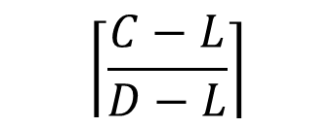
Parallel DAG Task Scheduling
C=18
L=13
D=16
$$\left\lceil \frac{C−L}{D−L}\right\rceil$$
$$=\left\lceil \frac{18−13}{16−13}\right\rceil$$
$$=2$$
c=5
c=3
c=2
c=8

Slide 6
Federated Scheduling
Assign each parallel task its own dedicated cores

Slide 7
Federated Scheduling
What if the system is overloaded?

Slide 8
Elastic Scheduling
Reduce task workloads so the system becomes schedulable
Force early termination of iterative anytime algorithm

Slide 9
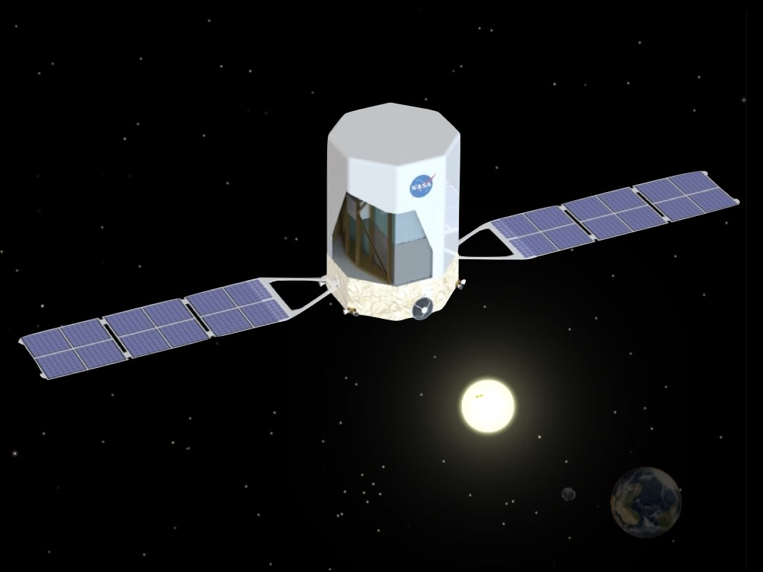
Elastic Scheduling
Reduce task workloads so the system becomes schedulable
γ
γ
γ
γ
γ
γ
γ
γ
γ
γ
Force early termination of iterative anytime algorithm
Reduce quantity of input data to process

Slide 10

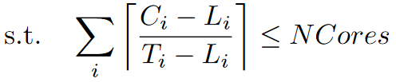

Elastic Scheduling: Optimization
J. Orr, C. Gill, K. Agrawal, S. Baruah, C. Cianfarani, P. Ang, and C. Wong, “Elasticity of Workloads and Periods of Parallel Real-Time Tasks,” RTNS 2018

Slide 11
Elastic Scheduling: Optimization
J. Orr, C. Gill, K. Agrawal, S. Baruah, C. Cianfarani, P. Ang, and C. Wong, “Elasticity of Workloads and Periods of Parallel Real-Time Tasks,” RTNS 2018
This does not address how and where to reduce workloads!

Slide 12
Considering Subtasks

Slide 13
Considering Subtasks
C=18
C=14
L=13
c=5
c=1
c=3
c=2
c=8

Slide 14
Considering Subtasks
C=18
C=14
L=13
c=5
c=1
c=3
c=2
c=8
c=4

Slide 15
Considering Subtasks
C=18
C=14
L=13
L=10
c=5
c=3
c=2
c=4

Slide 16
Considering Subtasks
c=5
c=3
c=2
c=4

Slide 17
Subtask-Level Elastic Scheduling

Slide 18
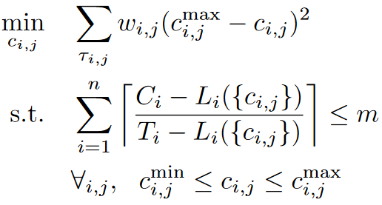
Subtask-Level Elastic Scheduling

Slide 19
OPtimization for Embedded and ReAl-time systems

Slide 20
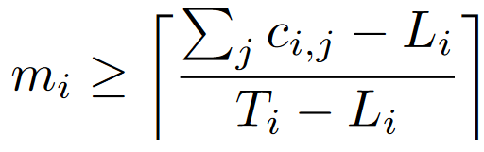
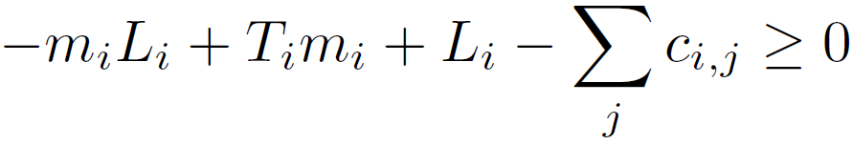
Constraints on Core Assignments
Integer
Variable

Slide 21
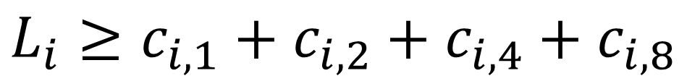
Constraints on Span
c_{i,4}
c_{i,2}
c_{i,8}
c_{i,1}
c_{i,5}
c_{i,3}
c_{i,7}
$$L_{i}≥c_{i,1}+c_{i,2}+c_{i,4}+c_{i,8}$$
c_{i,6}
$$L_{i}≥c_{i,1}+c_{i,2}+c_{i,5}+c_{i,7}+c_{i,8}$$
$$L_{i}≥c_{i,1}+c_{i,3}+c_{i,6}+c_{i,7}+c_{i,8}$$

Slide 22
Enumerating Possible Spans
S
c=0
T
c=0

Slide 23
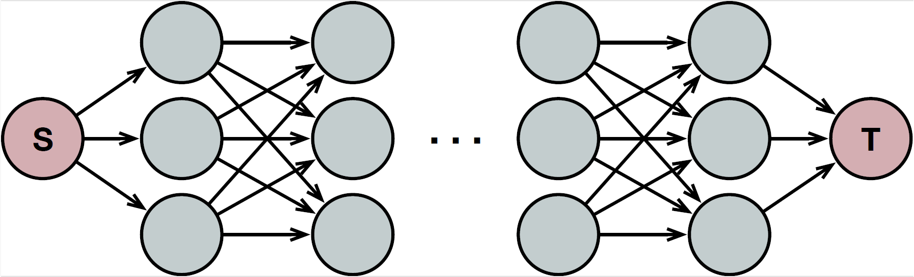
Number of Span Constraints

Slide 24
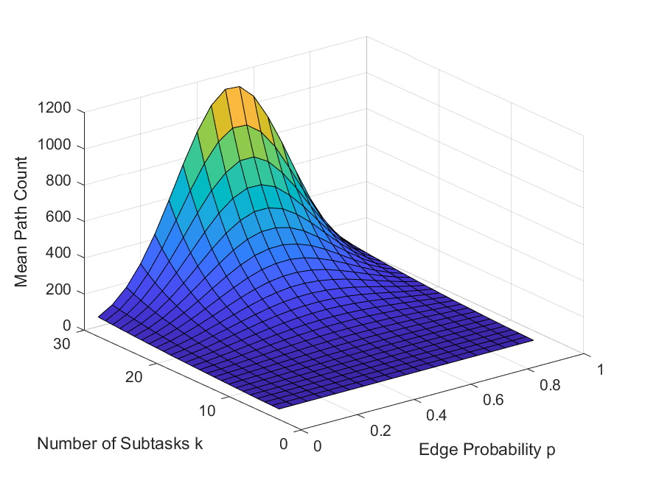
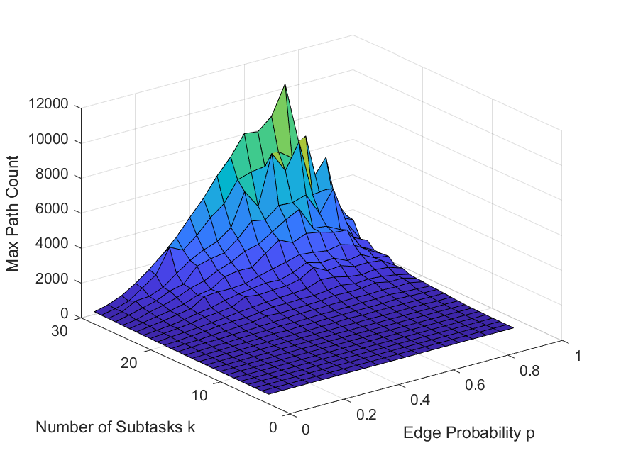
Number of Span Constraints
Mean
Max
100,000 DAGs per input combination

Slide 25
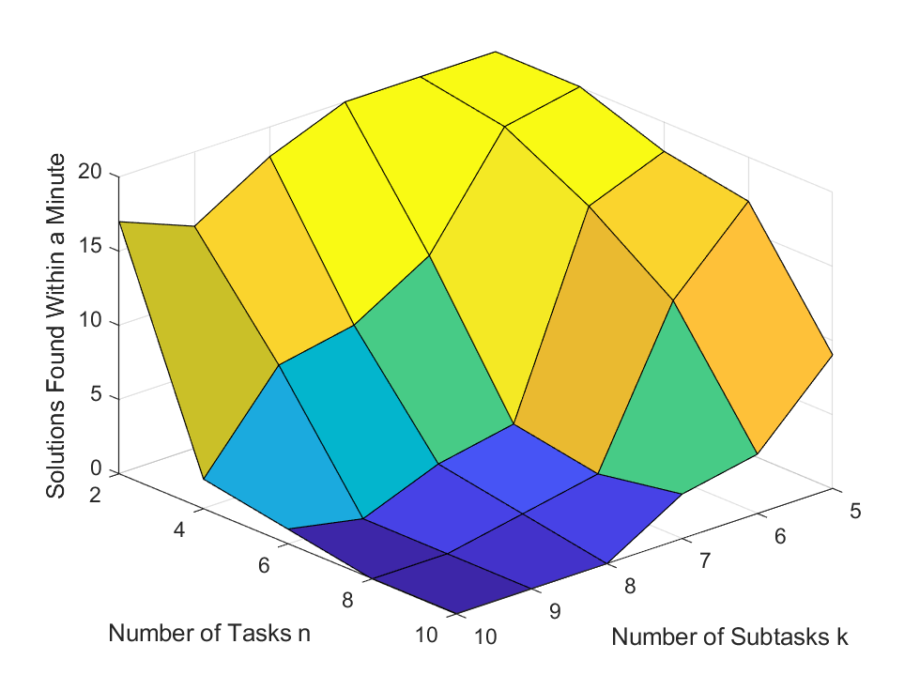
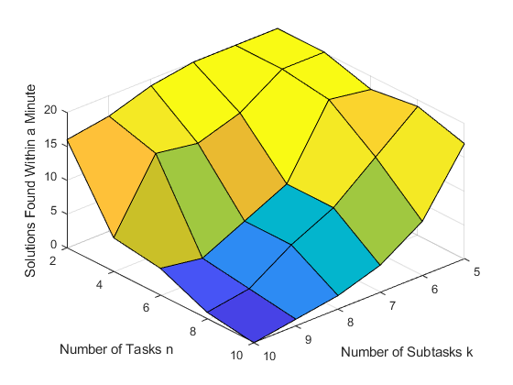
Solving in SCIP
1 minute timeout
1 hour timeout
20 DAGs per input combination
Running on Xeon Gold 6130 at 2.1 GHz

Slide 26
Parallel task workloads can adapt in response to system overload
Elastic scheduling frames this as a quadratic optimization problem
We should consider adaptation at the individual subtask level
But this adds a constraint for each possible critical path
SCIP can solve efficiently for small task sets

Slide 27
Preprocess to remove unnecessary span constraints
Try other solvers (Gurobi, CPLEX)
Try an iterative solution (apply increasing “compression” on subtasks until schedulable)
Any questions or suggestions?

