Slide 1
Elastic Scheduling for Fixed-Priority
Constrained Deadline Tasks
Marion Sudvarg, Sanjoy Baruah, Chris Gill
ISORC 2023
Nashville, Tennessee, United States
This research was supported in part by NSF grants CNS-2141256 and CNS-2229290 (CPS), NASA grant 80NSSC21K1741, and a gift from BECS Technology, Inc.

Slide 2
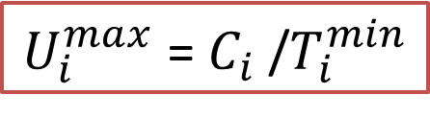

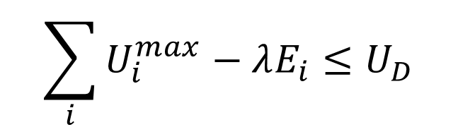
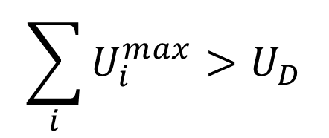
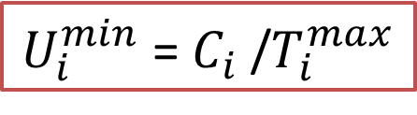
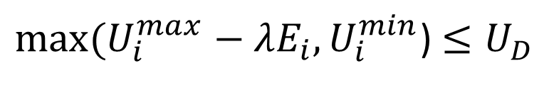
Implicit-Deadline Uniprocessor Elastic Scheduling
G.C. Buttazzo, G. Lipari, L. Abeni, “Elastic task model for adaptive rate control,” RTSS 1998
A framework to reduce the utilizations of individual tasks in response to system overload.
𝜏_{i} = ($C_{i}$,$T_{i}^{min}$,$T_{i}^{max}$,$E_{i}$)
WCET
Minimum (desired) period
Maximum serviceable period
Elasticity (relative adaptability)
$U_{i}^{max}$= $C_{i}$/$T_{i}^{min}$
$U_{i}^{min}$= $C_{i}$/$T_{i}^{max}$
Overload
Compress utilization proportionally to elasticity
$$\sum_{i}{U_{i}^{max}}>U_{D}$$
$$\sum_{i}{U_{i}^{max}−λE_{i}}≤U_{D}$$
Find $λ$ s.t.
$max⁡(U_{i}^{max}−λE_{i},U_{i}^{min}$) $≤U_{D}$
$$T_{i}=C_{i}/max⁡(U_{i}^{max}−λE_{i},U_{i}^{min}\text{)}$$

Slide 3


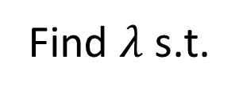
Fixed-Priority Constrained-Deadline Tasks
𝜏_{i} = ($C_{i}$,$T_{i}^{min}$,$T_{i}^{max}$,$E_{i}$,$D_{i}$)
$D_{i}≤$ $T_{i}^{min}$
Utilization bound test is no longer sufficient for schedulability
$$\sum_{i}{U_{i}}≤U_{D}$$
Find $λ$ s.t.

Slide 4

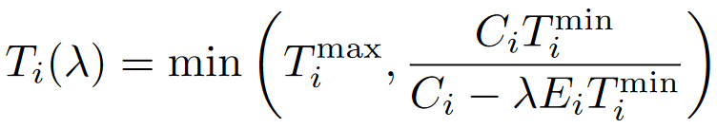
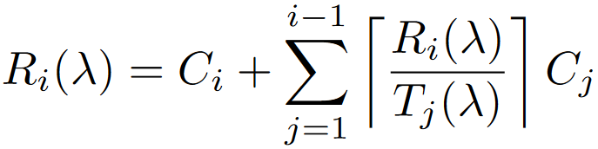


Use Response-Time Analysis
Find the smallest value $λ$ such that:

Slide 5
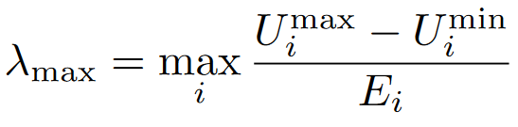
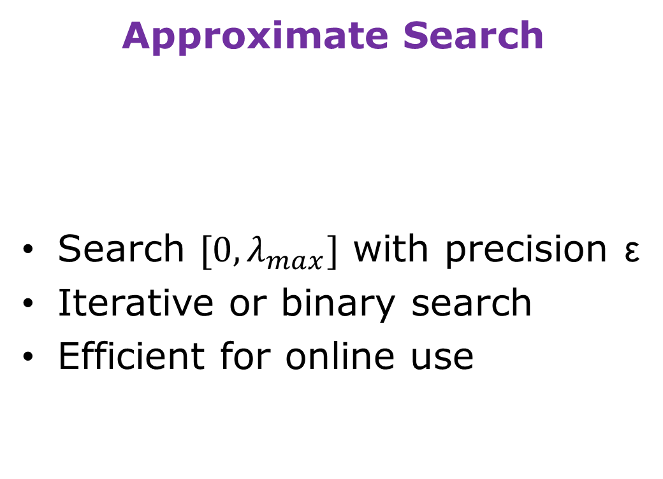
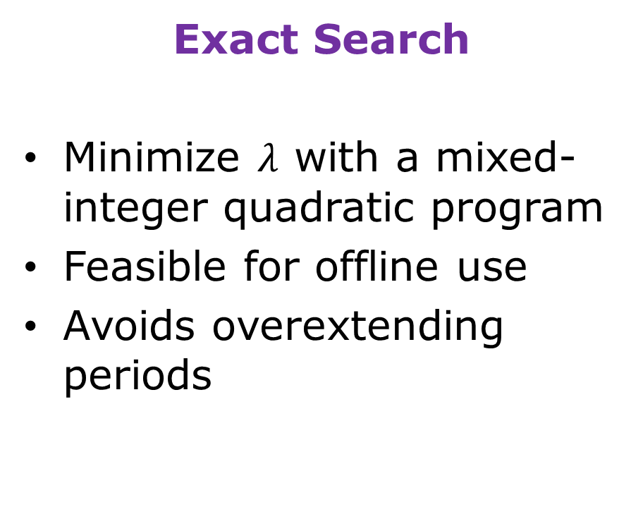
Considered Approaches
Approximate Search
Search $[0,λ_{max}]$ with precision ε
Iterative or binary search
Efficient for online use
Exact Search
Minimize $λ$ with a mixed-integer quadratic program
Feasible for offline use
Avoids overextending periods

Slide 6
Iterative Approach
λ
0
ε
λ
λ_{max}
𝜏₁
𝜏₂
𝜏₃
𝜏₄
𝜏₅
…
𝜏_{n}
RTA
RTA
RTA
RTA
RTA
RTA
✅
✅
✅
✅
✅
✅

Slide 7


Iterative Approach
λ
0
ε
λ_{max}
𝜏₁
𝜏₂
𝜏₃
𝜏₄
𝜏₅
…
𝜏_{n}
( )
$$\left\lfloor \frac{λ_{max}}{ε}\right\rfloor$$
Running Time: RTA for a single task ×
$n+$

Slide 8
Binary Search
λ
0
λ_{max}
𝜏₁
𝜏₂
𝜏₃
𝜏₄
𝜏₅
…
𝜏_{n}
RTA
RTA
RTA
RTA
RTA
RTA
✅
✅
✅
✅
✅
✅

Slide 9
Binary Search
λ
λ_{lo}
λ_{hi}
λ_{hi}
𝜏₁
𝜏₂
𝜏₃
𝜏₄
𝜏₅
…
𝜏_{n}
RTA
RTA
RTA
RTA
RTA
RTA
✅
✅
✅
✅
✅
✅

Slide 10
Binary Search
λ
λ_{lo}
λ_{hi}
λ_{lo}
𝜏₁
𝜏₂
𝜏₃
𝜏₄
𝜏₅
…
𝜏_{n}
RTA
RTA
RTA
RTA
✅
✅
✅

Slide 11
Binary Search
λ
λ_{lo}
λ_{hi}
𝜏₁
𝜏₂
𝜏₃
𝜏₄
𝜏₅
…
𝜏_{n}
RTA
RTA
RTA
✅
✅
✅

Slide 12
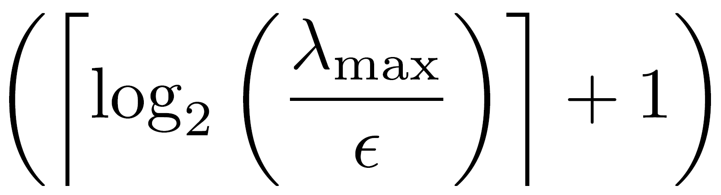

Binary Search
≤ε
λ
λ
λ_{lo}
λ_{hi}
𝜏₁
𝜏₂
𝜏₃
𝜏₄
𝜏₅
…
𝜏_{n}
Running Time: RTA for a single task ×
$n \text{×}$

Slide 13
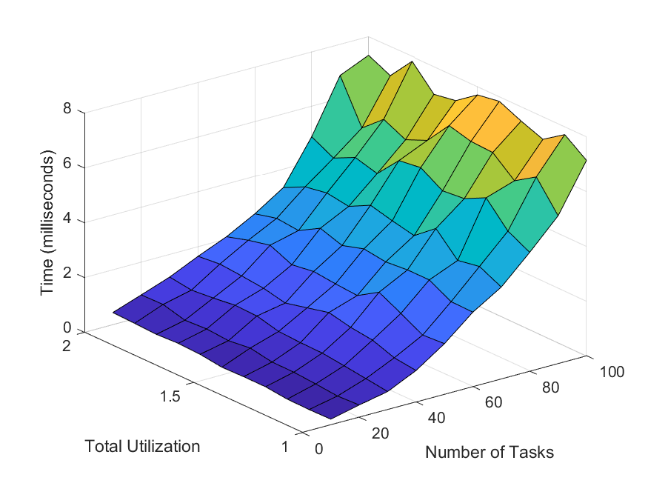
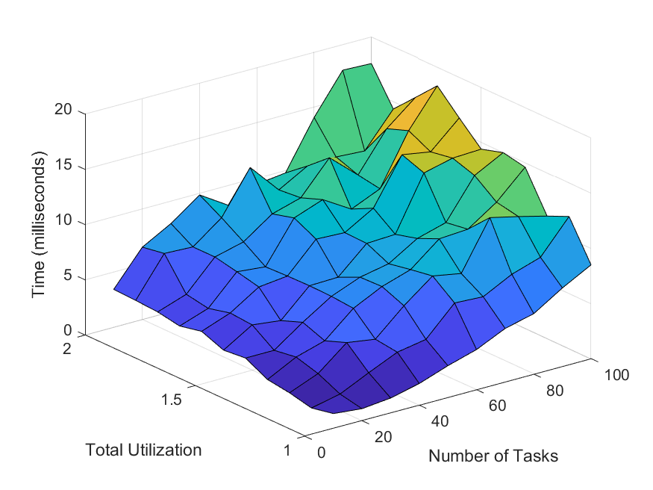
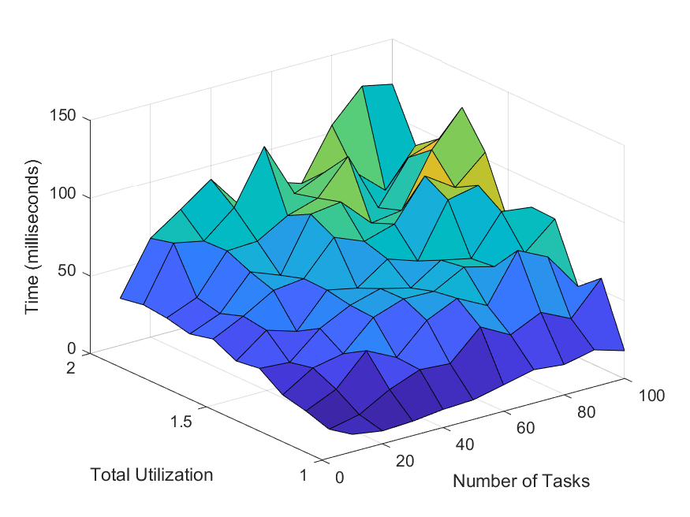
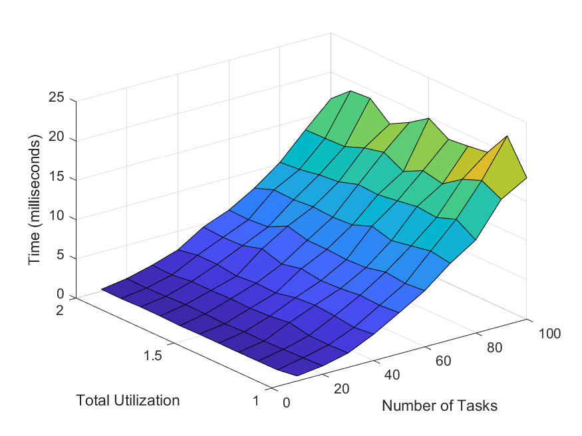
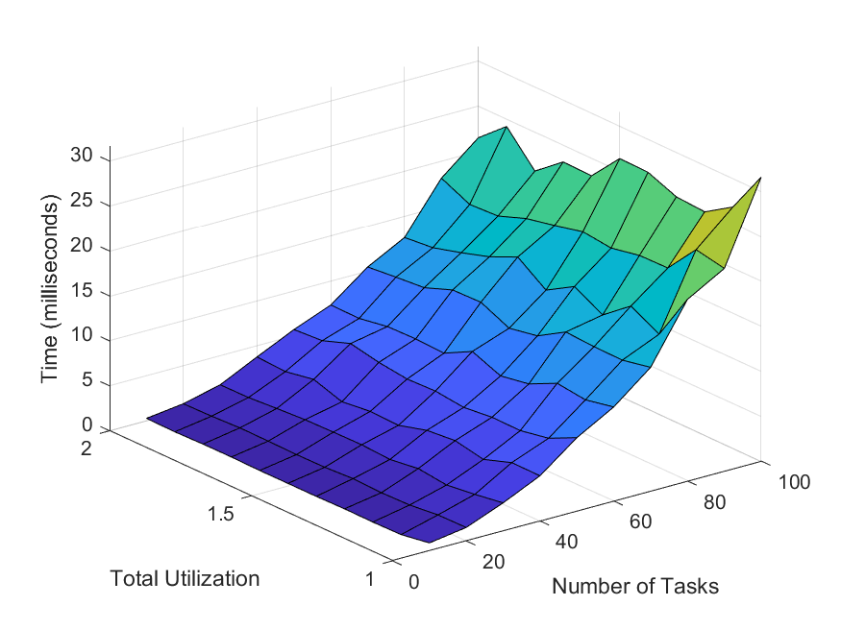
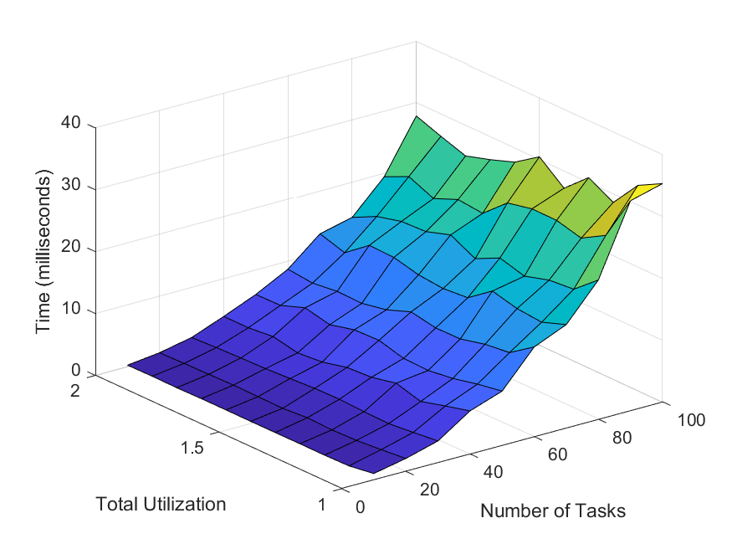



Worst Observed Execution Times – RPi3B+
$$\frac{λ_{max}}{ε}=100$$
$$\frac{λ_{max}}{ε}=1000$$
$$\frac{λ_{max}}{ε}=10,000$$
8ms
20ms
150ms
Iterative
25ms
30ms
40ms
Binary
Search
Notes:
11000 task sets

Slide 14
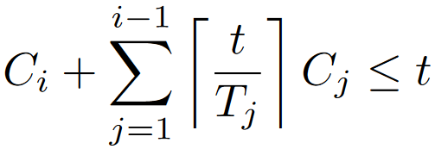
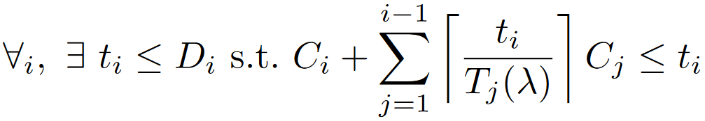
Exact Compression
Under DM, 𝜏_{i} is schedulable iff there exists $t≤D_{i}$ for which:
Find the minimum value $λ$ satisfying:
We formulate the problem of finding the minimum $λ_{i}$
for a single task 𝜏_{i} as a mixed-integer quadratic program

Slide 15
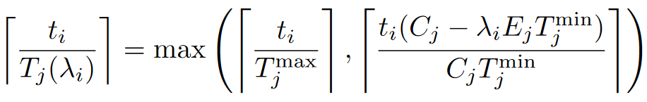
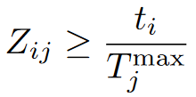
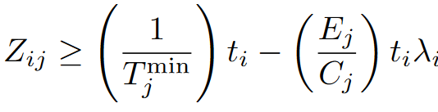
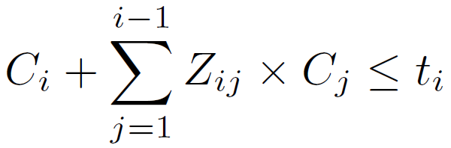


MIQP Formulation
Real variable $t_{i}$, constraint ${0<t}_{i}≤D_{i}$
For each j≤i-1, integer variable Z_{ij}
Constraint:
Constraint:
Constraint:
Minimize $λ_{i}$

Slide 16
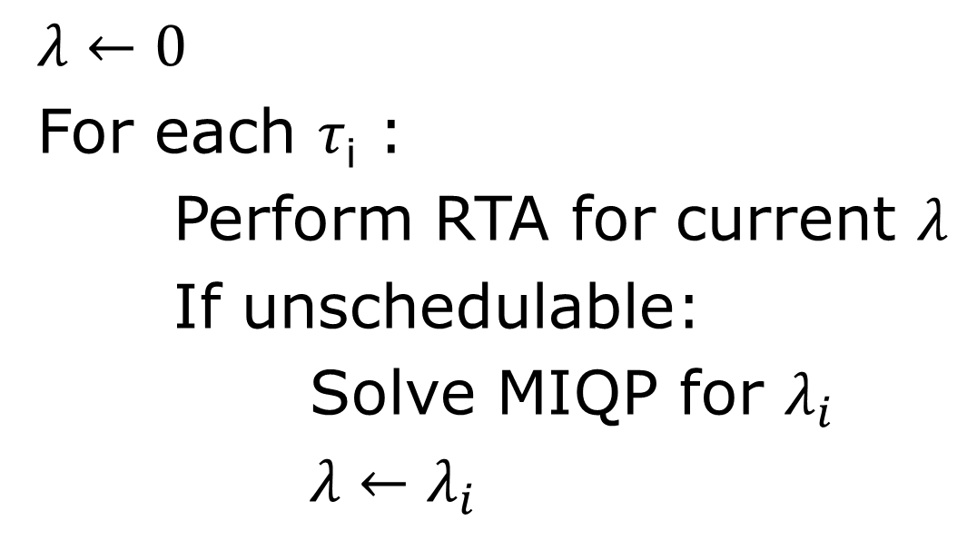
MIQP-Based Algorithm
$λ←0$
For each 𝜏_{i} :
Perform RTA for current $λ$
If unschedulable:
Solve MIQP for $λ_{i}$
$λ←λ_{i}$

Slide 17
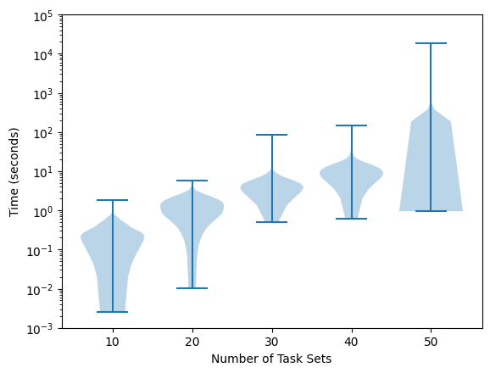
MIQP-Based Algorithm Execution Times
– Xeon Gold 6130
1 hour
5 minutes
1 minute

Slide 18
Is the MIQP Worth It?
Fast offline solution for smaller task systems (≤40 tasks)
Avoids occasional significant overextending of task periods under approximate approaches
Provides an exact baseline for comparison
May be extended for different system models

Slide 19
Conclusions
Elastic scheduling extended to fixed-priority constrained-deadline uniprocessor systems
Efficient approximate techniques
Exact MIQP-based algorithm for use offline
Obvious extensions:
  Multiprocessor scheduling of sequential tasks
  Computationally-elastic tasks

Slide 20
Thank You!
Any Questions?

Slide 21
Elastic Scheduling
A framework to reduce the utilizations of individual tasks in response to system overload.
Each task’s utilization is “compressed” proportionally to its “elasticity.”
Buttazzo, Lipari, Abeni
Implicit-deadline uniprocessor
Chantem, Hu, Lemmon
Showed equivalence to quadratic optimization
Constrained-deadline uniprocessor EDF
Orr, et al.
Federated scheduling of parallel tasks
Baruah
Improved constrained-deadline uniprocessor EDF
(approximate iterative method)
Sudvarg, Baruah, Gill
Constrained-deadline uniprocessor DM
Orr and Baruah
Implicit-deadline multiprocessor
1998
2006
2018
2019
2023
Today

Slide 22
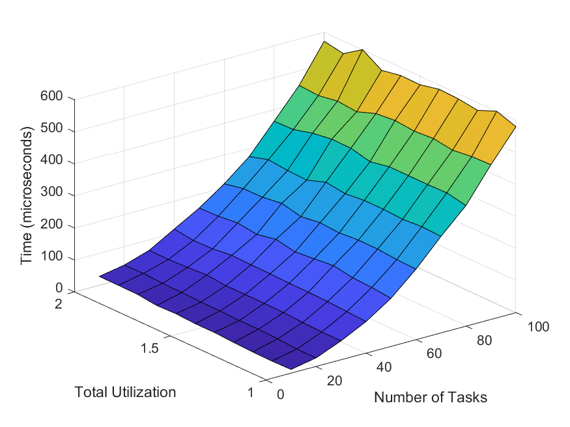
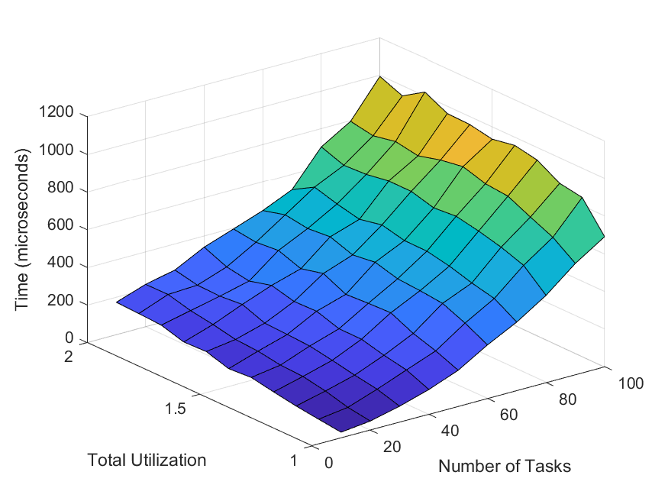
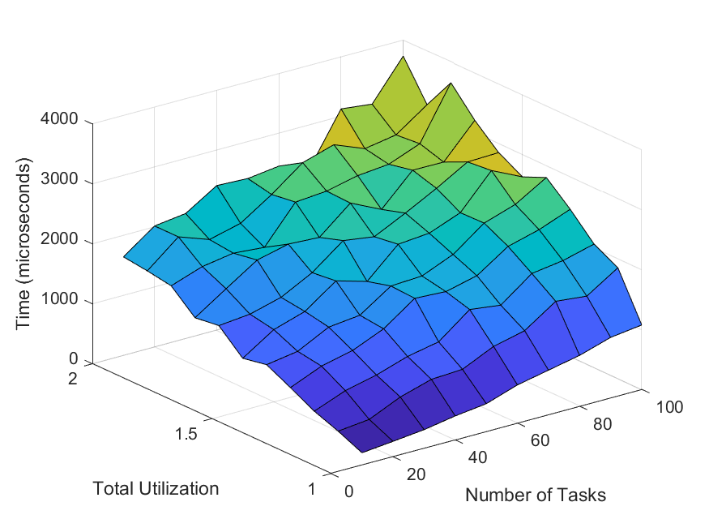
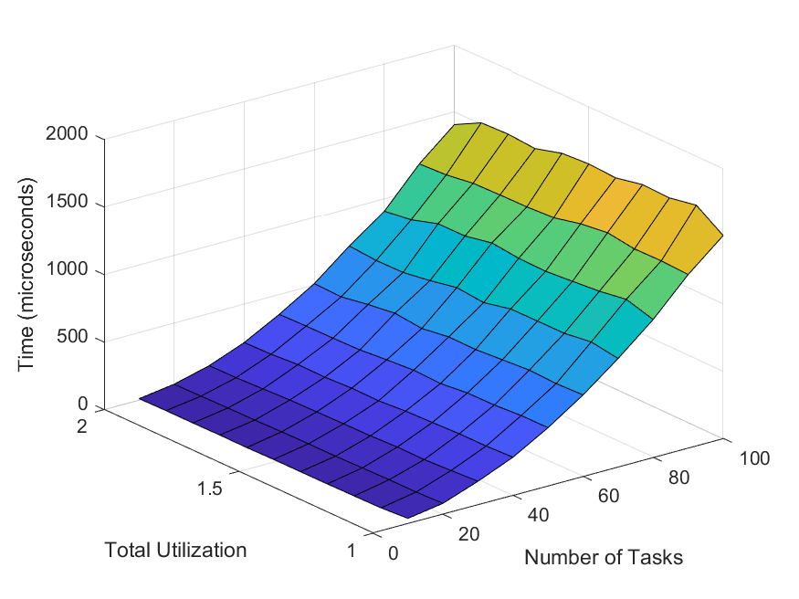
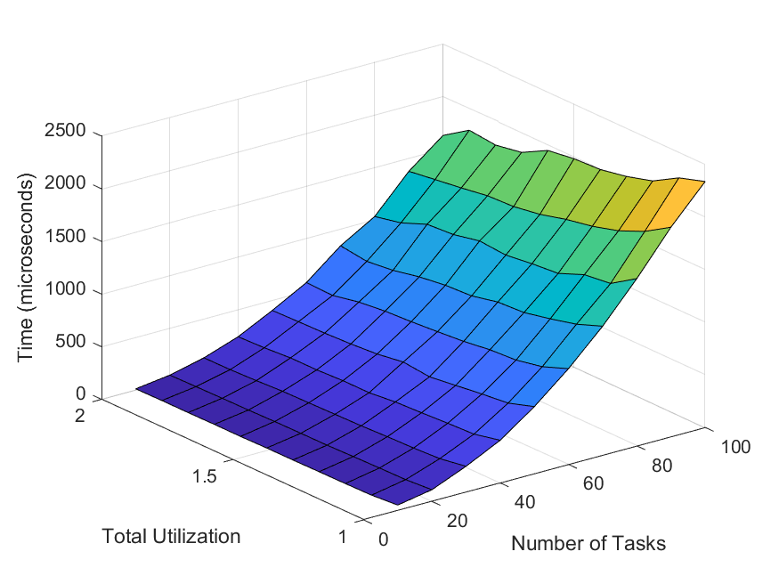
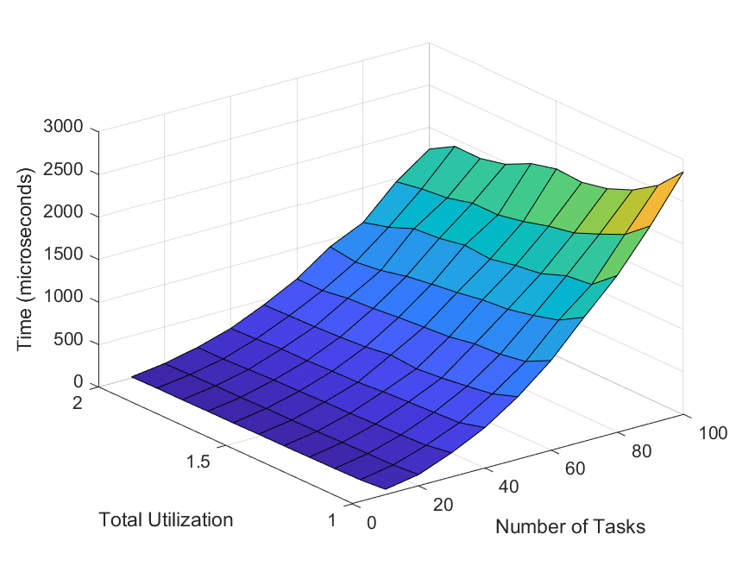
Mean Execution Times – Xeon Gold 6130
$$\frac{λ_{max}}{ε}=100$$
$$\frac{λ_{max}}{ε}=1000$$
$$\frac{λ_{max}}{ε}=10,000$$
Iterative
Binary
Search
Notes:
11000 task sets

Slide 23
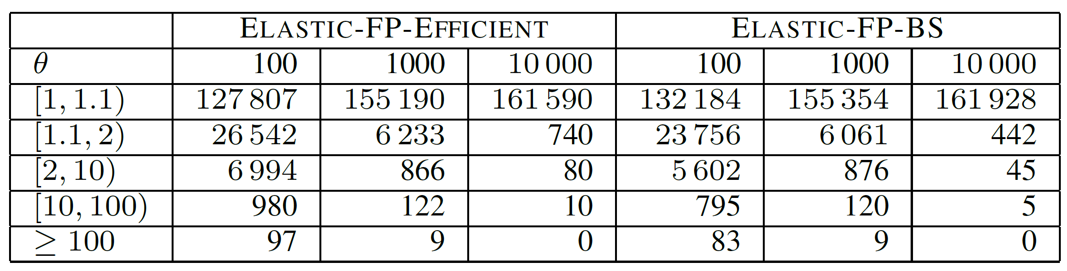
Relative Overcompression

