Slide 1
Elastic Scheduling for the
ARM Augmented Reality Heads-Up Display
Marion Sudvarg, Ao Li, Chris Gill, Ning Zhang
Thursday, 11 July, 2024
ECRTS 2024 Industrial Challenge

Slide 2
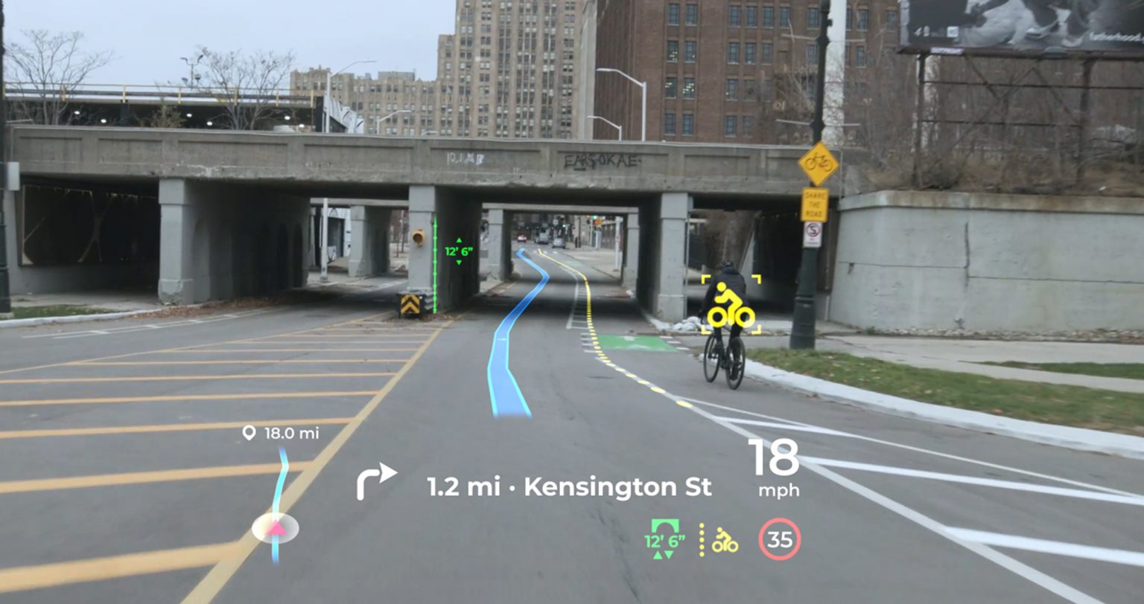

Slide 3
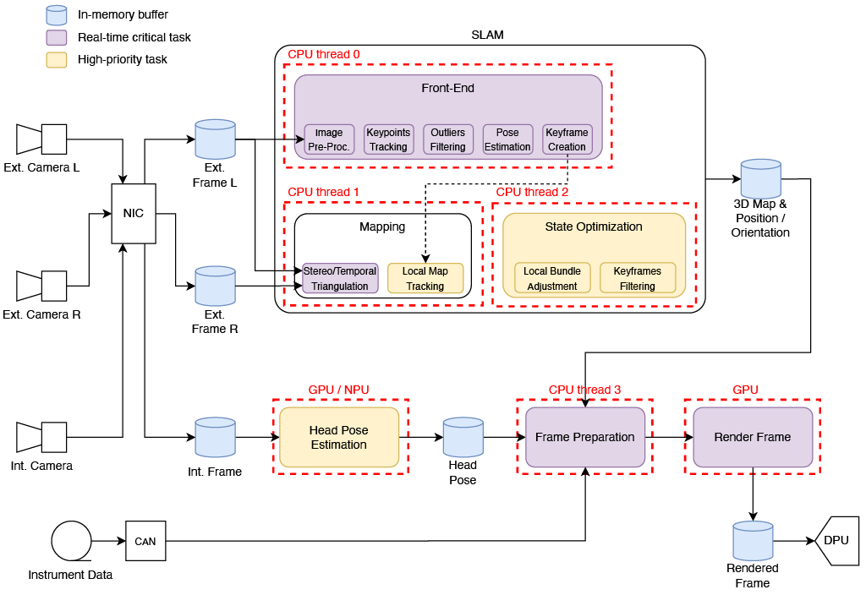

Slide 5
OV²SLAM
Vehicle orientation + trajectory
3D map of surroundings
Identify objects / features in map

Slide 6
Hopenet
Convolutional Neural Network

Slide 8
30-60 fps

Slide 13


Challenge: Construct a Scheduling Policy
Meet the desired timing semantics of the application
Critical tasks at 30-60fps
Non-critical tasks can accommodate some dropped frames
Maintain guarantees with “aggressor” workloads
Maintain guarantees in dynamic environments

Slide 14
Dropping frames is wasted work
Why not adapt (extend) task periods to maintain schedulability?
Elastic Scheduling
Giorgio Buttazzo, Giuseppe Lipari, and Luca Abeni. “Elastic task model for adaptive rate control.” RTSS 1998

Slide 15
Elastic Scheduling
Tasks are characterized by:
Minimum period
Maximum period
Elasticity (adaptability)
Utilizations compressed from max proportionally to elasticity (stopping at min) until system schedulable
60fps
16.7 ms
SLAM front-end
Frame Prep
Bundle Adj.
30fps
33.3 ms
100 ms
500 ms
Giorgio Buttazzo, Giuseppe Lipari, and Luca Abeni. “Elastic task model for adaptive rate control.” RTSS 1998

Slide 16

Dataflow Imposes Harmonic Period Constraints
50 fps
SLAM
T=20ms
Stereo/Temporal Triangulation
T=27ms

Slide 17
Elastic Scheduling of Implicit-Deadline Tasks with Harmonic Periods
Marion Sudvarg, Ao Li, Daisy Wang, Sanjoy Baruah, Jeremy Buhler, Chris Gill, Ning Zhang, Pontus Ekberg.
“Elastic Scheduling for Harmonic Task Systems.” RTAS 2024.

Slide 18
Remainder of this Proposal
Brief overview of harmonic elastic scheduling
Results for ORB-SLAM3
Model extensions needed for ARM HUD challenge

Slide 19
Problem
Proportional compression may not maintain the harmonic period relationships

Slide 20
Solution
Use equivalent constrained optimization

Slide 21
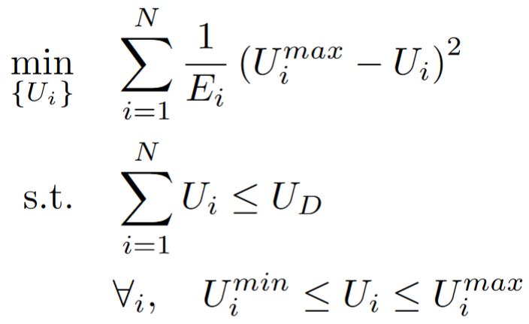
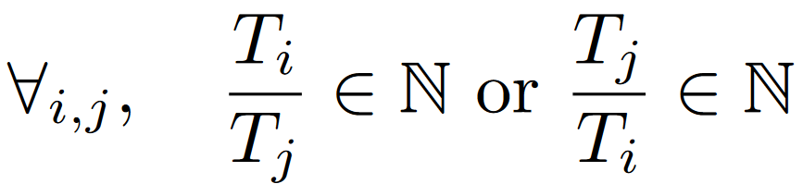
Thidapat (Tam) Chantem, Xiaobo (Sharon) Hu, and Michael D. Lemmon. “Generalized Elastic Scheduling.” RTSS 2006

Slide 22
Thidapat (Tam) Chantem, Xiaobo (Sharon) Hu, and Michael D. Lemmon. “Generalized Elastic Scheduling.” RTSS 2006

Slide 23
Problem
Solving this constrained-optimization problem is NP-hard

Slide 24
Build a lookup table offline
to enable polynomial-time online compression in response to changes in available utilization
Notes:
Elastic scheduling model was first introduced by Buttazzo and others in 1998

Slide 25
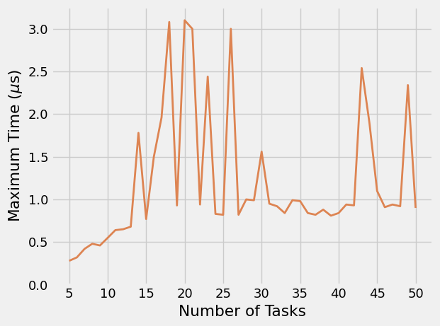
Overhead of Task Period Reassignment

Slide 26
Case Study: ORB-SLAM3

Slide 27
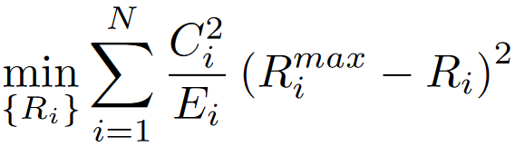
Selecting elastic constants to minimize result error within the constraints of schedulability

Slide 28
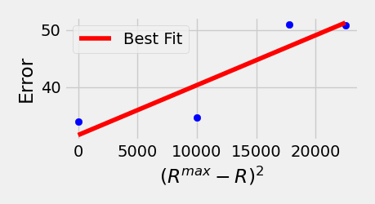
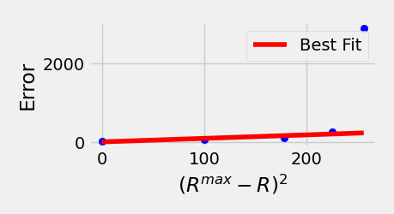
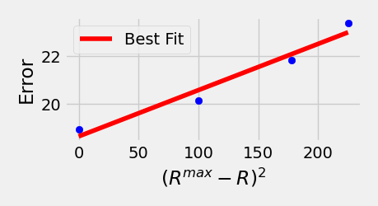
Error $={10}^{4}×$Relative Translational Error
IMU
Camera
Mapping

Slide 29
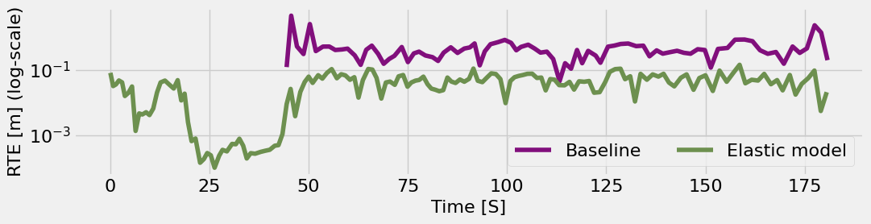
Quality of Produced Map

Slide 30
Extensions Needed for Online Adaptation in ARM AR HUD

Slide 31
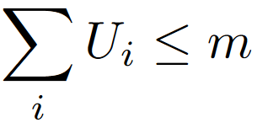
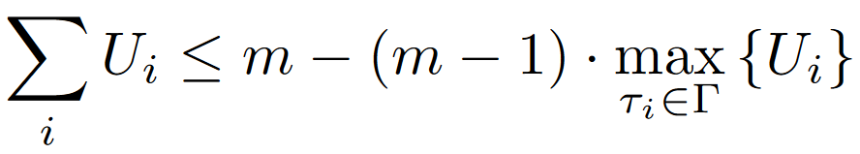
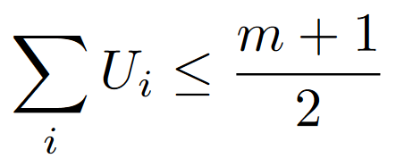
Multicore Scheduling
Assume m processors
Fluid scheduling
Global EDF
Partitioned EDF

Slide 32
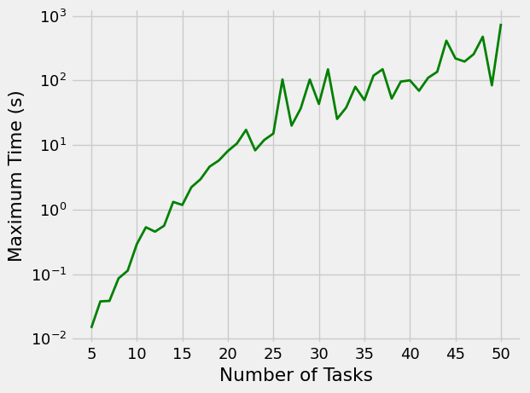
Dynamic Execution Times
Workloads depend on environment
Execution times vary with resource contention
Algorithm still inefficient in these scenarios
Up to 38 ms for 6 tasks

Slide 33
Takeaway Message
ARM’s AR HUD presents several challenges
We focus on designing a dynamic scheduling policy
We propose to apply elastic scheduling for harmonic tasks
Needs to be extended to multiprocessor
Must consider dynamic execution times

